Slide 1
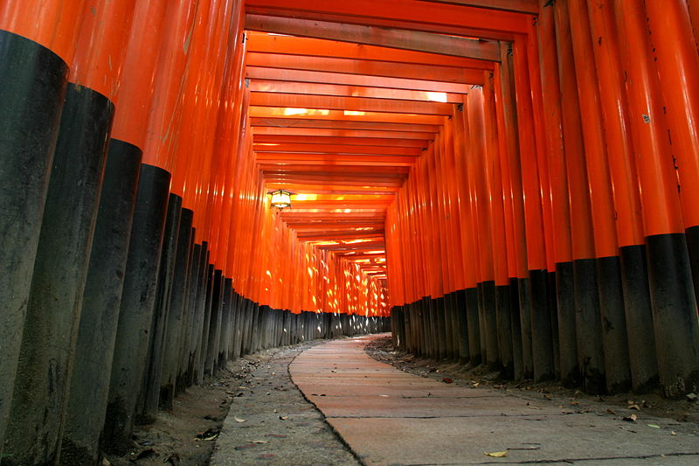
Introduction to Discussion of the PPAP
Input to the European Strategy –
Neutrinos and Non-Accelerator
Dave Wark
Oxford University
July 16th, 2018

Slide 2
The CERN European Strategy
The process by which the Member States of CERN come to a consensus about the major directions for particle physics over the coming ~5 years, and not just at CERN.
While CERN can sometimes appear as a free agent, it is clear that the organization pays very careful attention to the Strategy and tries very hard to implement its recommendations.
The latest update has begun, and will publish the new Strategy update in late spring 2020.
At its Closed Session on 14 June 2018, the Council decided, by consensus, the venues for :
  The Open Symposium Granada, Spain (13-16 May 2019)
  The Strategy Dafting Session Bad Honnef, Germany (20-24 January 2020)
CERN has requested community input by December 18, 2018, and the PPAP will respond (and others will as well).
What advice should the UK give in the areas of neutrino and non-accelerator physics?

Slide 3
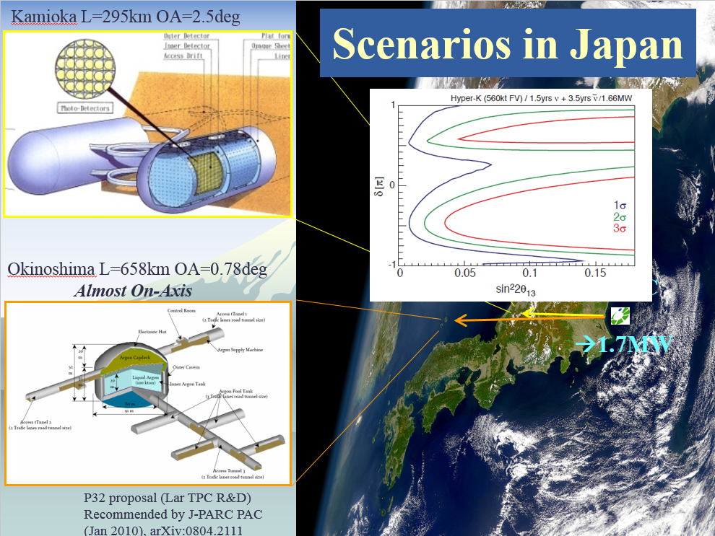
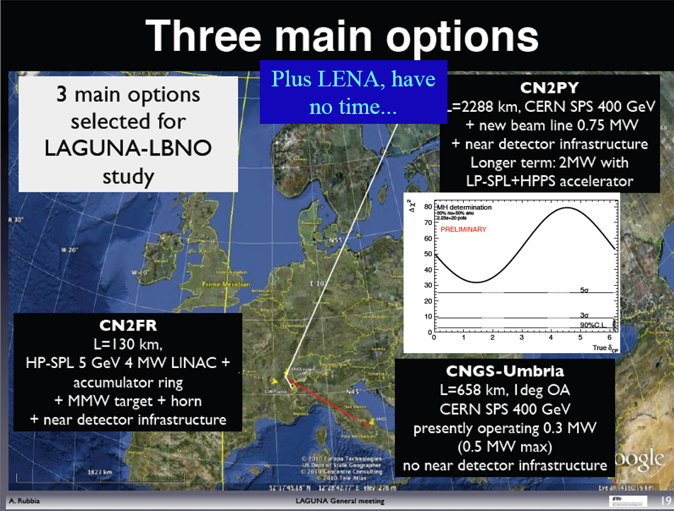
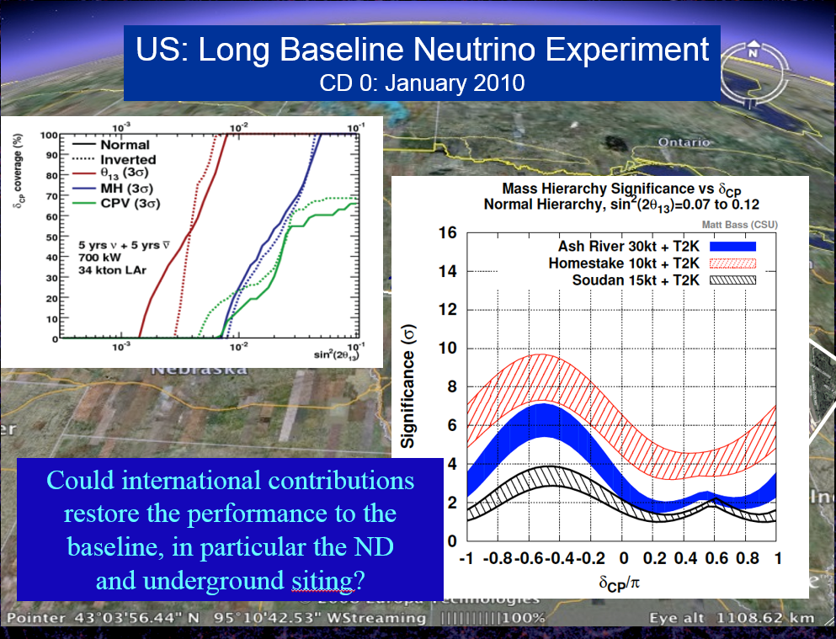
The European
Long-Baseline
Landscape in 2012 –
Three options, each with strong supporters

Slide 4
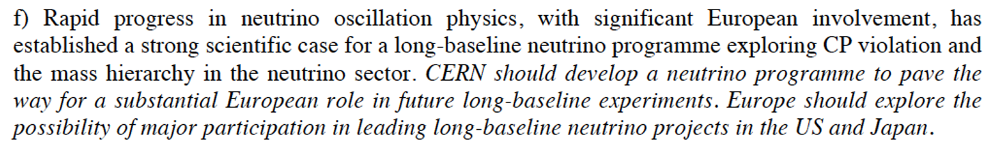
The Outcome of the 2013 Strategy for Neutrinos. . .
While the European version, LBNO, was arguably the most capable for long-baseline physics, the discussion at Erice was very much along the lines that Europe can’t do everything.
A compromise was reached:
This has led to the CERN Neutrino Platform and a very significant contribution of CERN/Europe to DUNE, as well as direct involvement of CERN in the T2K ND280M upgrades.
This has been to the great benefit of the UK programme.
These are long-term programmes, and I assume it would be non-controversial to say we support the continuation of this part of the strategy – but if so we need to say it, how we have benefitted and how we would continue to benefit.

Slide 5
The Neutrino Platform
The level of expenditure on the NP was not uniformly popular, so if we want it to continue, we should defend it.
However the NP will complete the programme we wanted for it during the strategy period.
If we have other things in mind for it, we should say.
Some possibilities will follow in this talk, but we should have a discussion and come up with a considered view.

Slide 6
Other Neutrino Physics in the Strategy.
As a rule, things that can be done at the national level should be, and the CERN Strategy reserved for things that really require coordination at that level.
That being said, if you want CERN involvement in non-traditional activities you should get them into the strategy.
The CERN strategy is for particle physics, and some of these topics wander into astroparticle physics, which is the remit of ApPEC, which has its own strategy.
Other neutrino areas that might be relevant:
  0νββ decay experiments
  Hadron production/neutrino interaction experiments
  NuStorm
  High-energy neutrino astronomy
  Steriles?
  Absolute neutrino mass experiments? Probably too small during the period of this strategy.

Slide 7
0νββ decay
Experiments in this area with UK involvement will continue during the period of the strategy.
Two UK involvements currently (SNO+ and SuperNEMO), but others contemplated.
This is a no-lose area – either you find it, and then you need to measure it better and in more nuclei; or you don’t, and then you have to keep looking.

Slide 8
0νββ decay
These experiments have traditionally been sub-strategy sized, but they are growing in size and shrinking in number.
As these are underground experiments they have been coordinated by ApPEC, but ApPEC is a talking shop and CERN builds stuff, so as these experiments get to ~0.1-1.0 B$, it would be useful to get CERN involved.
Also requires coordination with the Americans, who are doing a down select, and this is DoE Nuclear Physics, who we don’t know as well, so getting a coordinated European position would be even more useful.

Slide 9
  Hadron production/neutrino interaction experiments
CERN involvement in NA61 has been critical to advances in long-baseline sensitivity, so we must push strongly for continued/upgraded activities there.
Those who are most closely involved in trying to understand neutrino interactions have pushed for parallel experiments to give detailed understanding of interaction modes and cross sections, but it is somewhat an orphaned activity (although CERN has become involved).
If the next generation neutrino oscillation experiments are going to reach their design sensitivities, this activity will (in my opinion) be critical – we should lobby for CERN to really take the lead in pushing this to production-scale experiments.

Slide 10
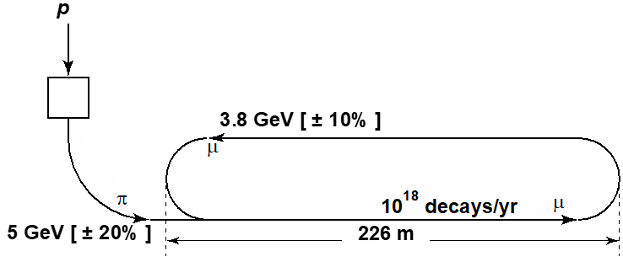
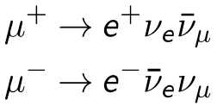
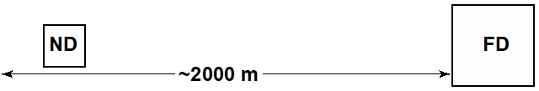

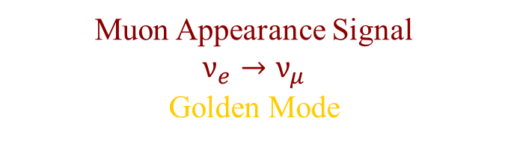
nuSTORM: Muon Storage Ring Beam
nuSTORM is a low-energy muon storage ring that produces pure and well-characterized beams of ${\overline{ν}}_{μ}$ and $ν_{e}$ (or $ν_{μ}$ and ${\overline{ν}}_{e}$).
In the $ν_{μ}$ appearance channel, you’re looking for wrong sign muons, and that’s all you need to establish oscillations.
A magnetized detector, like Minos, separates oscillated $ν_{μ}$ from beam ${\overline{ν}}_{μ}$.
The nuSTORM project would also be a great “near detector” for DUNE, allowing the study of $ν_{e}$ pattern recognition and $ν_{e}$ cross section measurements.
Muon Appearance Signal
$$ν_{e}→ν_{μ}$$
Golden Mode
CPT conjugate to LSND
11

Slide 11
nuSTORM at CERN
This strategy is the last chance to have this
ready in time – the UK should take a view.

Slide 12
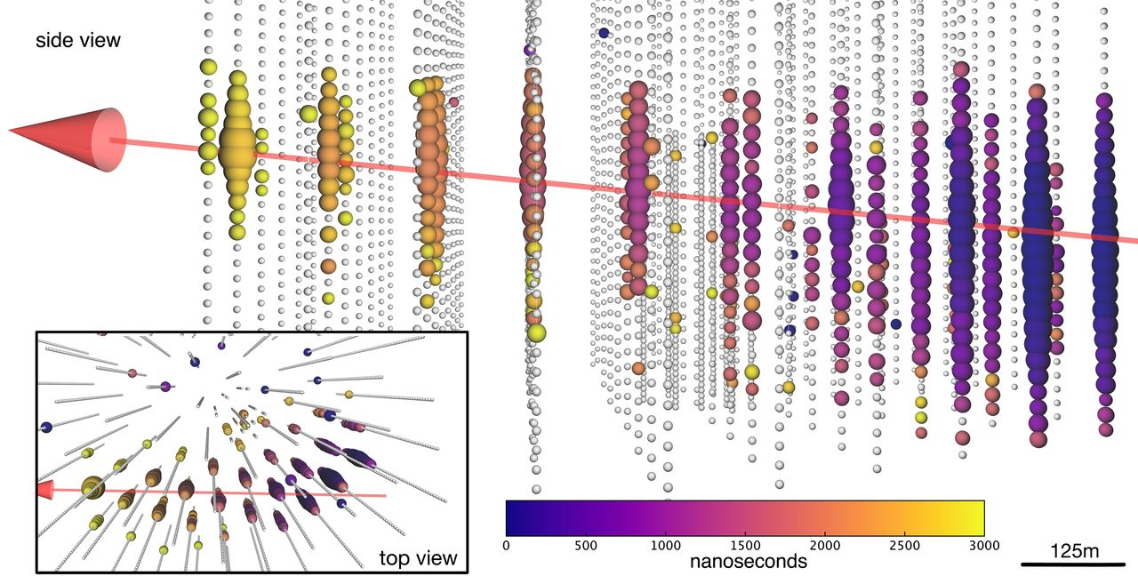
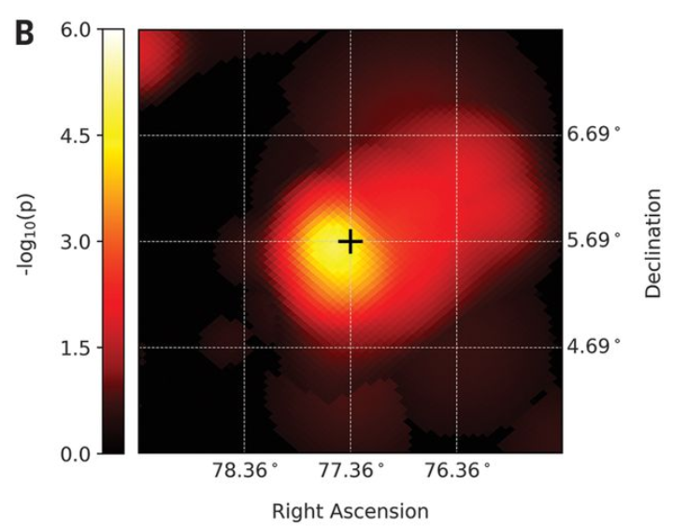
High-E ν astronomy(!)
IceCube have now observed a high-E cosmic neutrino source (the poetically named blazar TXS 0506+056), confirmed in many wavebands.
This will make a big push for upgrades and new detectors – is the UK going to pass?
CERN could be a big help in professionalizing this activity.

Slide 13
Other Non-Accelerator Physics
I may have forgotten something, but there is only one other area that seems to me to be possibly relevant to the CERN Strategy.
Dark Matter experiments are in a similar position to 0νββ decay experiments, in that many small experiments are coalescing into a few big ones.
The UK is heavily involved in LZ, but also thinking about the future, where the ApPEC strategy calls for 50 ton Xe and 300 ton Ar detectors.
We should push CERN to continue to coordinate with ApPEC to keep the European efforts coherent, and to coordinate with all our international partners as well.

