Slide 1
Future Accelerator Options at CERN
CERN is preparing a list of potential future high energy accelerator projects for discussion at the CERN SPC:
HC) Hadron Collider Projects
LC) Lepton Collider Projects
IP) Ion Physics Program
eh) Lepton-Hadron Collider Projects
Oliver Brüning, CERN, September 19th 2018

Slide 2
Hadron Collider Projects
1) CERN is studying the following hadron collider projects for discussion at the CERN SPC:
HC1) LHC: 2 general purpose and 2 dedicated experiments
Operation until 2023; goal of accumulating 300fb⁻¹ with ca. 60fb⁻¹ / year
HC2) HL-LHC: 2 general purpose and 1-2 dedicated experiments
Implementation during LS3 from 2023 to 2026; operation at 7TeV [14TeV]
Studies for operation beyond 7TeV [3 phases]: 7TeV, 7.5TeV and $≈$8TeV
Operation 2026 until 2037; goal of ca. 250fb⁻¹ / year and 3ab⁻¹ total
HC3) High Energy LHC: operation after HL-LHC – potentially by 2040
Implementation after HL-LHC; demonstrator for 16T magnet technology
for FCC: 13.5TeV [27 TeV CM] collision energy; ca. 500fb⁻¹ / year
HC4) FCC: 100km tunnel with 16T magnets for a 100TeV CM collider
Assuming a 20y magnet R&D program; CE start in 2028; collider in 2043
2 scenarios: ca. 250fb⁻¹ / year or ca. 1000fb⁻¹ / year
All the proton collider options assume ca. 160 days of scheduled time for physics
[365 days – 125YETS; 40startup; 20MD; 5SP; 10TS]
and
ca. 40% to 50% luminosity efficiency [ca. 70% to 80% machine efficiency]
All the proton collider options can be operated with ion beams [e.g. Pb]
Between 10nb⁻¹ and 65nb⁻¹ / year
Oliver Brüning, CERN, September 19th 2018

Slide 3
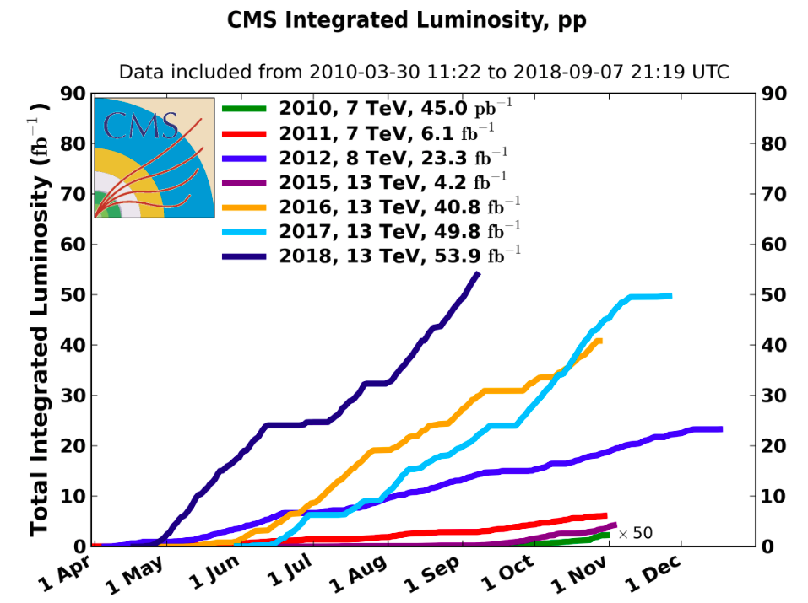
LHC Performance
ca. 0.7 fb⁻¹ / day
with 30 days left
Notes:
Corresponds to over 7Million Higgs and more than 150Million top particle productions!

Slide 4
Schedule: ➔ HL-LHC CE during LS2
Oliver Brüning, CERN, September 19th 2018

Slide 5
Lepton-Hadron Collider Projects
CERN is studying the following e-h collider projects for discussion at the CERN SPC:
-Modular accelerator design based on Energy Recovery Linac scheme
-Possibility for a staged installation [e.g. half electron beam energy]
-Identical configuration can be applied to all hadron collider projects!
eh1) LHeC:
Earliest operation after LS4; 2 operation scenarios:
i) Parallel with LHC: ca. 20-50fb⁻¹ / year and
ii) dedicated [after Run6]: ca. 180fb⁻¹ / year; and 1ab⁻¹ total
eh2) HE-LHeC
Implementation in parallel with HE-LHC; operation in parallel to HE-LHC
with: ca. 150fb⁻¹ / year and ca. 2ab⁻¹ total
eh3) FCC-eh:
Implementation in parallel with FCC-hh; operation in parallel to FCC-hh
with: ca. 200fb⁻¹ / year and ca. 2-3ab⁻¹ total
All the electron - proton collider options assume ca. 160 days of scheduled time for physics
[365 days – 125YETS; 40startup; 20MD; 5SP; 10TS]
and
ca. 40% to 50% luminosity efficiency [ca. 90% ERL machine efficiency]
Oliver Brüning, CERN, September 19th 2018

Slide 6
Circular Lepton Collider Projects
CERN is studying the following circular e⁺/e⁻ collider projects for discussion at the CERN SPC:
Collider based on normal conducting magnets and SRF installed in the same tunnel as the FCC-hh collider [precursor for FCC-hh]; 4 experim;
The following stages are assumed to be installed sequentially:
FCC-ee-1) Z physics program:
Beam energy of 45.6GeV; goal of generating 150ab⁻¹ in 4 years
FCC-ee-2) W physics program:
Beam Energy of 80GeV; goal of generating 10ab⁻¹ in 1 year
FCC-ee-3) Higgs physics program:
Beam Energy of 120GeV; goal of generating 5ab⁻¹ in 3 years
FCC-ee-4) top physics program:
Beam Energy of 182.5GeV; goal of generating 1.7ab⁻¹ in 5 years
All the e+ / e- collider options assume ca. 160 days of scheduled time for physics
[365 days – 119YETS; 30startup; 20MD; 10TS]
and
ca. 75% physics efficiency and 80% machine efficiency
Total of 13 years physics program
Oliver Brüning, CERN, September 19th 2018

Slide 7
Linear Lepton Collider Project
CERN is studying the following e⁺/e⁻ linear collider project for discussion at the CERN SPC:
Collider based on normal conducting RF system with drive beam and / or klystron power generation; X-band RF [12GHz]
The following stages are assumed to be installed sequentially:
CLIC-1) ECM = 380GeV; length of 11.4km
Goal of generating 180fb⁻¹ / year with 8 years of operation ➔ ca. 1ab⁻¹ total
CLIC-2) ECM = 1500GeV; length of 29km
Goal of generating 444fb⁻¹ / year with 7 years of operation ➔ ca. 3ab⁻¹ total
CLIC-3) ECM = 3000GeV; length of 50km
Goal of generating 720fb⁻¹ / year with 8 years of operation➔ ca. > 5ab⁻¹ total
All the linear e+ / e- collider options assume ca. 160 days of scheduled time for physics
[365 days – 120YETS; 30startup; 20MD; 10TS]
and
ca. 75% physics efficiency [equal to machine efficiency for linear collider]
Total of 23 years of physics program separated by two 2 year stops for linac upgrades
Oliver Brüning, CERN, September 19th 2018

