Slide 1
Spin clocks
self-oscillating co-magnetometers
Witold Chalupczak
22-03-2019

Slide 2
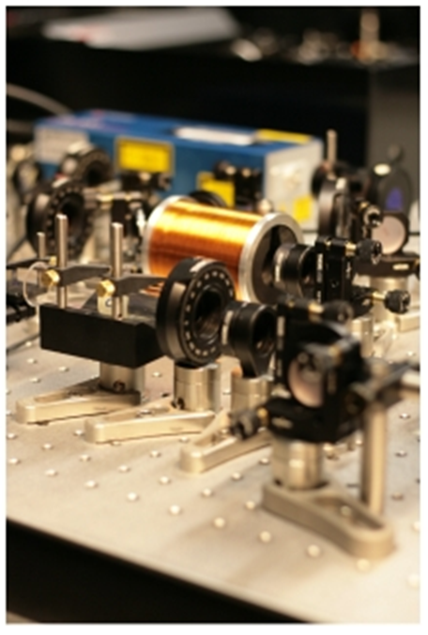
Outline
Atomic magnetometer –principle of operation
Noble gas spin maser
Alkali-metal spin maser
Self-oscillating system

Slide 3
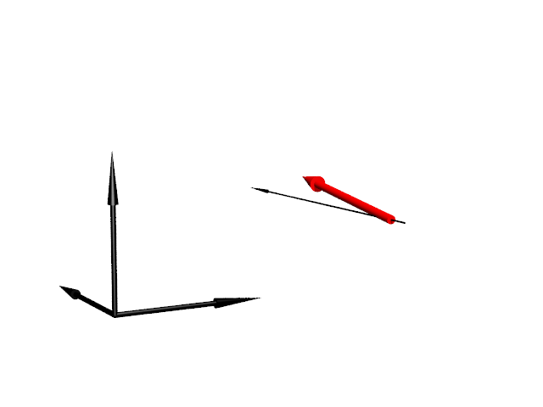
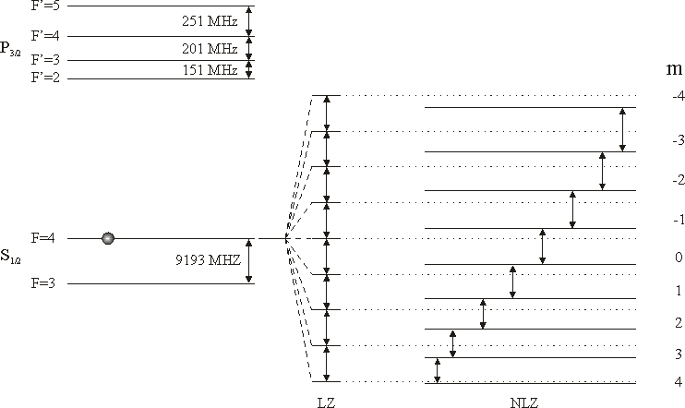
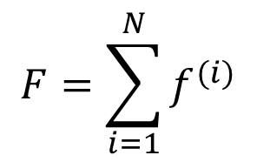
Setting the scene - terminology
x
F
B
z
y
$$F=\sum_{i=1}^{N}{f^{(i)}}$$

Slide 4
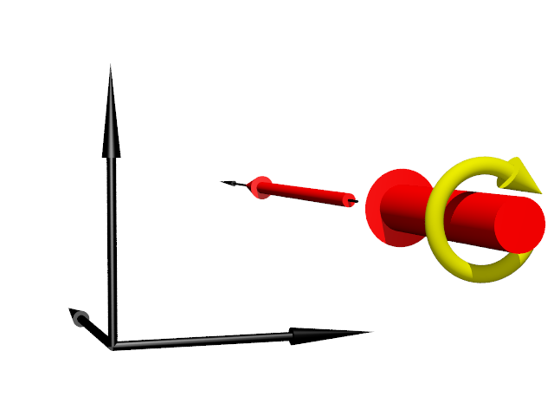
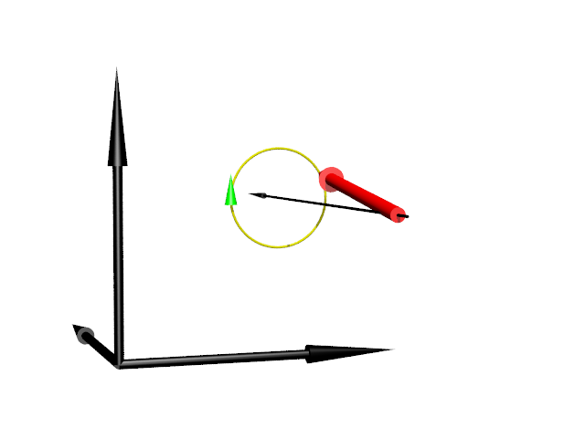
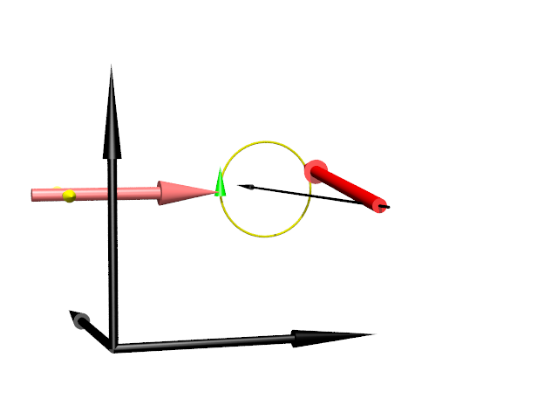
Principle of rf operation
F
B
Polarization
Interaction
Read out

Slide 5
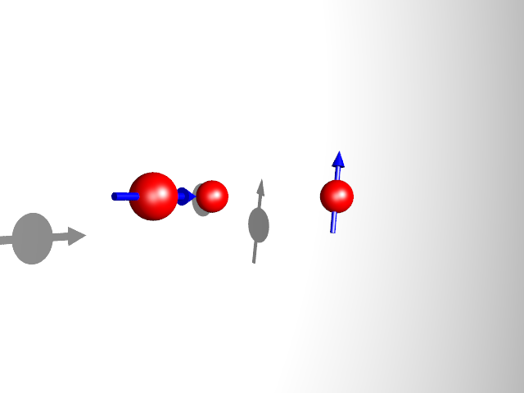
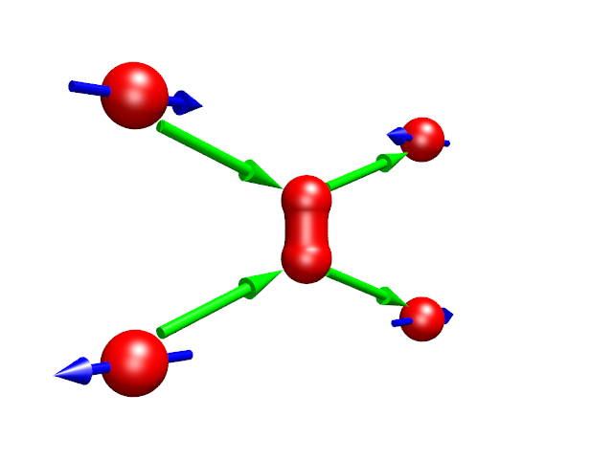
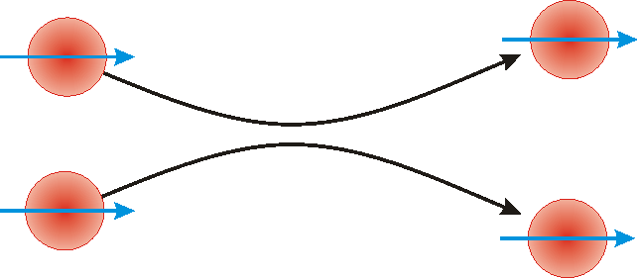
Atoms - collisions
Background collisions
Spin-Exchange Collisions (SEC)
F=4, m_{F}=4
F=4, m_{F}=4

Slide 6
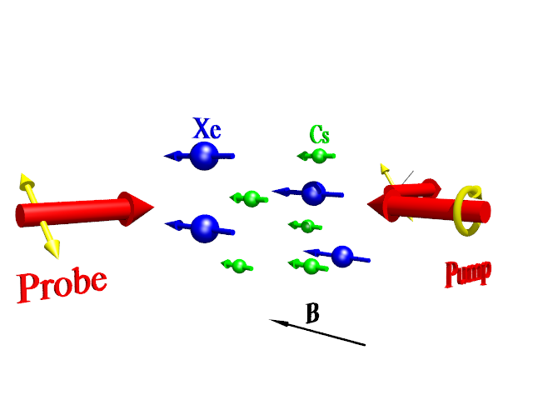
Spin-exchange pumping – co-magnetometer

Slide 7
Nuclear spin maser
T. Chupp et al., Phys. Rev. Lett. 72, 2363, 1994

Slide 8
¹²⁹Xe – ¹³¹Xe spin maser
T. Sato et al., Phys. Lett. A 382, 588, 2018

Slide 9
³He – ¹²⁹Xe co-magnetometer
M. E. Limes, D. Sheng, and M. V. Romalis, Phys. Rev. Lett. 120, 033401, 2018

Slide 10
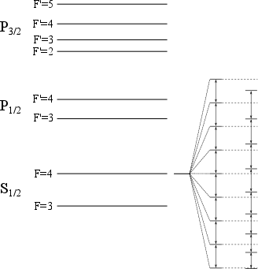
Ground state coherences
W. Chalupczak et all., Phys. Rev. A. 85, 043402 (2012)

Slide 11
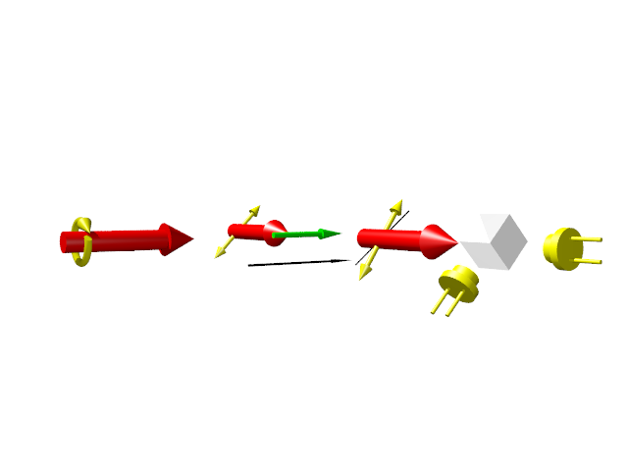

Non-linear spin dynamics
$$H_{INT}=α_{2}{\left|E_{p}\right|}^{2}{\hat{F}}_{}^{2}$$
W. Chalupczak, P. Josephs-Franks, Phys. Rev. Lett. 115, 033004 (2015)

Slide 12

Non-linear spin dynamics
$$H_{INT}=α_{2}{\left|E_{p}\right|}^{2}{\hat{F}}_{z}^{2}$$
S. M. Rochester, M. P. Ledbetter, T. Zigdon, A. D. Wilson-Gordon,
D. Budker, Phys. Rev. A 85, 022125 (2012)

Slide 13
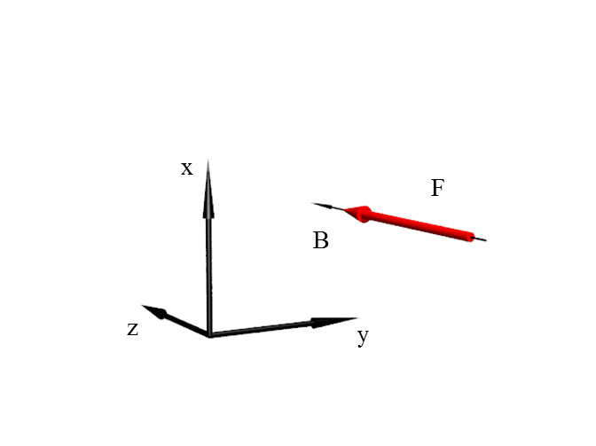
Nonlinear spin dynamics
W. Chalupczak and P. Josephs-Franks, Phys. Rev. Lett. 115, 033004, 2015

Slide 14
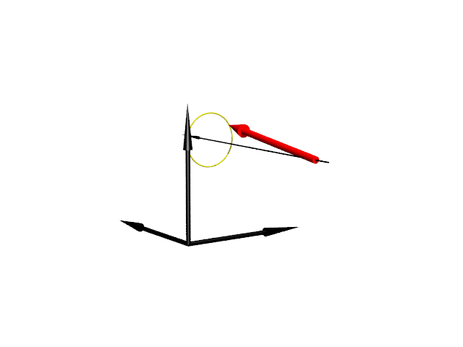
Spin maser
W. Chalupczak and P. Josephs-Franks, Phys. Rev. Lett. 115, 033004, 2015

Slide 15
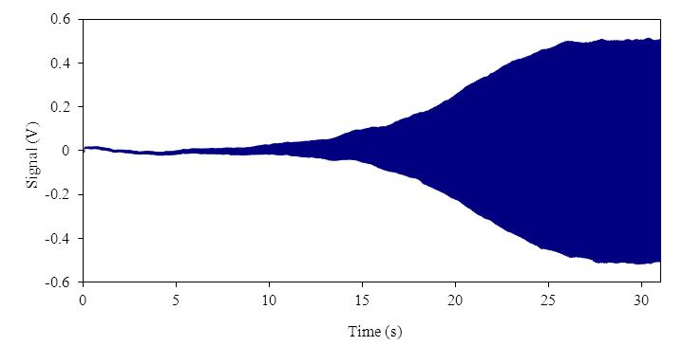
Alkali atom spin maser
W. Chalupczak and P. Josephs-Franks, Phys. Rev. Lett. 115, 033004, 2015

Slide 16
Self-oscillating systems
P. D. D. Schwindt, L. Holberg, and J. Kitching, Rev.Sci.Instr. 75, 126103, 2005

Slide 17
To conclude
Electronic spin maser –UCL
Nuclear spin maser NPL, UoB

Slide 18
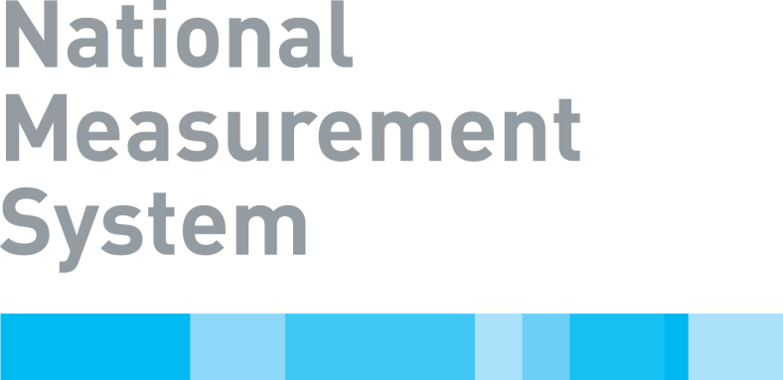




Title of Presentation
Name of Speaker
Date
The National Measurement System delivers world-class
measurement science & technology through these organisations
The National Measurement System is the UK’s national infrastructure of measurement
Laboratories, which deliver world-class measurement science and technology through four
National Measurement Institutes (NMIs): LGC, NPL the National Physical Laboratory, TUV NEL
The former National Engineering Laboratory, and the National Measurement Office (NMO).

Slide 19
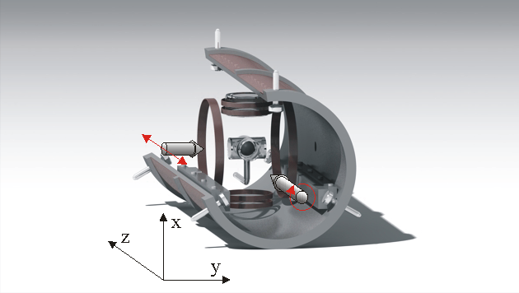
Instrumentation

