Slide 1

Physics beyond colliders: experimental overview
Mike Lamont
Joerg Jaeckel, Claude Vallée
PBC working groups

Slide 2
PBC - Brief
Maximize physics reach of existing complex
  New facilities exploiting existing complex
  Novel exploitation of existing facilities
  Provide support for novel off-site facilities
  Harness the existing technology and expertise
Within the limits posed by an already vibrant and diverse physics program
Evaluate options’ motivation and competitiveness in a world wide scape

Slide 3
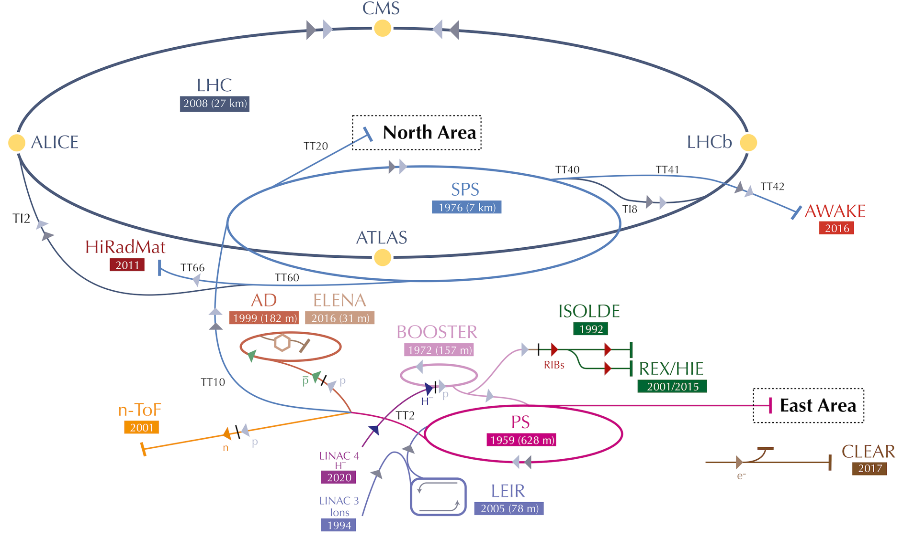

Slide 4
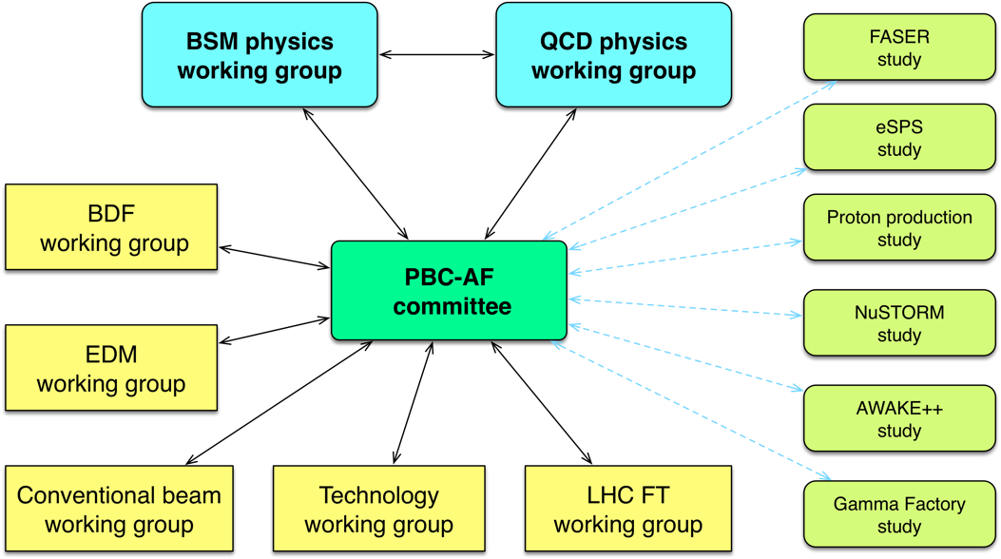
PBC structure
Evaluate proposed options in the worldwide landscape

Slide 5
PBC accelerator side - main themes
Exploitation of SPS/North Area
  Conventional North Area beams (NA62+, KLEVER, NA64+, COMPASS…)
  Beam Dump Facility for SHiP/TauFV
  eSPS for LDMX
  nuSTORM for neutrino cross-section etc.
Novel approaches
  EDM proton storage ring, Gamma Factory, AWAKE++
LHC
  LHC fixed target (gas, crystals)
  Long Lived Particles (FASER, MATHUSLA, CODEX-b, milliQan)
Technology
  Various options (Helioscopes, “light-shining-through-walls”…)

Slide 6
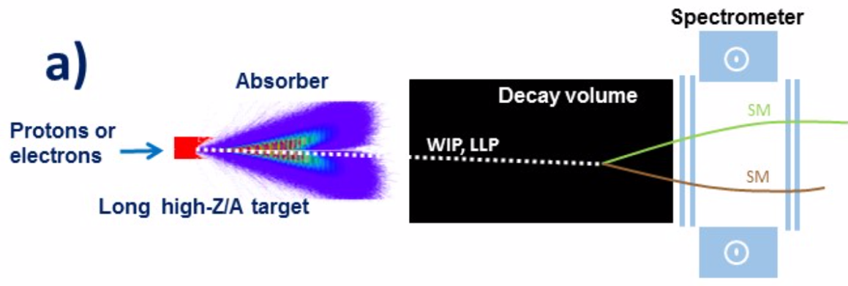
Beam Dump Facilities
BDFs ideal for exploring light super-weakly interacting particles and Light Dark Matter
  Luminosity (yield of π, K, D, B decay and photons):
    HL-LHC: ~10³⁵ cm⁻²s⁻¹ x 10⁷ s = 10⁴² cm⁻²
    SPS (1 m long high A/Z target): 4*10¹³ x 6*10²⁴ cm⁻³ x 10² cm x 10⁶ ~ 2*10⁴⁶ cm⁻²
    Superior luminosity compensates for lower energy (e.g. yield of charm hadrons ~10¹⁶@HL-LHC vs ~10¹⁸@SPS)
  Geometrical acceptance
  Long lifetimes
  Background suppression
Notes:
Lumi is 4 orders of magnitude higher while cross-section is only ~2 orders of magnitude less at E_CMS=27 GeV than at 13 TeV
Geometrical acceptance: large boost ensures good acceptance at BDF
Long lifetimes: BDF ideal for lower masses and weak couplings -- lifetime of HNLs goes as inverse of the 5th power of mass for instance
Background suppression: BDF configuration allow efficient filtering of background with shields

Slide 7
Active beam dumps

Slide 8
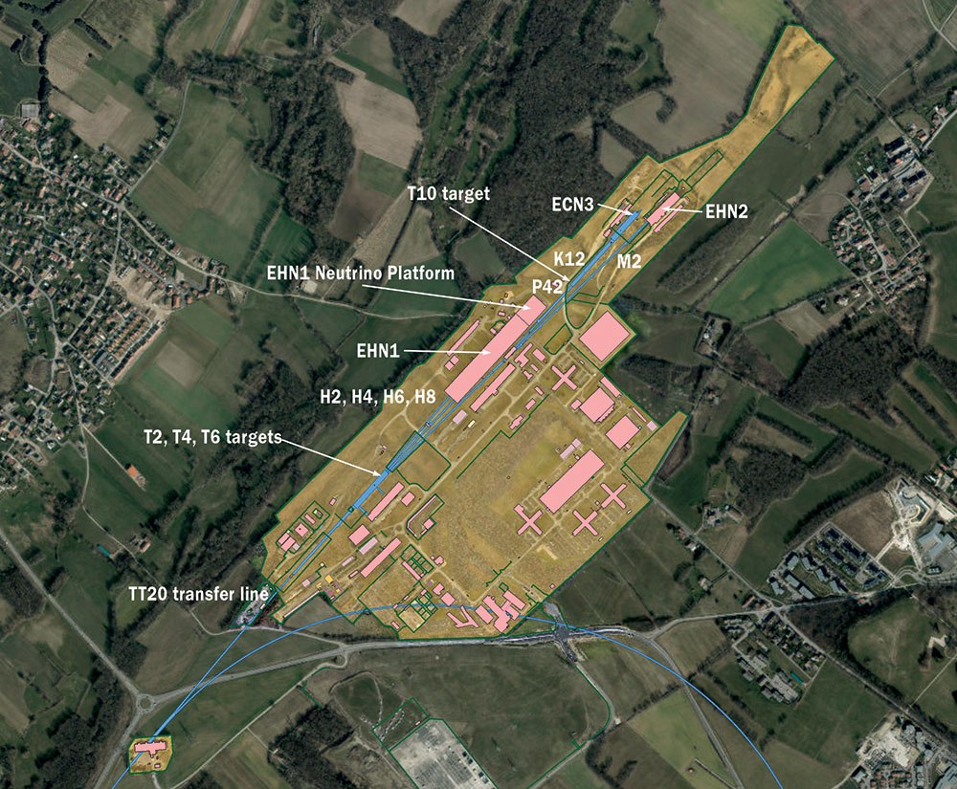
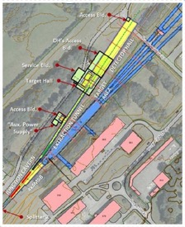
North Area
NA64++ (muons)
M2: 100 – 160 GeV
up to 1e13 mot/year
NA64++ (electrons)
H4: 100 GeV
up to 5e12 eot/year
NA62-dump mode K12: 400 GeV protons
up to 1e19 pot/year
KLEVER
K12: 400 GeV protons
up to 1e19 pot/year
BDF -> SHiP, TauFV
400 GeV protons
4e19 pot/year
Attempting to rebrand as the HSC (Hidden Sector Campus)

Slide 9
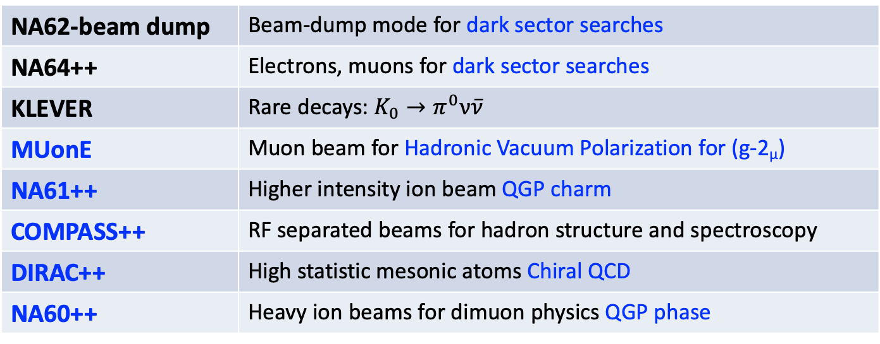
Conventional Beams at the North Area
Proposals followed by the CB WG - healthy mix of HS/QCD
NA62-beam dump | Beam-dump mode for dark sector searches
NA64++ | Electrons, muons for dark sector searches
KLEVER | Rare decays: $K_{0}→π^{0}ν\overline{ν}$
MUonE | Muon beam for Hadronic Vacuum Polarization for (g-2_{μ})
NA61++ | Higher intensity ion beam QGP charm
COMPASS++ | RF separated beams for hadron structure and spectroscopy
DIRAC++ | High statistic mesonic atoms Chiral QCD
NA60++ | Heavy ion beams for dimuon physics QGP phase
Maturity of proposals and the effort required varies considerably
Follow-up dictated by collaboration strength and CERN side resources; overseen by CERN committees

Slide 10
NA64++

Slide 11
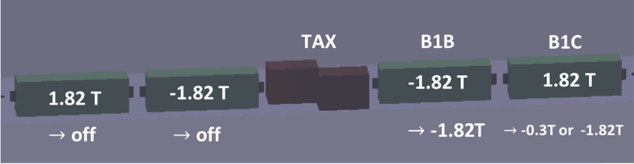
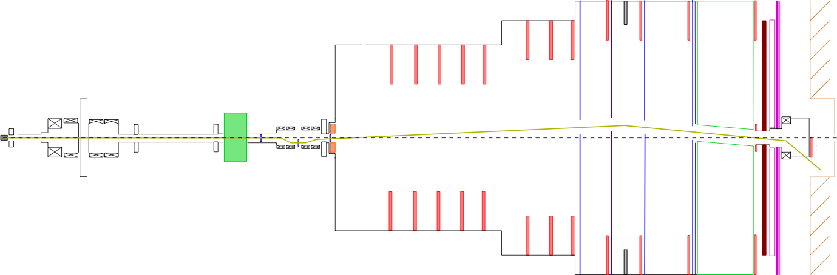
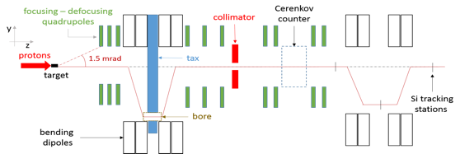
NA62++: dump mode
Transfer full proton intensity on TAX with T10 out and reduce flux of upstream pion and kaons decaying to muons.
Muons need to be efficiently swept as zero background from SM required.
Successful benchmarking of simulation with experimental data performed.
Configuration with closed TAXes and modified 1st achromat for optimum muon sweeping.
TAXes
Be target
HNL
A’
Dark Scalars
beam
ALPs
HNL, dark photons dark scalars and ALPS can originate from the charm, beauty and photons produced in the dump
20 m
80 m
Marcel Rosenthal

Slide 12
SPS Beam Dump Facility (BDF)
Slow extraction from SPS into existing TT20 transfer line
Switch to new transfer line at existing North Area splitters
Heavy target plus magnetized hadron absorber
Target complex with sophisticated handling capabilities
Underground Experimental Hall
Momentum | 400 GeV/c
Protons on target per cycle | 4.0e13
Cycle length | 7.2 s
Spill duration | 1 s
Avg. power on target | 355 kW
Avg. power on target during spill | 2560 kW
Protons on target (PoT) per year | 4e19
PoT in 5 years’ data taking | 2.0e20

Slide 13
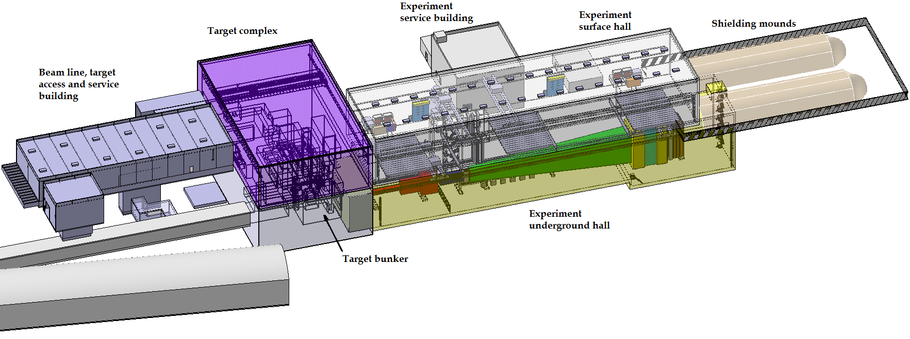
BDF Study
2016-2018: 3 year feasibility study following work since EoI 2013
  extraction, beamlines, target, target complex, experimental hall, integration, civil engineering, safety, and radiation protection
BDF Comprehensive Design Study in pre-publication

Slide 14
BDF
The study is mature.
Operationally it will be challenging but no show stoppers were identified.
Possible time-line from now:
  Continued design studies and prototyping
  ~3 years for TDR, followed by preparation for construction, component production
  Construction of BDF ~5 years
  Operation in Run 4 (2028+)
Material cost: ~160 MCHF (class 4 estimate)

Slide 15
SHiP
A discovery machine for weakly coupled LLPs with a complementary detector for neutrino physics and LDM scattering signatures
Large geometrical acceptance: long volume close to dump
Zero background with spectrometry, PID and VETO taggers
Well established collaboration, project in good shape, moving towards TDR

Slide 16
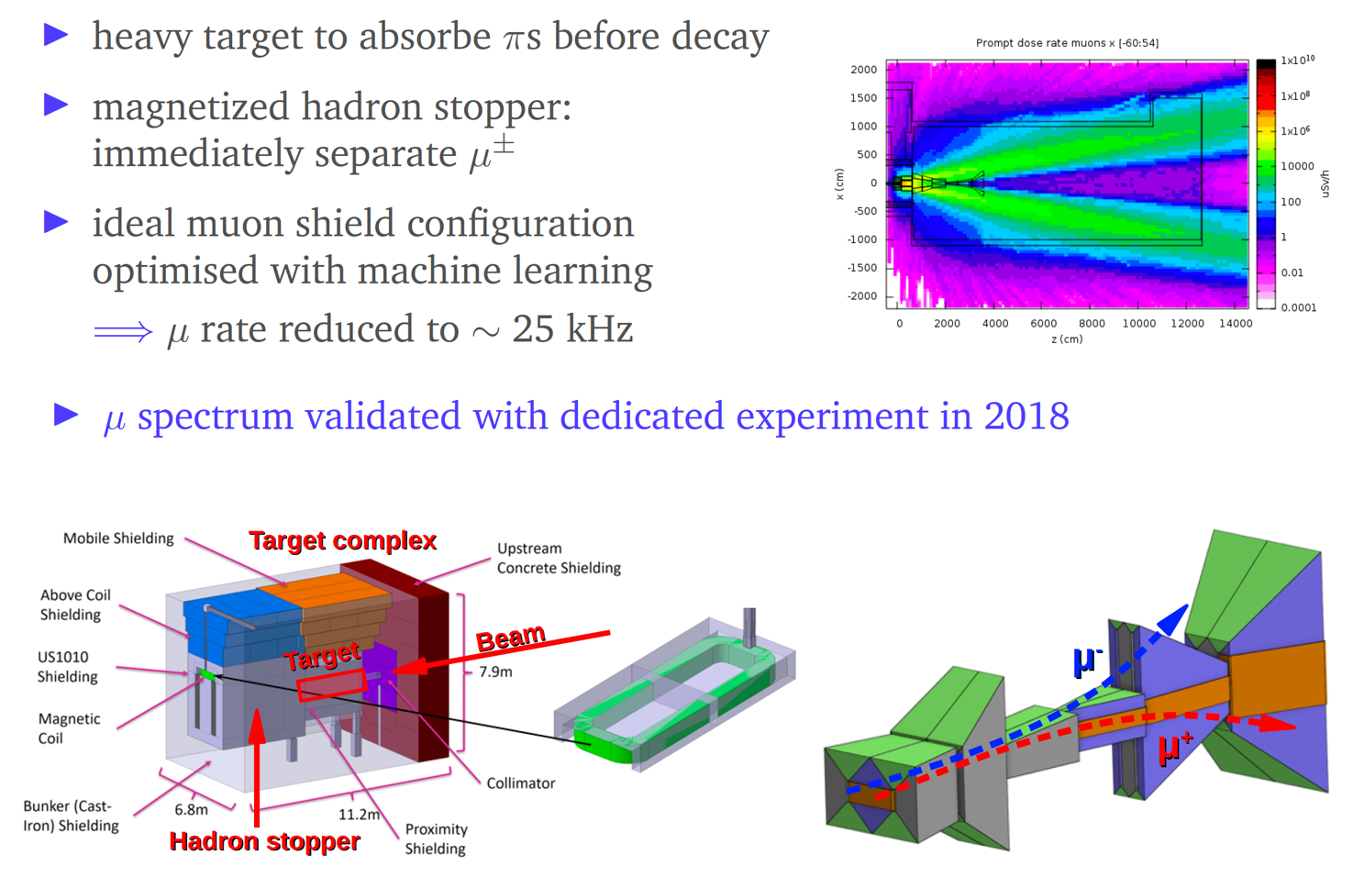
SHiP: target and shielding

Slide 17
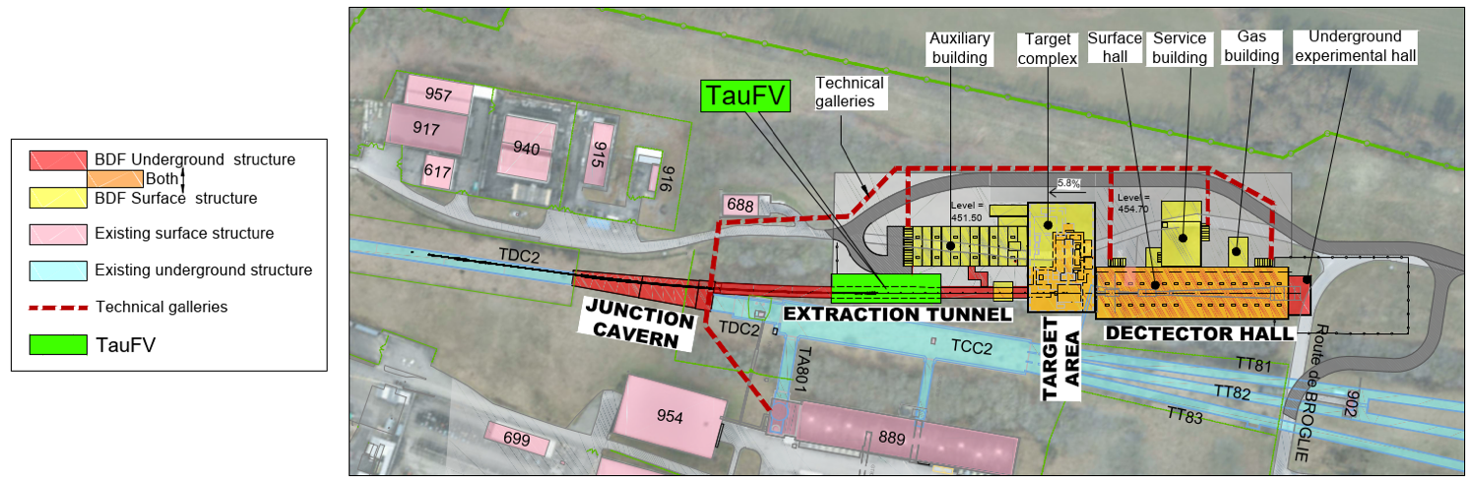
TauFV
Search for Lepton Flavour Violation and rare decays
Using a thin in-line target to intercept about 2% of the intensity delivered to the BDF target
Would have access to close to 8e13 tau lepton and 5e15 D₀ meson decays
TauFV in feasibility study phase at present - well motivated complement to SHiP

Slide 18
TauFV
Study of tau LFV decays timely: complement the quest for new physics in other cLFV modes, as mu2e @ FNAL and MEG/mu3e @ PSI.
400 GeV primary protons

Slide 19
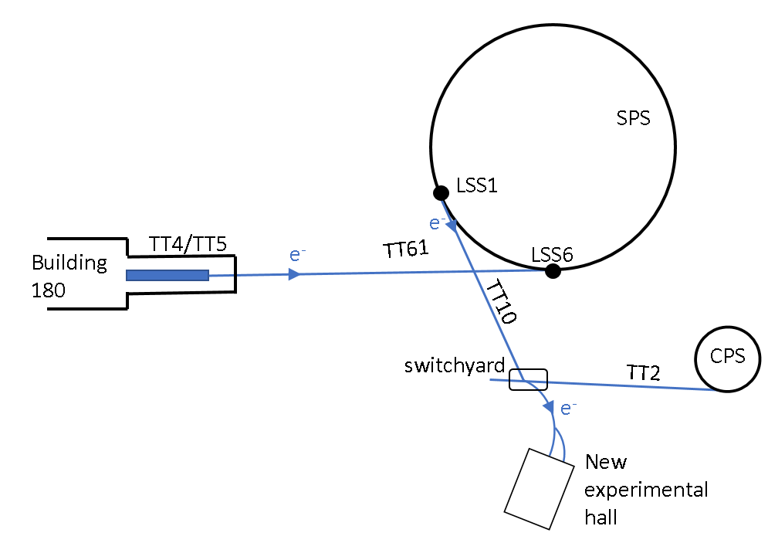
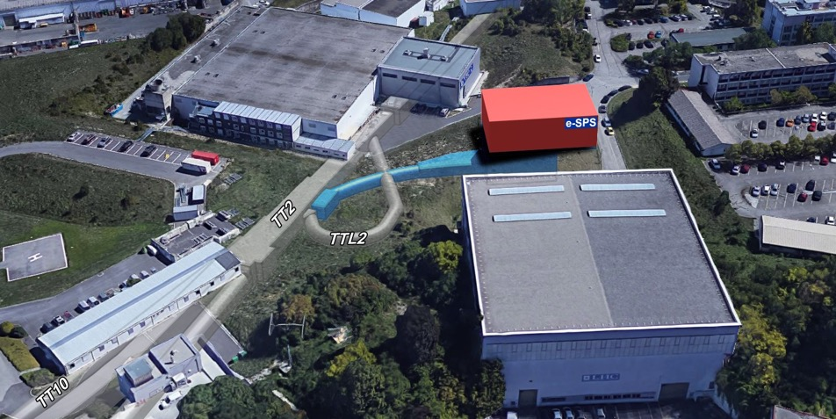
eSPS
~70 m long X-band based linac (CLIC technology): e- to 3.5 GeV
Acceleration to 16 GeV in the SPS
Slow resonant extraction in ~10 s
Beam delivered via the existing transfer line to the Meyrin site
A new, short beamline would branch to an experimental hall (LDMX)
R&D facility

Slide 20
LDMX
Options: - dedicated transfer line at LCLS-II (4 – 8 GeV)
or/and eSPS (16 GeV 10¹⁶ e⁻/year @ 1/3 SPS duty cycle)

Slide 21
AWAKE++

Slide 22
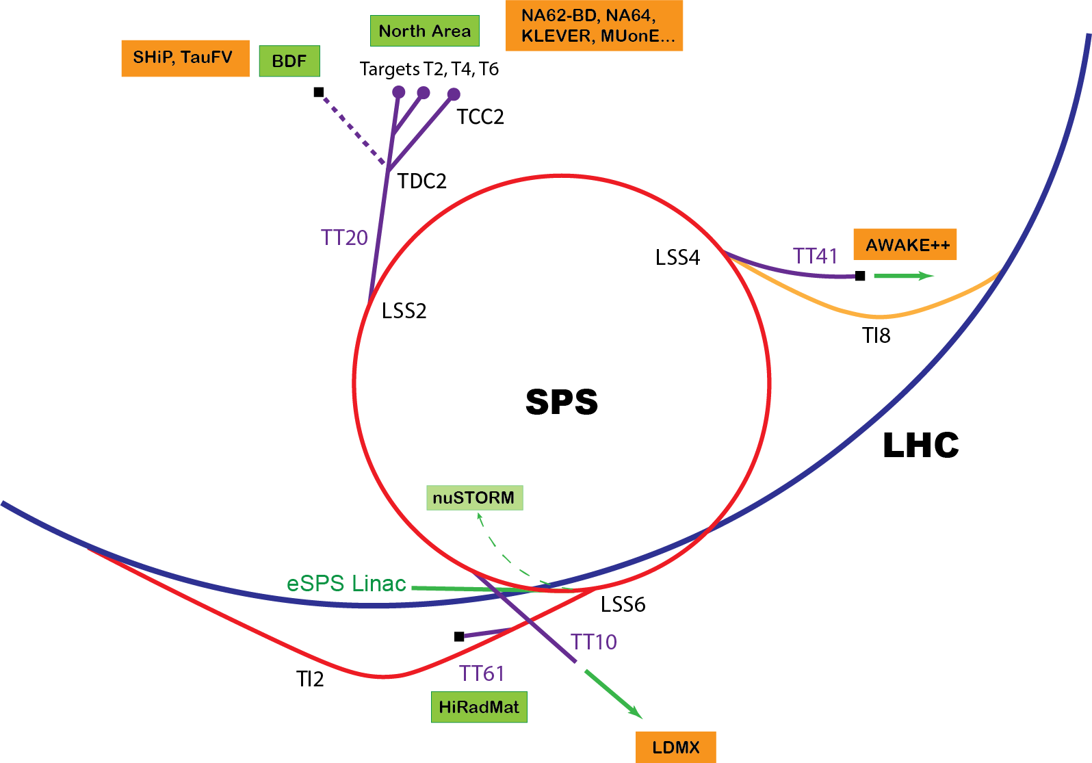

Slide 23
LHC Fixed Target - Gas
Already pioneered by LHCb in Run 2 with SMOG.
SMOG2 storage cell development:
FT lumi x ~100 in Run 3 – installation 2019-20
ALICE also interested
R&D ongoing on polarized gas targets
“Simple” storage cells already open unique opportunities in both hadron and QGP physics

Slide 24
Nicola Neri

Slide 25
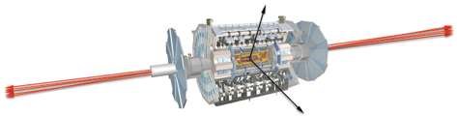
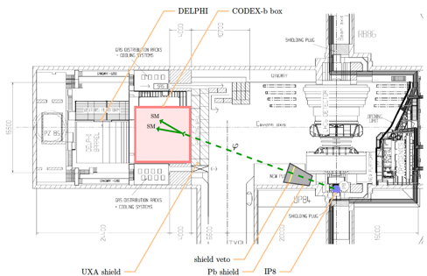
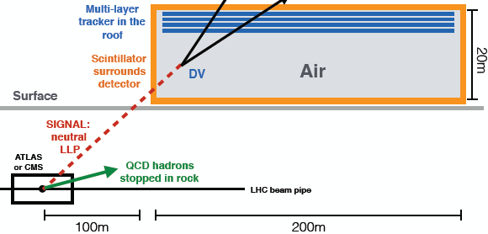
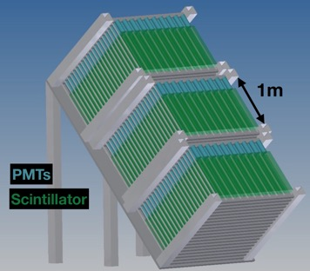
Long Lived Particles at the LHC
FASER
CODEX-b
~1 m³ ~ 5 μIKEAs
Feng, Galon, Kling, Trojanowski (2017)
~1000 m³
Gligorov, Knapen, Papucci, Robinson (2017)
milliQan
MATHUSLA
~800,000 m³ ~ 4 IKEA
Chou, Curtin, Lubatti (2016)
~9 m³ ~ 35 μIKEAs

Slide 26
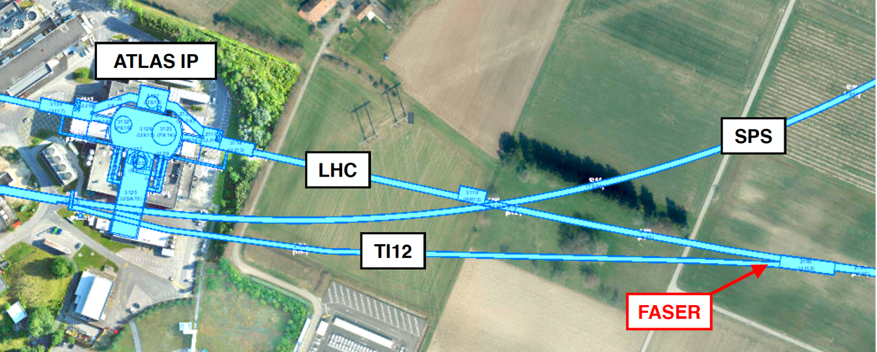
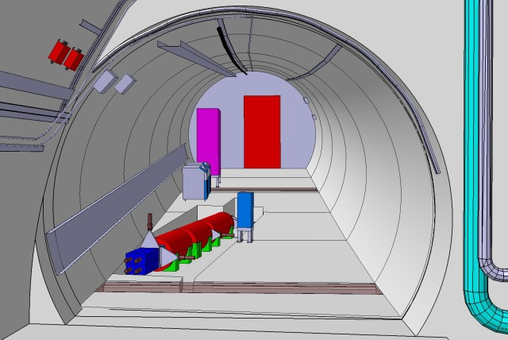
FASER
Preparation for installation in 2020 ongoing
FASER: sensitive to decays in a cylindrical region of radius R = 10 cm and length L = 1.5 m
FASER2: R = 1 m and L = 5 m for construction in Long Shutdown 3
See Clare’s talk for sensitivity reach

Slide 27
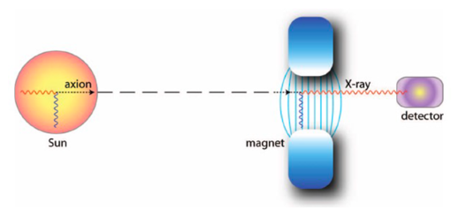
Technology
Exploration and evaluation of possible technological contributions of CERN to non-accelerator projects possibly hosted elsewhere
Initiative | Physics |  | Technology | CERN?
VMB@CERN | VMB | Search for Vacuum Magnetic Birefringence | optics, magnets | Y
JURA | LSW/ALPS | Via optics, detector development at ALPS II + FCC magnets | magnets | Y
STAX | LSW/ALPS | Transition-edge-sensors (TES); high Q Fabry-Perot cavities | magnets, cryo, RF | P
BabyIAXO/IAXO | Axions | Next generation helioscope - independent collaboration | magnets | N
DarkSide | WIMPs | Independent collaboration | vac, cryo, SIPM | N
Carbon Nano Tubes | CNB, DM | Electron recoils in large arrays of // carbon nanotubes - DM target for PTOLEMY | new material studies, neutrons | N
aKWISP | Chameleons | Short-distance interactions at sub-micron scales | cryo, thin films.. | N

Slide 28
Initiatives integrated into the Technology WG

Slide 29
Also considered
nuSTORM
possible implementation at CERN
1 < E_{μ} < 6 GeV
Proton storage ring EDM measurement
CPEDM collaboration investigations revealed need for a prototype ring to test and finalize control of systematics.
Possible prototype site: COSY in Jülich

Slide 30
Schematic overview of the BSM landscape
Beam dumps, Long Lived Particles
MeV – GeV (HNL, ALPS, Light Dark Matter)
Precision experiments
>>TeV (search for NP in clean and very rare flavour processes or in EDMs)
Non-accelerator projects
Sub-eV (axions, ALPs)
For comparative sensitivity plots of 11 benchmarks cases considered by the BSM group – see Clare’s presentation

Slide 31
Options - summary
Well motivated, competitive, cost-effective options, making good use of CERN’s existing complex, beams, and expertise.
Rare decays and precise measurements
KLEVER (K⁰_{L} → π⁰𝜈𝜈)
TauFV@BDF: 𝜏 → 3μ
REDTOP (𝜂 decays)
MUonE (hadronic vacuum polarization for (g-2_{μ}))
EDM proton storage ring
Long-lived particles from LHC collisions
FASER, MATHUSLA, CODEX-b, milliQAN
QCD measurements
COMPASS++, DIRAC++
NA61++, NA60++
Fixed target (gas, crystals) in ALICE & LHCb
Other facilities:
𝛾-factory from Partially Stripped Ions; nuSTORM
Hidden sector with “beam dumps”
NA64++ (e,μ)
NA62++
Beam Dump Facility at North Area (SHiP)
LDMX@eSPS
AWAKE++
Non-accelerator projects
Exploit CERN’s technology (RF, vacuum, magnets, optics, cryogenics) for
experiments possibly located in other labs.
E.g. axion searches: IAXO (helioscope), JURA (Light Shining through Wall)

Slide 32
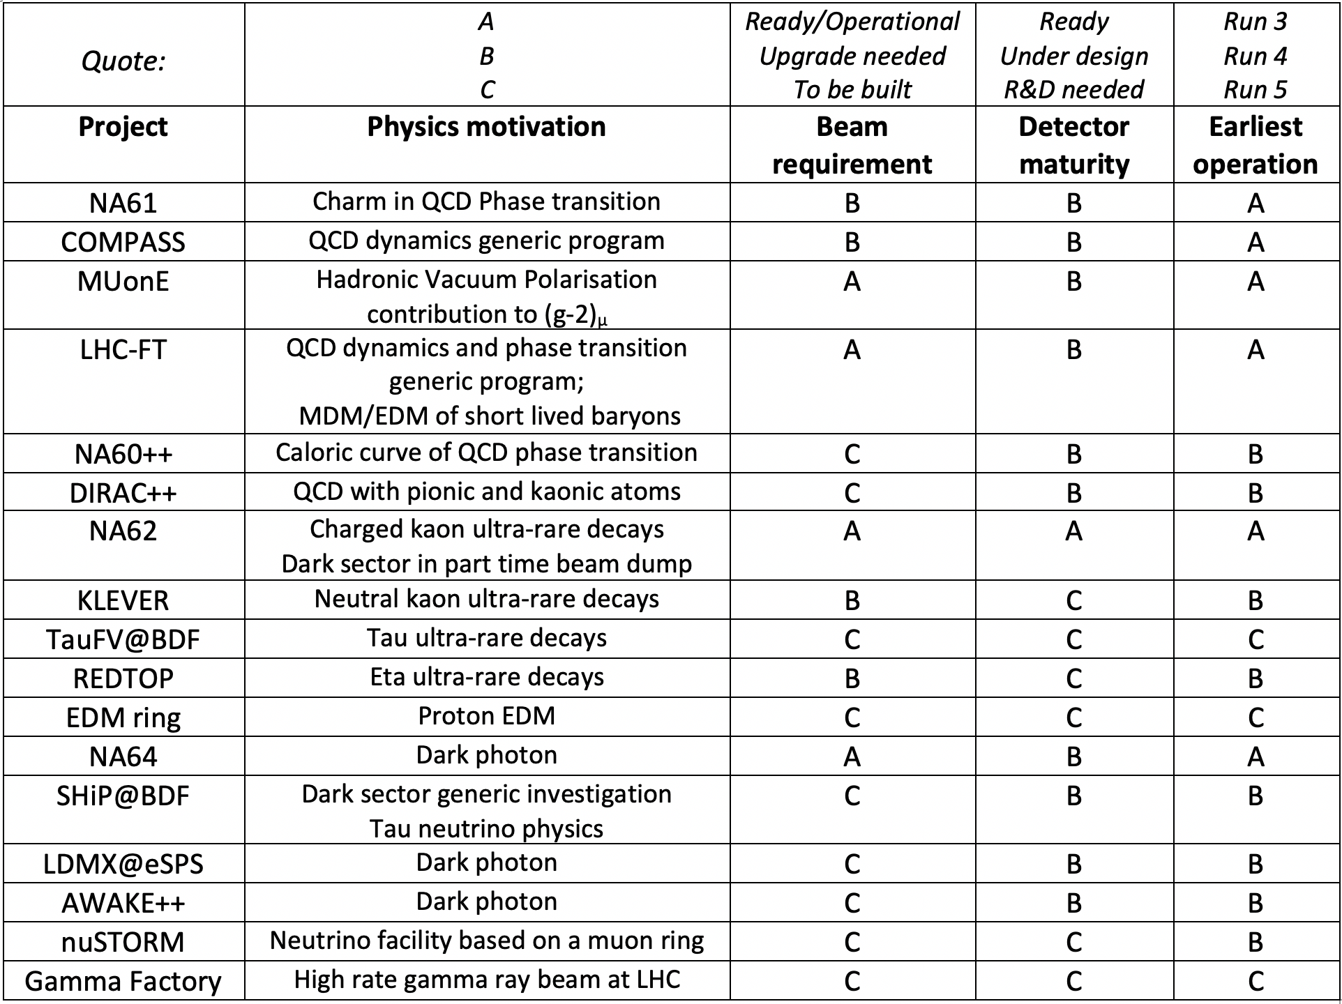
Readiness of experiments
New projects also constrained by existing beamlines/beams/ halls/experiments...

Slide 33
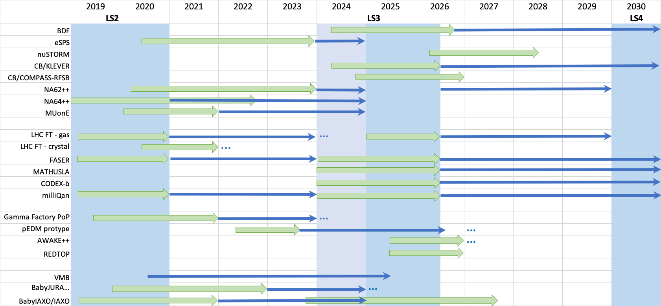
Approximate “ideal” timelines

Slide 34
Conclusion from PBC BSM report
The absence, so far, of unambiguous signals of NP from
  direct searches at the LHC,
  indirect searches in flavour physics,
  and direct detection Dark Matter experiments,
  along with the absence of a clear guidance from theory about the NP scale,
  motivates today, more than ever, the broadening of the experimental effort in the quest for NP and exploring different ranges of interaction strengths and masses with respect to what is already covered by existing or planned in initiatives.
CERN could offer an unprecedented variety of high-intensity, high energy beams and scientific infrastructure that could be exploited to this endeavour.
This effort would nicely complement and further broaden the already rich physics programme ongoing at the LHC and HL-LHC.

Slide 35
Conclusions
Interesting exercise, fostered a number of options to exploit the complex and technology - mix of:
  smaller scale options which can be addressed within CERN’s remit
  promising novel proposals
  larger scale projects
Initiatives are:
  well motivated by their physics potential in interesting times;
  cost-effective opportunities to make a significant contribution and provide important input to future plans;
  allow full exploitation of the complex in parallel to the LHC and preparation for the longer term.

Slide 36
ADDITIONAL MATERIAL

Slide 37
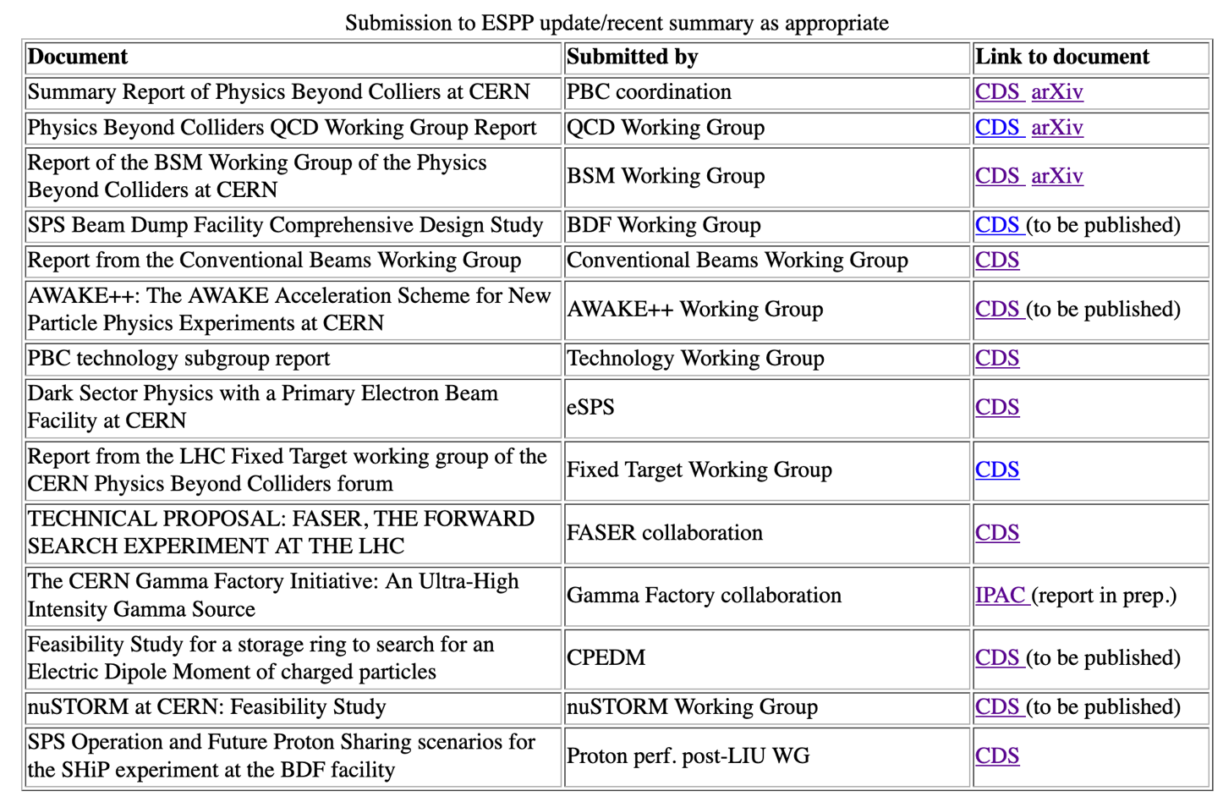
Doc
http://pbc.web.cern.ch/

Slide 38
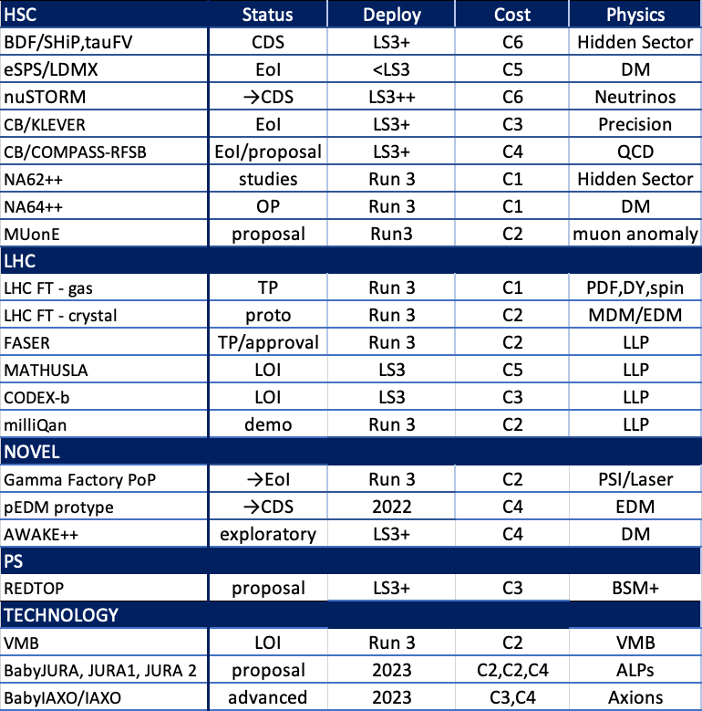
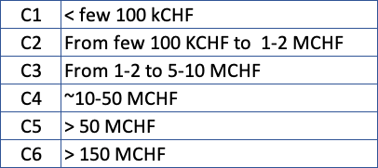
Summary
Class 4 for BDF, eSPS;
Preliminary for nuSTORM
Conventional beams – see PBC report
Technology – all options – see PBC report
Cost Scale

