Slide 1
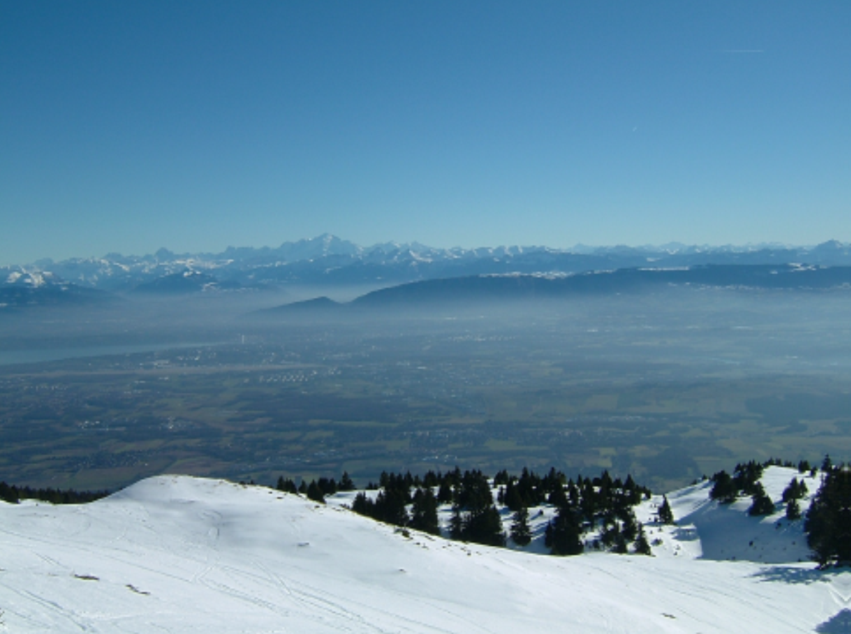
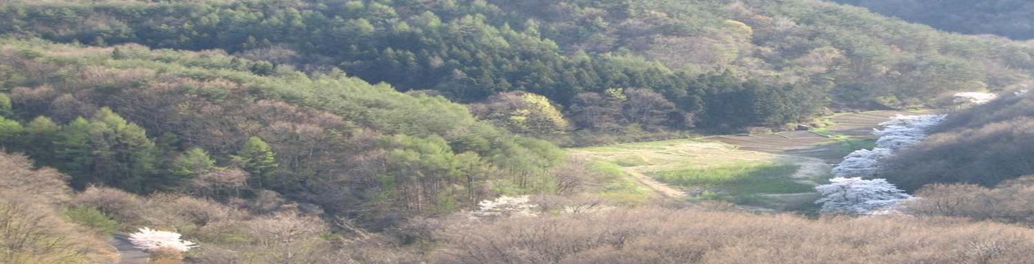
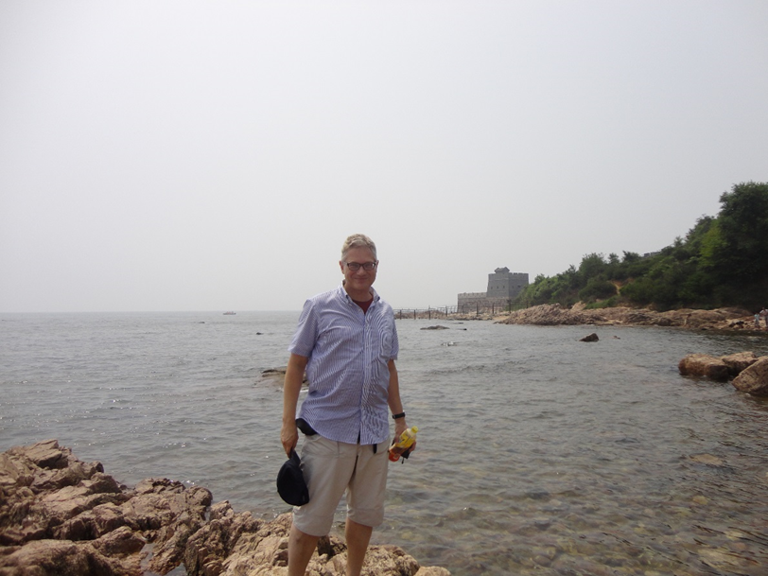


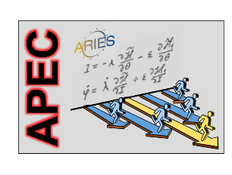
future accelerators for particle physics - hadron and lepton colliders
Geneva site
Kitakami site
Frank Zimmermann, CERN
PPAP Community Meeting
Birmingham, 12 September 2019
* including slides from M. Benedikt, D. Contardo, D. Schulte et al.
Frank Zimmermann
CERN, BE Department
Helmholtz School CALC2018 Dubna
Qinhuangdao site
Work supported by the European Commission under Capacities 7th Framework Programme, Grant Agreement 312453

Slide 2
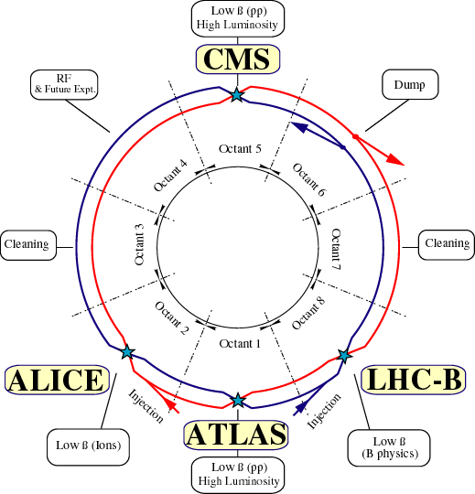
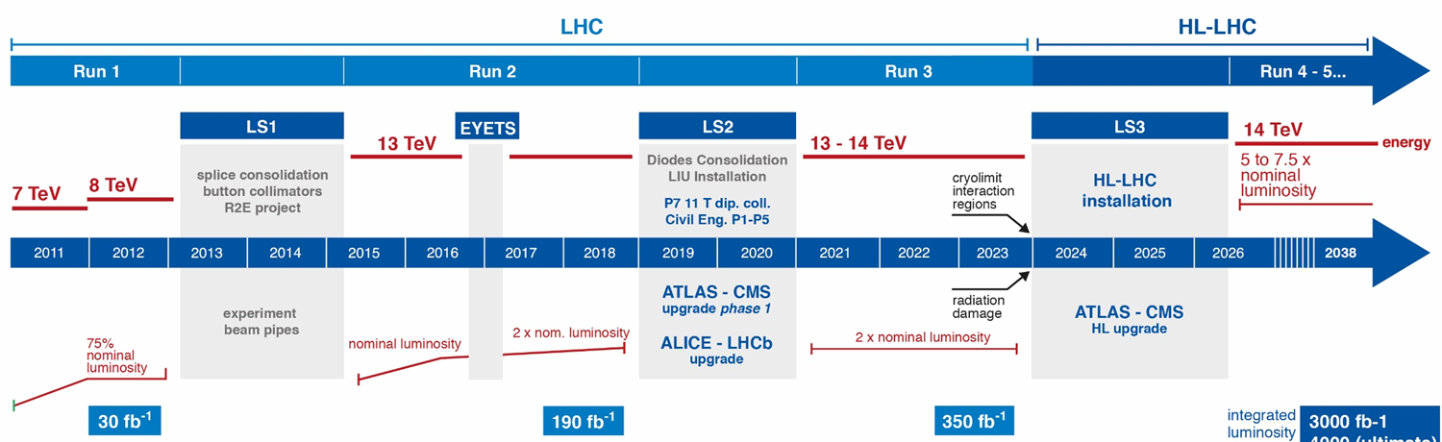
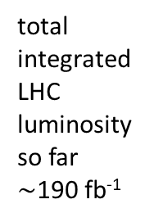
LHC: today’s frontier collider
total integrated
LHC luminosity
so far $\sim$190 fb⁻¹

Slide 3
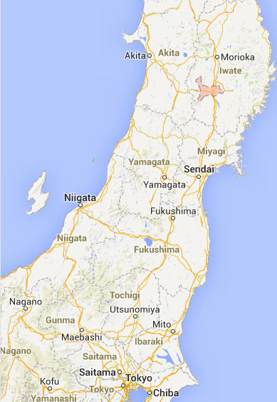
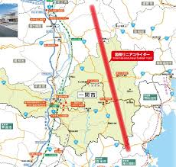
proposed linear e⁺e⁻ collider: ILC
J-ILC
J-ILC

Slide 4
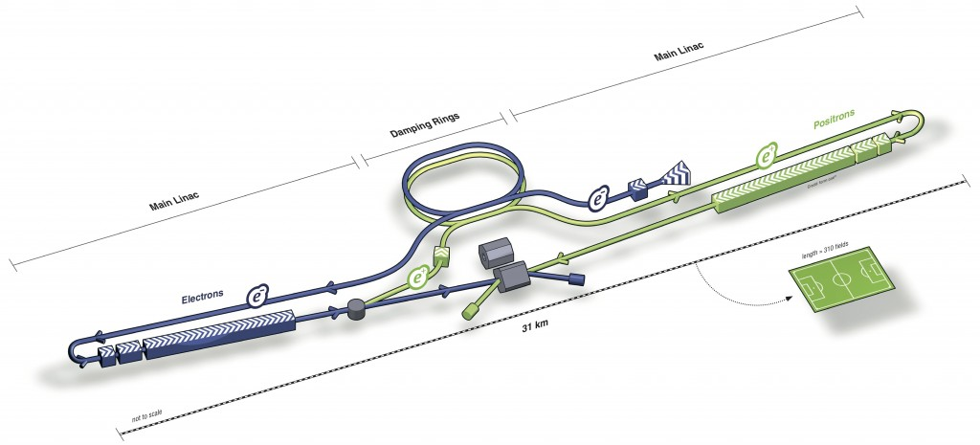
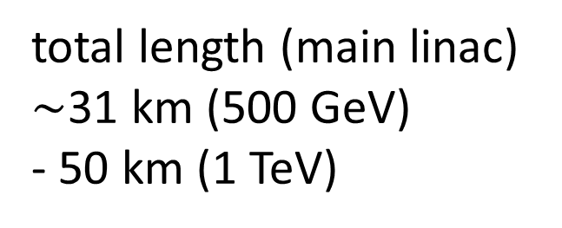
ILC
total length (main linac)
$\sim$31 km (500 GeV)
- 50 km (1 TeV)
accelerating cavities
O(65%) of linac length
Parameters | Value
C.M. Energy | 250 GeV
Peak luminosity | 1.35 x10³⁴ cm⁻²s⁻¹
Beam power | 5 MW
Beam Rep. rate | 5 Hz
E gradient | 31.5 MV/m +/-20%
500 GeV ILC: 16,000 9-cell cavities in 31 km linac

Slide 5
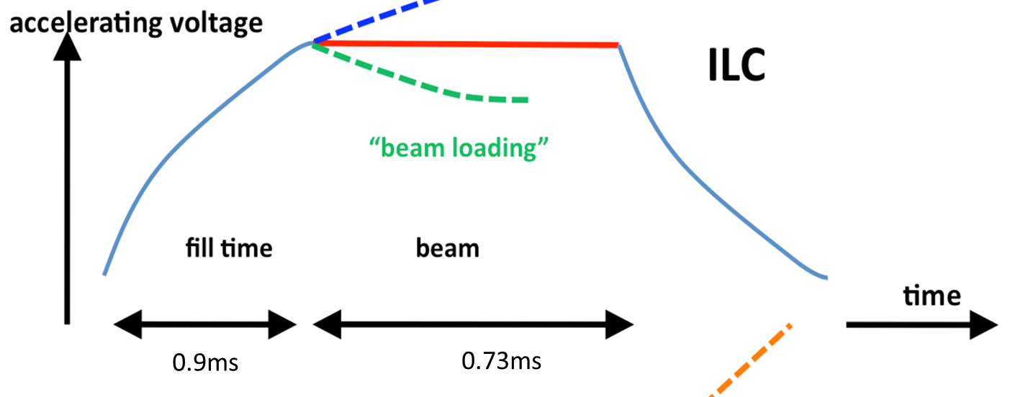
ILC RF gradient achieved at XFEL in Hamburg
From N. Walker
pulsed operation
5 RF pulses of 1.6 ms per s
(1312 bunches in 0.73 ms):
due to heat losses in the wall
about 1 W/m
w/o pulsing losses x100 worse
RF power in pulse: 5 MW / (5 x 0.73 ms) = O (1500 MW) = O (150 klystrons) for 250 GeV
From D. Schulte

Slide 6
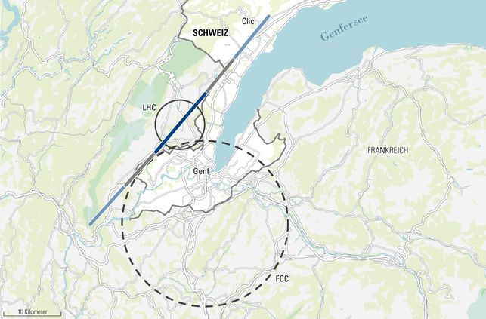
proposed linear & circular colliders: CLIC & FCC
Geneva basin
CLIC
FCC
C NZZ

Slide 7
CLIC
total length (main linac) $\sim$11 (500 GeV) - 48 km (3 TeV)

Slide 8
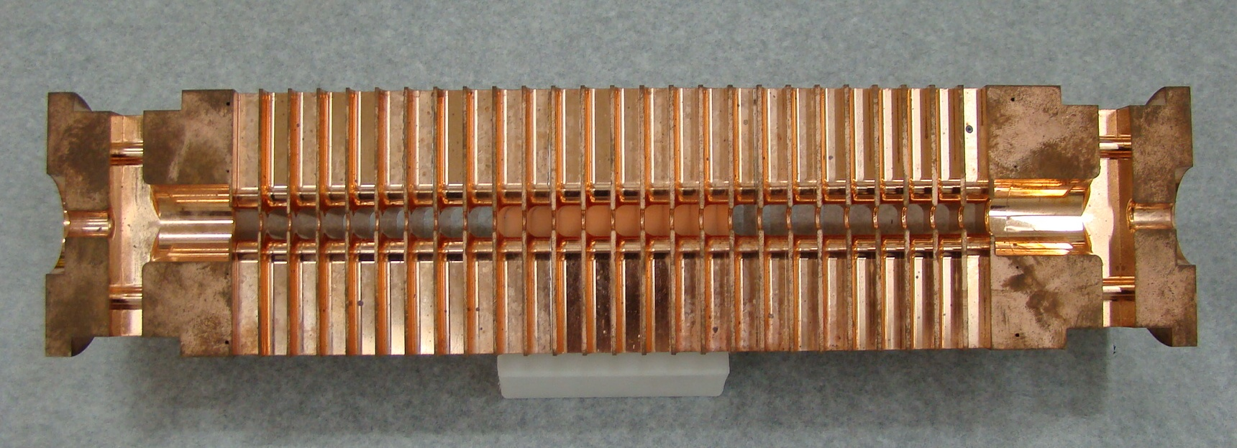
CLIC Accelerating Structure
Power flow
1/3 lost in cavity walls
1/3 in filling the structure and into load
1/3 into the beam
12 GHz, 23 cm long, normal conducting
Loaded gradient 100 MV/m
Allows to reach higher energies
140,000 RF structures at 3 TeV
But strong losses in the walls
50 RF bursts per second
240 ns, 60 MW, 312 bunches
Power during pulse 8.5 x 10⁶ MW (3000 x ILC)
Average RF power about 3 kW/m
About 1 kW/m into beam

Slide 9
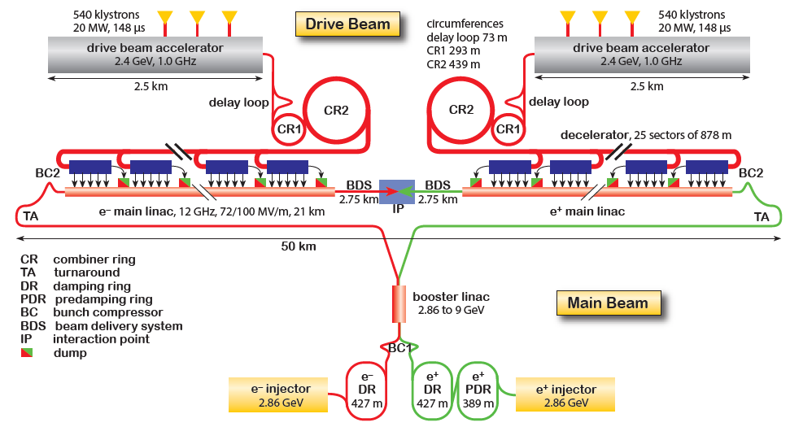
CLIC complex
Goal: Lepton energy frontier
Drive Beam Generation Complex
CLIC at 3TeV shown
50km
Main Beam Generation Complex
Stages at E_{cms}=0.38, 1.5 and 3TeV L=6x10³⁴cm⁻²s⁻¹ at 3TeV
Beam power 30MW at 3TeV

Slide 10


Future Circular Collider (FCC)
integrated project plan
CDR published in EPJ C and EPJ ST (1350 authors from 350 institutes)
~100 km tunnel infrastructure in Geneva area, linked to CERN accelerator complex
e⁺e⁻ collider (FCC-ee), → potential first step
pp-collider (FCC-hh) → long-term goal, defining infrastructure requirements
HE-LHC w. FCC magnets
ion-ion collisions & lepton-hadron options
~16 T ⇒ 100 TeV pp in 100 km

Slide 11
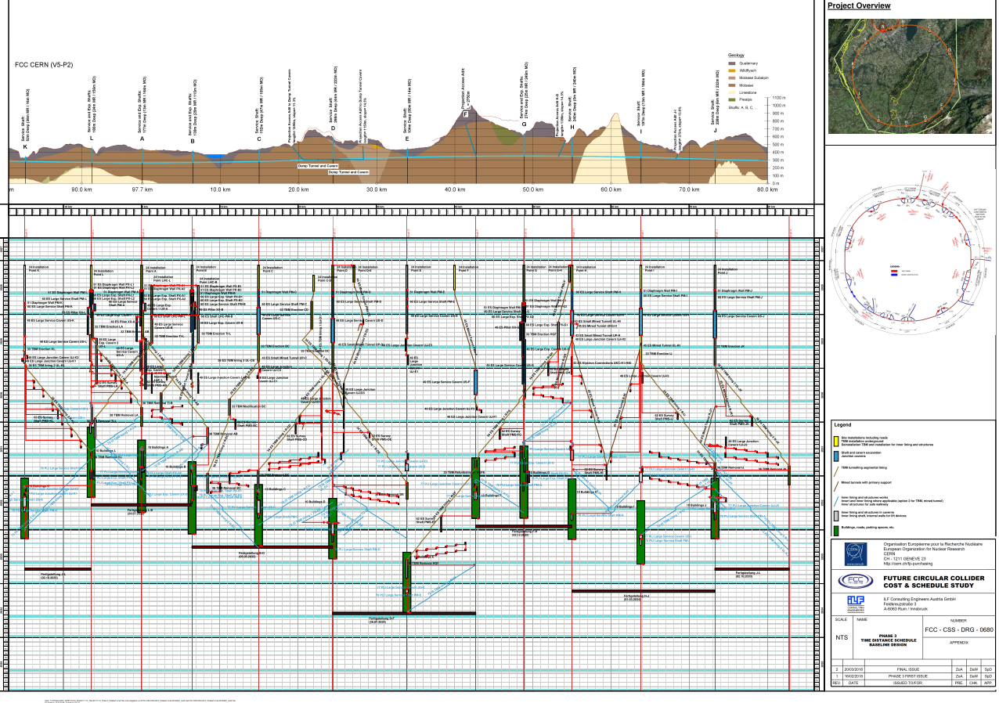
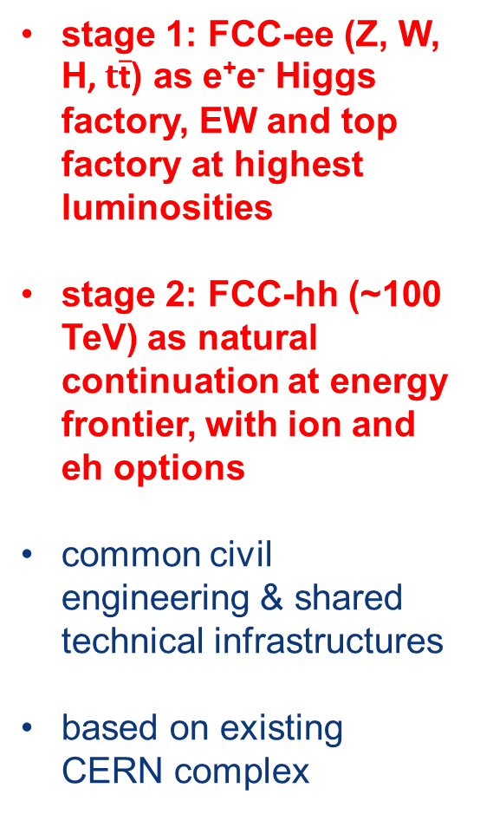
FCC implementation studies
construction of 97.75 km tunnel
stage 1: FCC-ee (Z, W, H, $t\overline{\text{t}}$) as e⁺e⁻ Higgs factory, EW and top factory at highest luminosities
stage 2: FCC-hh (~100 TeV) as natural continuation at energy frontier, with ion and eh options
common civil engineering & shared technical infrastructures
based on existing CERN complex
4.5yrs
6.5yrs
total construction duration 7 years
first sectors ready after 4.5 years

Slide 12
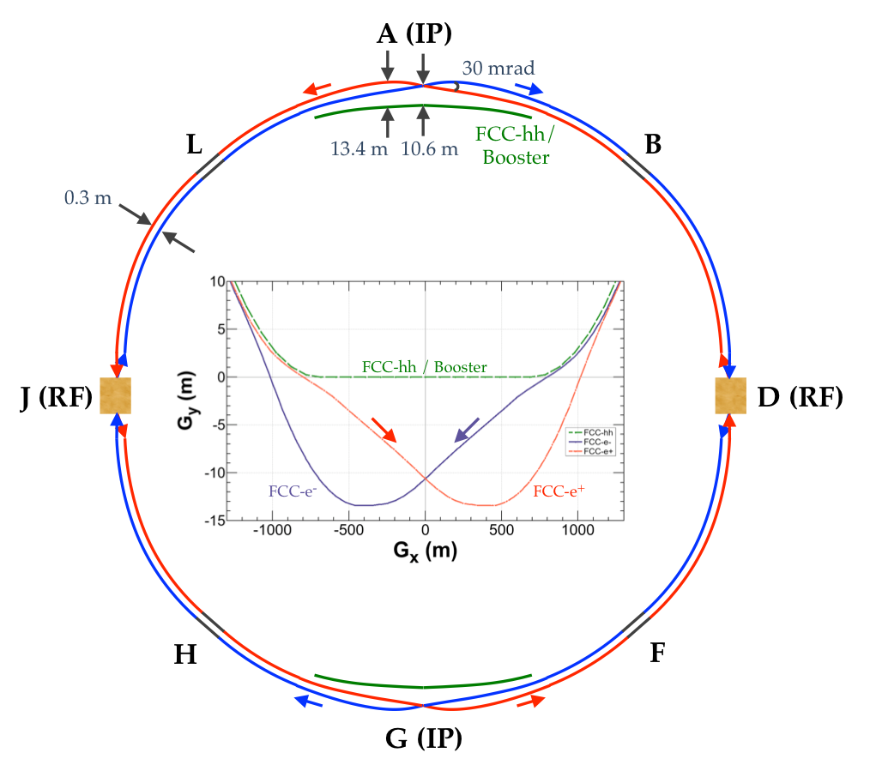
common layouts for hh & ee
two main IPs in A, G for both machines
common footprint except around IPs
FCC-ee asymmetric IR layout to limit synchrotron radiation
FCC-ee
FCC-hh
K. Oide
similar solutions for a project in China (CEPC/SppC)

Slide 13
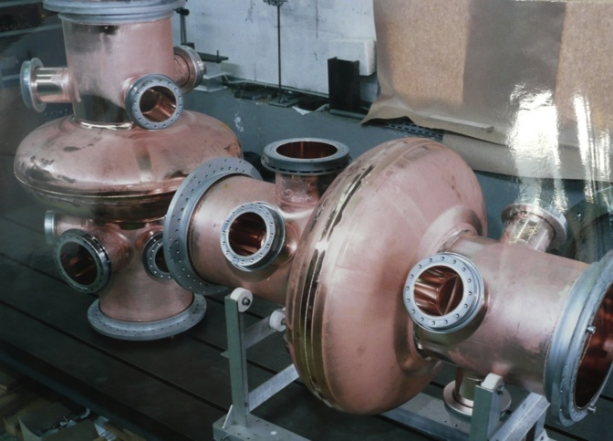
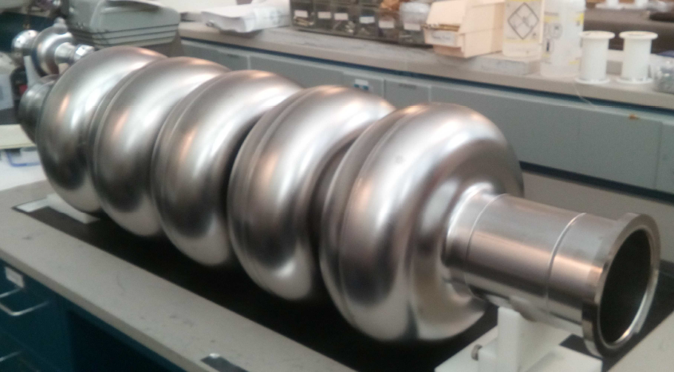
FCC-ee cavities
Z running:
single cell cavities,
400 MHz,
Nb/Cu at 4.5 K,
like LHC cavities
ttbar running:
five-cell cavities,
800 MHz,
bulk Nb at 2 K,
in addition to
400 <MHz
four-cell cavities
at 400 MHz
Z-pole FCC-ee: 116 single-cell cavities
JLAB, Oct 25, 2017
F. Marhauser et al
ttbar FCC-ee: 396 four-cell 400 MHz + 852 five-cell 800 MHz cavities

Slide 14
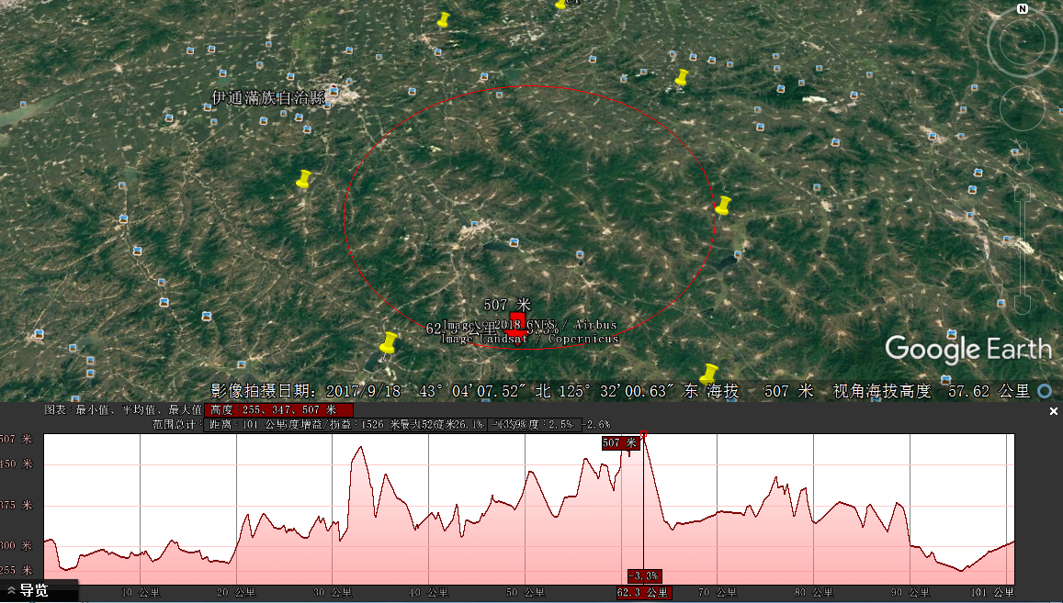
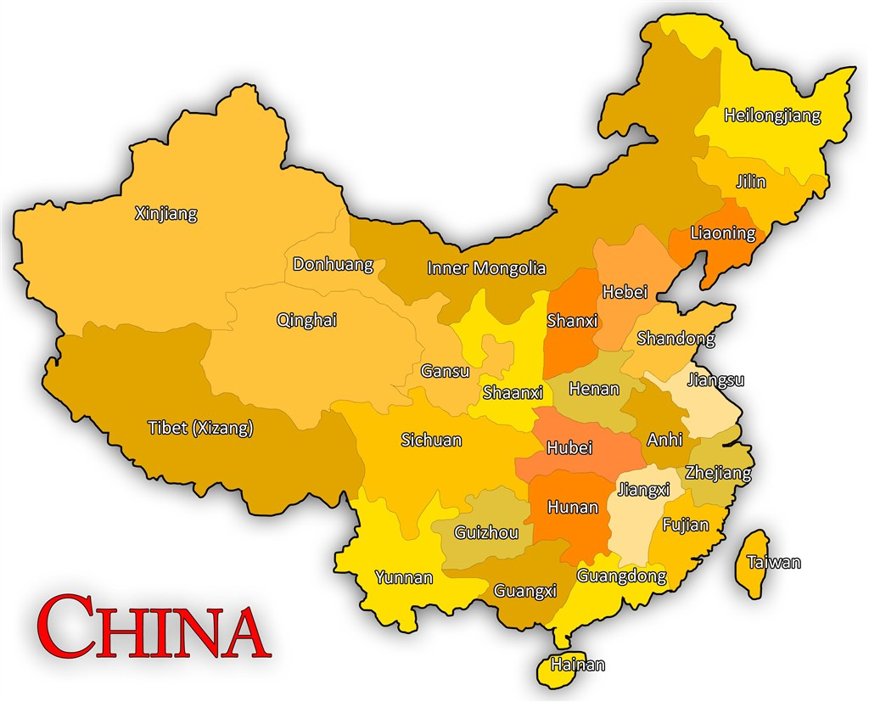
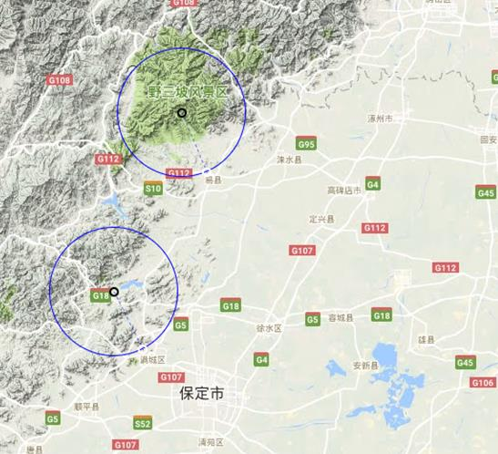
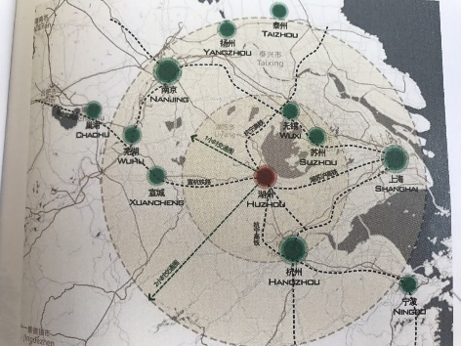
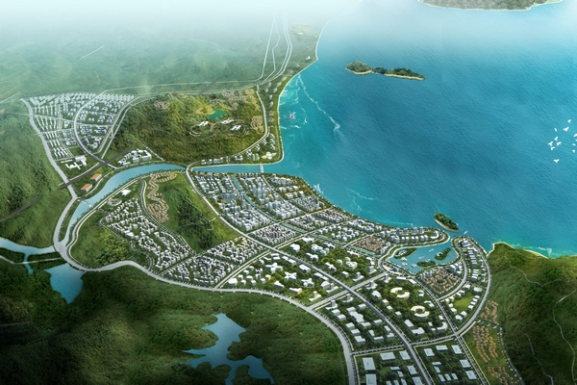
proposed circular colliders: CEPC/SppC
6
1
China
1)
4
4
2
2)
5
1) Qinhuangdao, Hebei Province（Completed in 2014）
2) Huangling, Shanxi Province（Completed in 2017)
3) Shenshan, Guangdong Province(Completed in 2016)
4) Baoding (Xiong an), Hebei Province (Started in August 2017)
5) Huzhou, Zhejiang Province (Started in March 2018)
6) Chuangchun, Jilin Province (Started in May 2018)
3)
3
J. Gao

Slide 15
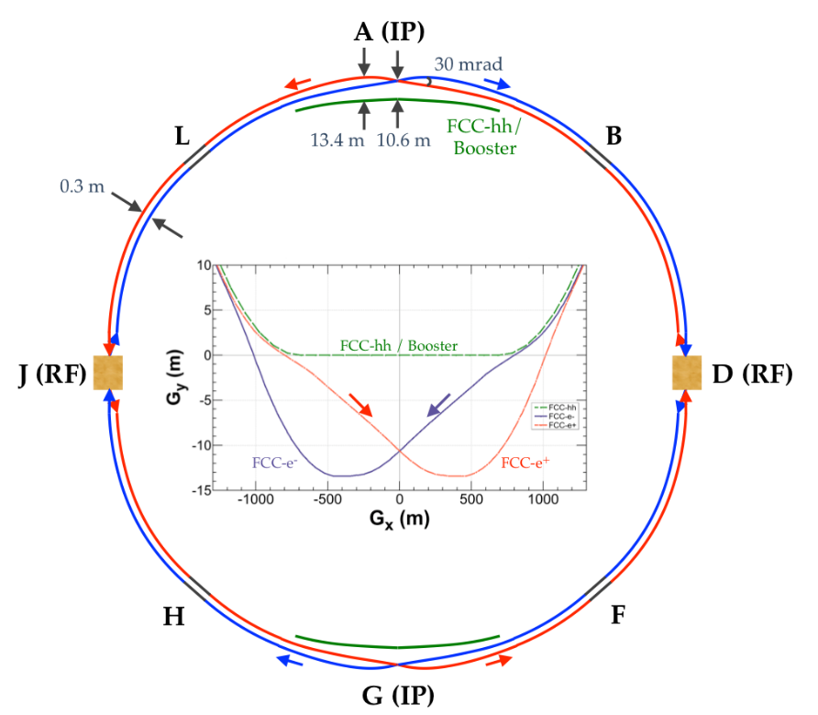
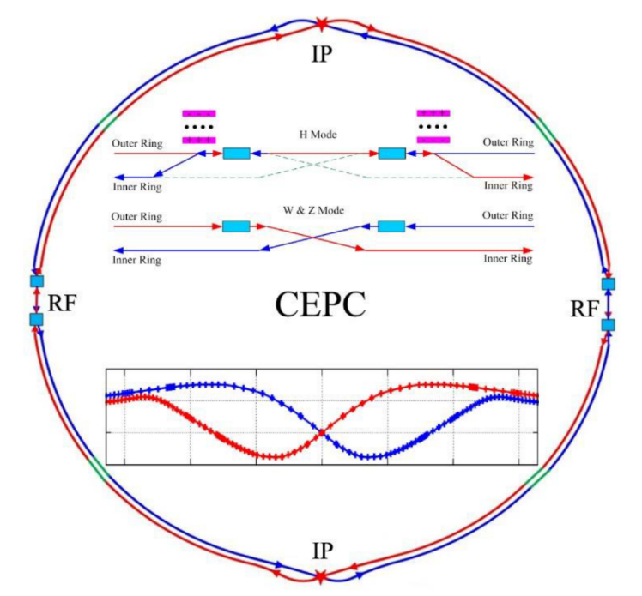
similar solutions for FCC-ee and CEPC
double ring colliders with full-energy top-up booster ring,
CEPC evolved from initial 54 km - single-ring design, practically to the FCC-ee 100 km design.
2 IPs, 2 RF straights, tapering of arc magnet strengths to match local energy
asymmetric IR layout to limit SR of incoming beams towards detectors and generate large crossing angle
common use of RF systems for both beams at highest energy working point (ttbar/ZH for FCC-ee/CEPC)
FCC

Slide 16
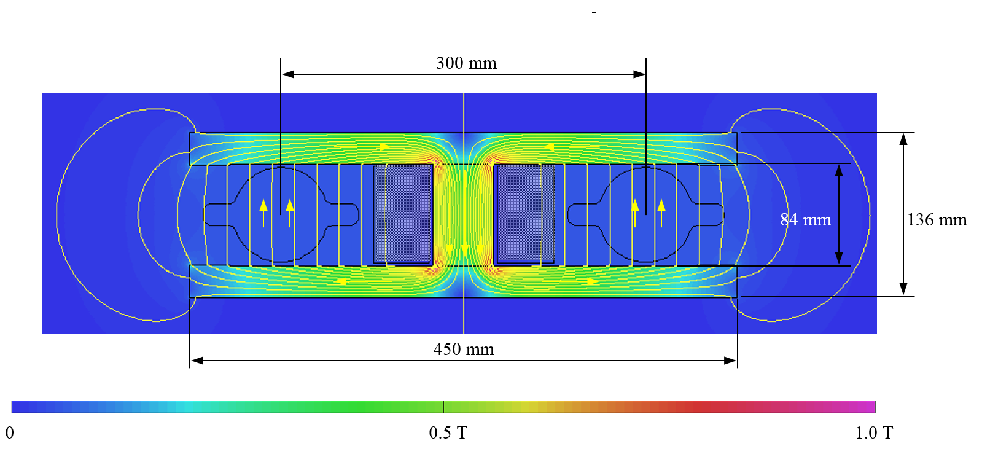
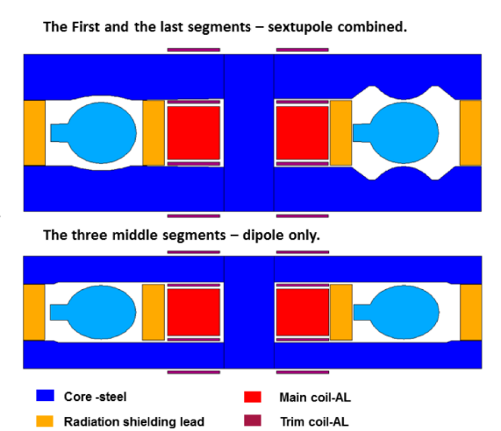
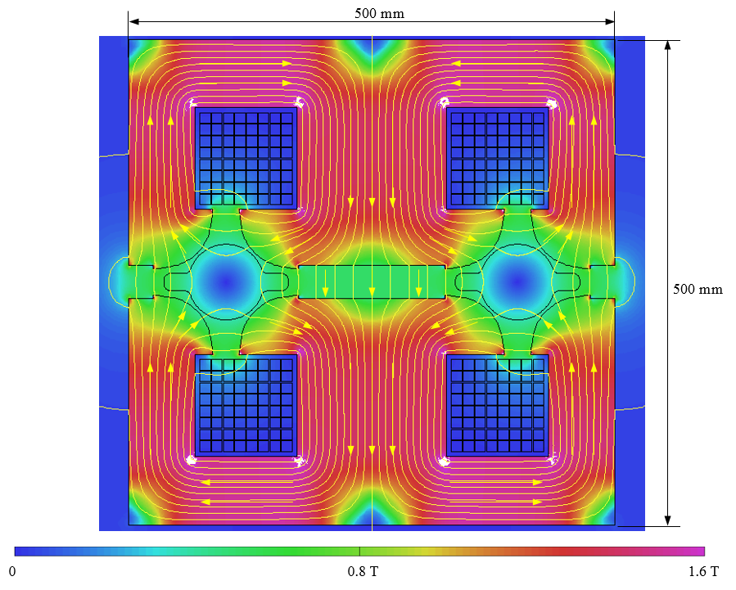
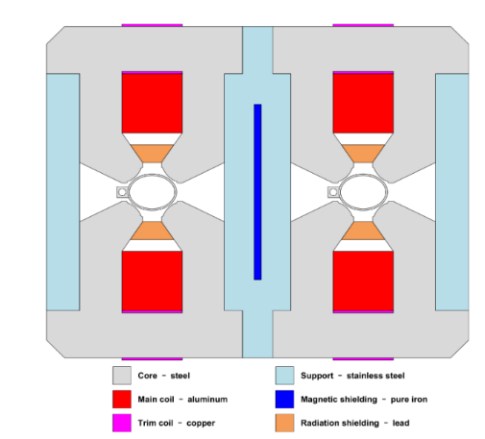
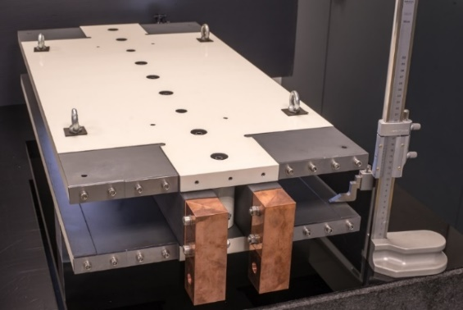
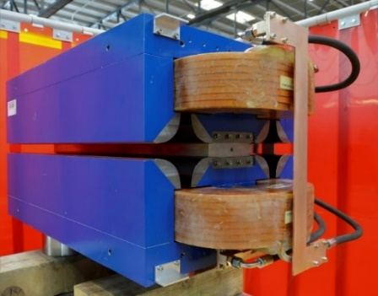
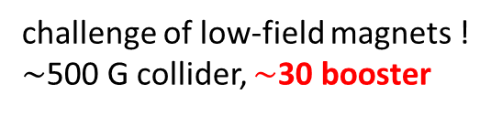
design of low-power magnets for FCC-ee and CEPC
FCC-ee
challenge of low-field magnets !
$\sim$500 G collider, $\sim$30 booster
CEPC
Twin-dipole design with 2× power saving
16 MW at 175 GeV
Twin arc magnet combined function dipole with sextupole component
Twin F/D arc quad with 2× power saving
25 MW at 175 GeV
dipole prototype
Twin F/D arc quad with 2× power saving
quadrupoleprototype
power reduction by factor 2 w.r.t. single-aperture magnets

Slide 17
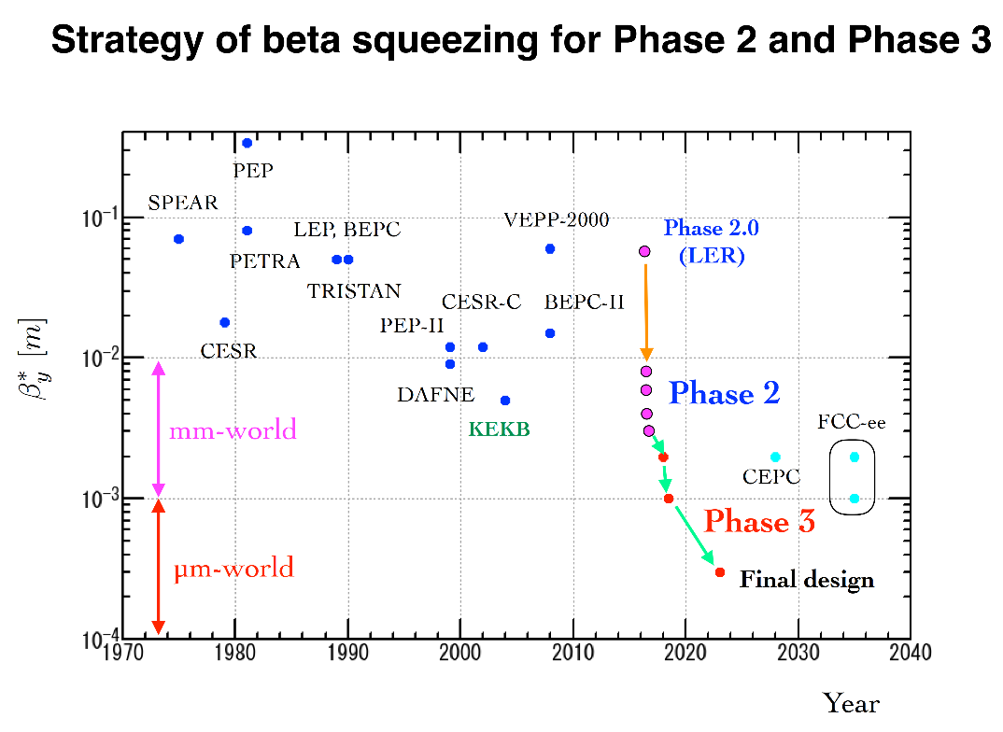

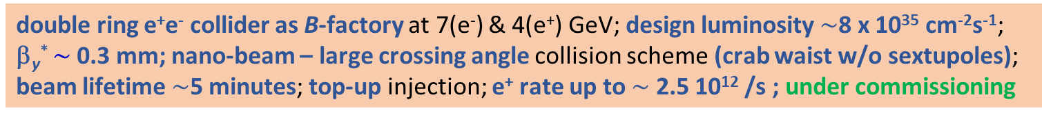
Super KEKB – pushing the frontiers of L & β*
double ring e⁺e⁻ collider as B-factory at 7(e⁻) & 4(e⁺) GeV; design luminosity $\sim$8 x 10³⁵ cm⁻²s⁻¹; β_{y}* $\sim$0.3 mm; nano-beam – large crossing angle collision scheme (crab waist w/o sextupoles); beam lifetime$\sim$5 minutes; top-up injection; e⁺ rate up to $\sim$ 2.5 10¹² /s ; under commissioning
Phase-2 goal of β_{y}* = 3 mm achieved in spring 2018
Further commissioning in progress this year but impacted by budget constraints.
Y. Funakoshi, Y. Ohnishi

Slide 18
Key technology for e⁺e⁻ colliders: RF system
 | f_{RF} [MHz] | #cavities | #cells/cavity | V_{RF,tot} [MV] | acc. gradient [MV/m] | technology
SuperKEKB | 509 | 30 (ARES) 8 (SCC) | 1 1 | 15 12 | 2 6 | warm Cu bulk Nb
charm-tau | 500 | 1 / ring | 1 | 2x1 | 6 | bulk Nb
FCC-ee-H | 400 | 136 / ring | 4 | 2000 | 10 | Nb/Cu
FCC-ee-t (addt’l) | 800 | 372 shared | 5 | 6930 | 19.8 | bulk Nb
CEPC | 650 | 240 shared | 2 | 2200 | 19.7 | bulk Nb
ILC250 | 1,300 | 8,000 | 9 | 250,000 | 31.5 | bulk Nb
ILC1000 | 1,300 | 32,000 | 9 | 1,000,000 | >31.5? | bulk Nb
CLIC380 | 10,000 | 20,368 | 33 | 380,000 | 72 | warm Cu
CLIC3000 | 12,000 | 140,000 | 33 | 3000,000 | 100 | warm Cu
preference for SC cavities,
FCC-ee RF system optimized for each working point, CEPC features single system

Slide 19
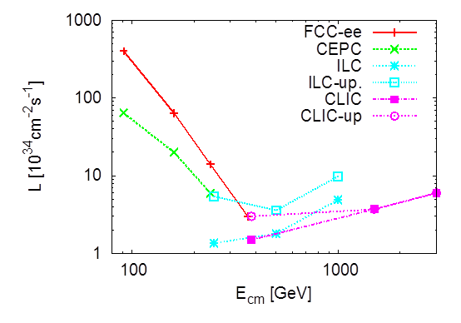
design luminosity vs. energy
Luminosity versus c.m. energy for e+e- Higgs Factories.
Two IPs are assumed for the circular colliders FCC-ee and CEPC.
D. Schulte, B. List

Slide 20
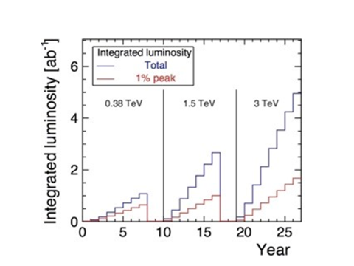
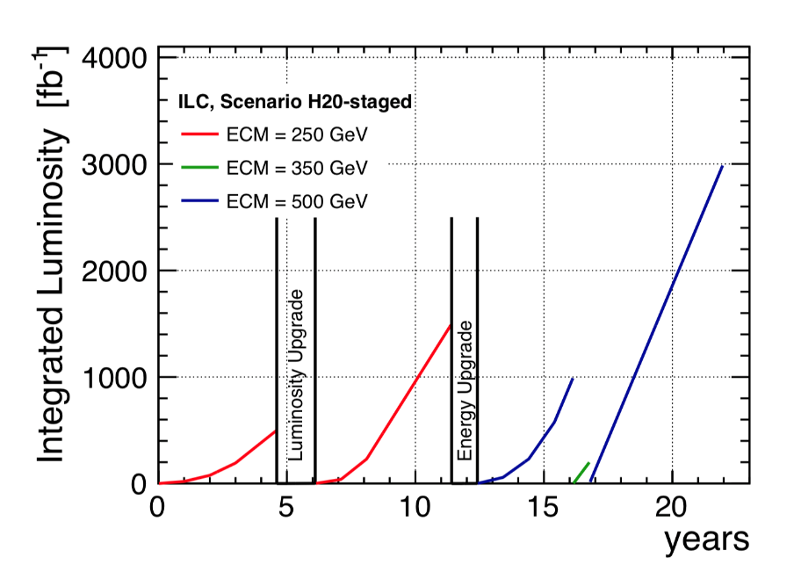
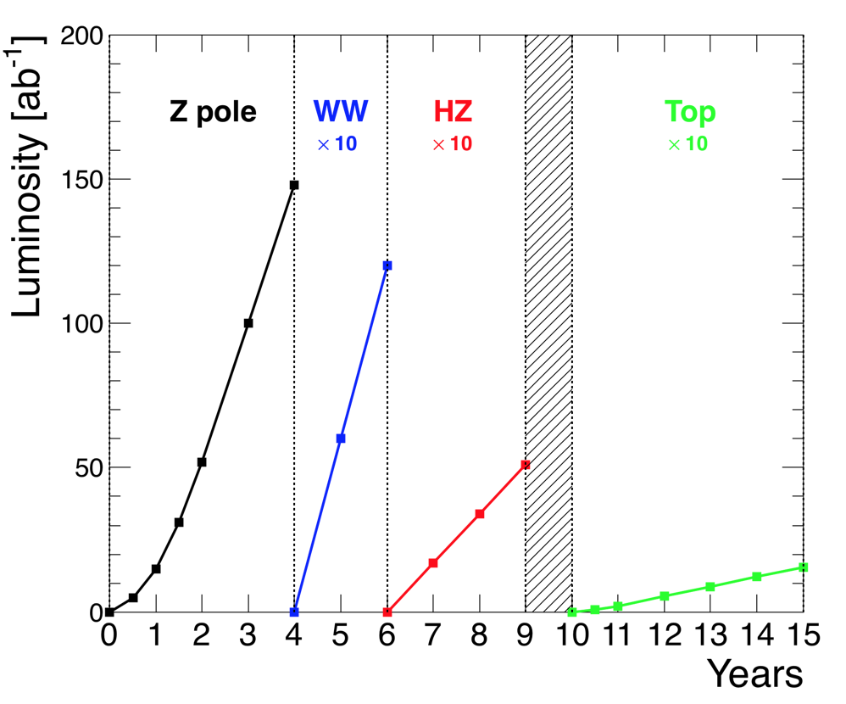
Foreseen integrated luminosities versus year.
ILC
CLIC
FCC

Slide 21
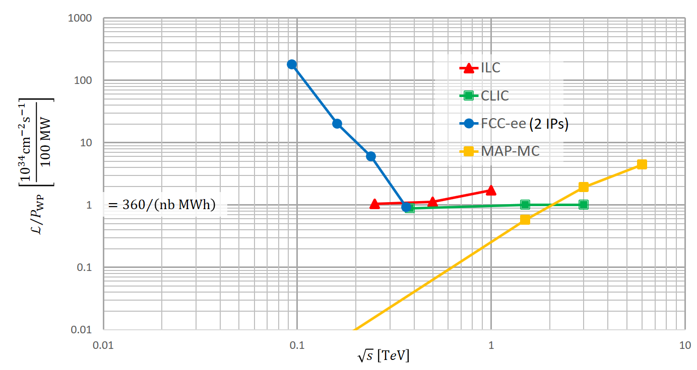
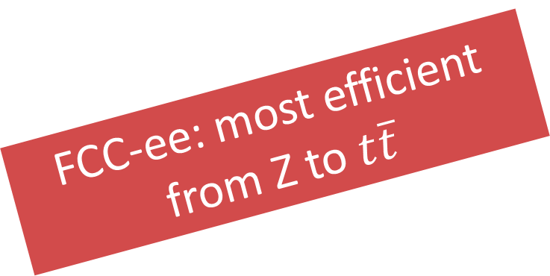
a figure of merit for lepton colliders
FCC-ee: most efficient from Z to $t\overline{t}$
E. Jensen, M. Seidel, EPPSU symposium, Granada

Slide 22
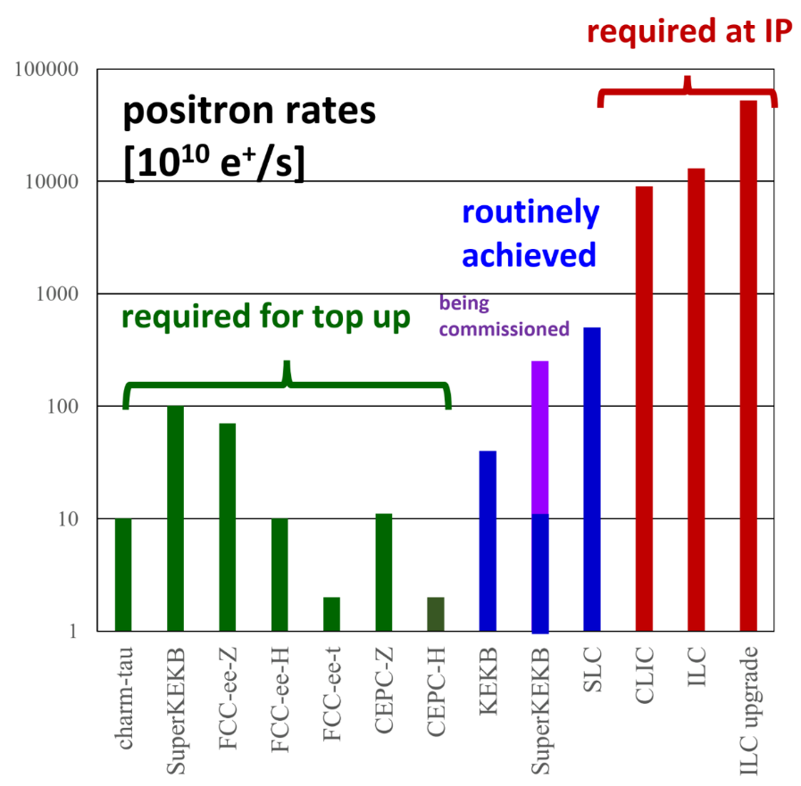
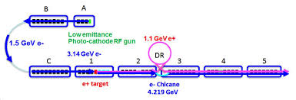
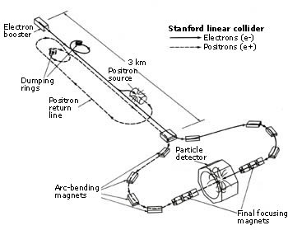
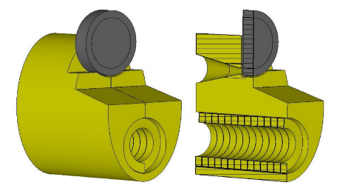
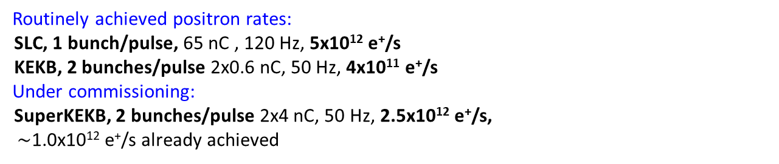
positron challenge
SuperKEKB injector
SLC complex
Routinely achieved positron rates:
SLC, 1 bunch/pulse, 65 nC , 120 Hz, 5x10¹² e⁺/s
KEKB, 2 bunches/pulse 2x0.6 nC, 50 Hz, 4x10¹¹ e⁺/s
Under commissioning:
SuperKEKB, 2 bunches/pulse 2x4 nC, 50 Hz, 2.5x10¹² e⁺/s,
$\sim$1.0x10¹² e⁺/s already achieved
FCC-ee
e⁺ source flux
concentrator
 | FCC-ee | S-KEKB | SLC | CLIC380 | ILC250
e⁺ / s | 7x10¹¹ at Z | 3 x 10¹² | 6 x 10¹² | 10¹⁴ | >2x10¹⁴

Slide 23

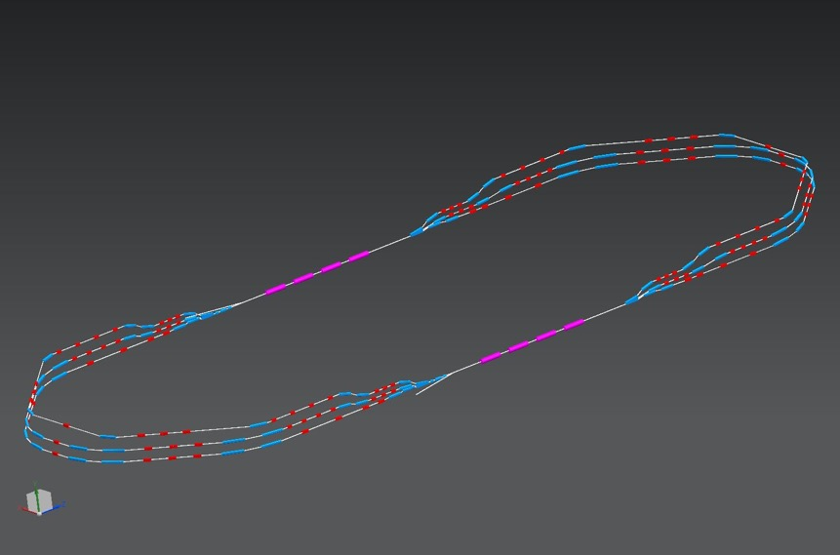
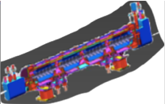
LHeC e-p collider based on the LHC
Superconducting Recirculating Linac with Energy Recovery
⅓ of LHC circumference
two 1 km long, 10 GeV
SC linacs with 3 accelerating and 3 decelerating passes in cw operation
SRF sees 6 times IP beam current (≈ 4ns spacing)
➔ Q₀ > 10¹⁰ required
1 : 3 : 5
944 cavities; 59 cryo modules per linac
ca. 9 km underground tunnel installation
more than 4500 magnets
injector
7 MeV
Multi-pass high-current ERL test facility for LHeC (and FCC-ee-ERL?)
under construction at LAL Orsay
2 : 4 : 6
ΔE = 80 MeV
7 MeV
dump
ΔC = λ_{RF}/2

Slide 24

FCC-ee ERL upgrade – recent proposal from BNL
Green FCC ee w. 10% of R-R power consumption and/or higher performance (luminosity & energy)
V. Litvinenko, T. Roser, M. Chamizo
FCCee
arXiv:1909.04437
not an option for Z and W, but interesting upgrade path towards higher energy (a “bent ILC”)
?
?
ERL based FCC ee at 100 MW SR
ERL based FCC ee at 10 MW SR
*Luminosity scaled linear with SR power – would see other limitations

Slide 25
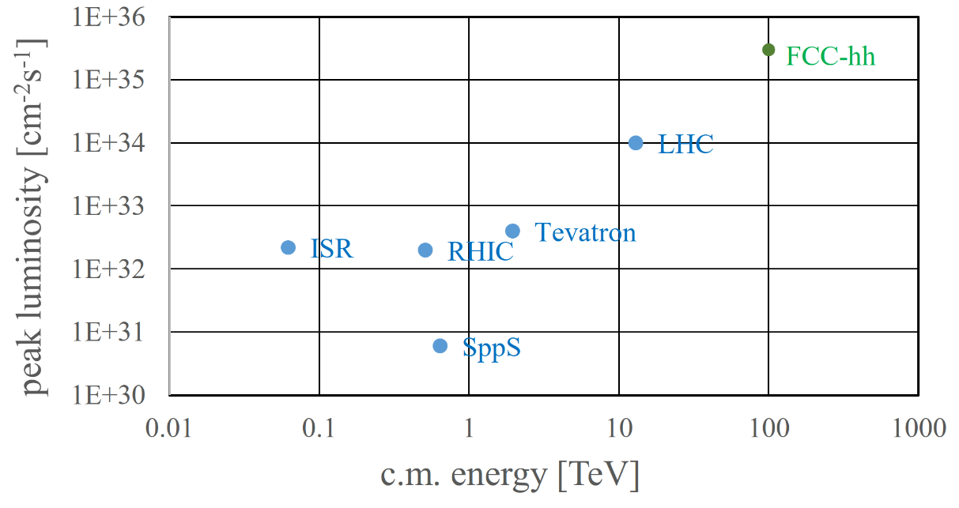






FCC-hh: performance
order of magnitude performance increase in both energy & luminosity
100 TeV cm collision energy (vs 14 TeV for LHC)
20 ab⁻¹ per experiment collected over 25 years of operation (vs 3 ab⁻¹ for LHC)
similar performance increase as from Tevatron to LHC
key technology: high-field magnets
from
LHC technology
8.3 T NbTi
via
HL-LHC technology
11 T Nb₃Sn
to
16 T Nb₃Sn
EuroCirCol, Chart, US MDP
+ BINP

Slide 26


superconductor for 16 T
recent US wires with Artificial Pinning Centres “APCs” have reached FCC target J_{c} (50% above HL-LHC wire) …
… and after less than one year, new suppliers from Japan, Korea and Russia already achieve HL-LHC specification
high B_{c2} (28.8 T at 4.2 K)
X. Xu et al.
FNAL, Hyper Tech Research Inc., and Ohio State
X. Xu et. al. https://arxiv.org/abs/1903.08121 ;
NHMFL, FAMU/FSU:
S. Balachandran et al. https://arxiv.org/ftp/arxiv/papers/1811/1811.08867.pdf

Slide 27

14 T accelerator dipole at FNAL !
→ A. Zlobin et al., NAPAC2019, MOPL020
60-mm aperture
4-layer graded coil
15 T dipole demonstrator
staged approach: In first step pre-stressed for 14 T
second test in fall 2019 with additional pre-stress for 15 T

Slide 28

SPPC layout 2017
coexistence ee, pp, ep
two high-luminosity pp experiments
two other experiments for AA & ep
one (combined) collimation insertion
one RF insertion
extraction insertion
injection insertion
greenfield injector chain
J. Gao
circumference: 100 km
J. Gao, X. Lou, J. Tang

Slide 29

SPPC greenfield injector chain
J. Gao
p-Linac: proton superconducting linac
p-RCS: proton rapid cycling synchrotron
MSS: Medium-Stage Synchrotron
SS: Super Synchrotron
ion beams: dedicated linac (I-Linac) and RCS (I-RCS)

Slide 30

SPPC: wire from Fe-based HTS*
*discovered at TIT/Japan in 2008
Chinese 10-year R&D target
for SPPC collider

Slide 31




D. Contardo
Summary: future e-e collider proposals
e⁺-e⁻ collider projects, technologies and overall designs considered mature (R&D ≃ 5 years)
Linear Colliders: 1 Interaction Point
Circular Colliders: ≥2 Interaction Points
CepC (China)
CLIC (CERN)
ILC (Japan)
FCC (CERN)
  20(30) km 250(500) GeV, 1.3 GHz SCRF cavities 30 MV/m
  11/29/50 km (0.38/1.5/3 TeV), 12 GHz, NCRF X-band 72/100 MV/m, e-drive beams
  100 km, FCC-ee 360 GeV, SCRF
  100 km, CEPC(ee) 240 GeV, SCRF
Technical dates, real start depends on approval time
CepC planning seems optimistic
Planning (from projects) | CepC | ILC | CLIC | FCC-ee
Start construction | 2022 | 2024 | 2026 | 2029
Start physics | 2030 | 2033 | 2035 | 2039
https://indico.cern.ch/event/808335/contributions/3380835/attachments/1845110/3026925/Summary-Accelerators-Granada.pdf

Slide 32


Summary: future h-h collider proposals
D. Contardo
h-h collider projects, timeline/energy can be adjusted to SC magnet R&D progress
  FCC-hh - 100 km 100 TeV, 16 T magnets 2+2 high/low luminosity IPs
  SppC (CepC) 100 km 75/150 TeV, 12/24 T magnets 2 high luminosity IPs
https://indico.cern.ch/event/808335/contributions/3365195/attachments/1842846/3038724/ESPP-Symp-2019-ay-190513bb.pdf

Slide 33


D. Contardo
Possible energy and luminosity scenarios
Cost estimates
2033
2044
2055
4.8/5.3+8 B$ (2012)
*
5B$ (ee)
2030
2040
2035
2043
5.9+5.1+7.3 BCHF
*
11.6+17 BCHF (ee+hh)
24 BCHF (hh only)
2039
2048
2054
2063
* Integrated luminosity for 2 Experiments
In above scenarios FCC-hh and SppC follow e-e colliders
FCC-hh luminosity scenario also includes option for concurrent operation with e-p, Pb-Pb, e-Pb beams
https://indico.cern.ch/event/808335/contributions/3365200/attachments/1843527/3026009/ESPP-Fabiola.pdf
https://indico.cern.ch/event/808335/contributions/3380835/attachments/1845110/3026925/Summary-Accelerators-Granada.pdf

Slide 34

Project timescales (few more scenarios & combinations)
Possible timelines for decisions
Master Plan of Scientific Council of Japan to be officially released May 2020
Chinese Ministery of Science and Technology initial plan 2020, final plan (earliest) 2022
Next European Strategy update 2026
FCC-hh at 100 TeV or HE-LHC at 27 TeV Likely not possible before ≃ 2055

Slide 35
next frontier collider summary table
Project | Type | Energy [TeV] | Int. Lumi. [a⁻¹] | Oper. Time [y] | Power [MW] | Cost
ILC | ee | 0.25 | 2 | 11 | 129 (upgr. 150-200) | 4.8-5.3 GILCU + upgrade
 |  | 0.5 | 4 | 10 | 163 (204) | 7.98 GILCU
 |  | 1.0 |  |  | 300 | ?
CLIC | ee | 0.38 | 1 | 8 | 168 | 5.9 GCHF
 |  | 1.5 | 2.5 | 7 | (370) | +5.1 GCHF
 |  | 3 | 5 | 8 | (590) | +7.3 GCHF
CEPC | ee | 0.091+0.16 | 16+2.6 |  | 149 | 5 G$
 |  | 0.24 | 5.6 | 7 | 266
FCC-ee | ee | 0.091+0.16 | 150+10 | 4+1 | 259 | 10.5 GCHF
 |  | 0.24 | 5 | 3 | 282
 |  | 0.365 (+0.35) | 1.5 (+0.2) | 4 (+1) | 340 | +1.1 GCHF
LHeC | ep | 60 / 7000 | 1 | 12 | (+100) | 1.75 GCHF
FCC-hh | pp | 100 | 30 | 25 | 580 (550) | 17 GCHF (+7 GCHF)
HE-LHC | pp | 27 | 20 | 20 |  | 7.2 GCHF
1 GILCU=10⁹ ILC Units= 1G$ 2012; 5 GILCU = 5.6 US$ 2019 ~ 5 GEuro 2019
D. Schulte
XFEL cost (17 GeV SC linac) = 1.51 GEuro (in 2019 Euro) vs. 250 GeV ILC at 5 GEuro?
15x the energy for 3x the price? CEPC cost limited to 5 G$ …

Slide 36

tentative extended technical timelines for various collider projects (V. Shiltsev, F.Z.)
comparable assumptions?

Slide 37

my opinion / thoughts
If an ultimate goal is to go to much higher energy with a hadron collider, FCC-ee (or CEPC) is the optimum springboard (similar to LEP / LHC)
FCC-ee is based on established technologies; promises optimum performance from 90 to 365 GeV; possible ERL upgrade path to higher energy to be studied
Circular machines also represent a much “greener” technology; the same particles and beam energies are reused over many collisions
Linear colliders are more difficult, entering unknown accelerator territory (many lessons learnt at the SLC, but surely many more to learn); but they promise the best performance from $\sim$ttbar upwards up to 1 TeV or 3 TeV; they could be exciting if there is physics in this energy range; much higher risk of “failure” (luminosity performance [final focus, e+ source, IP tuning, damping ring,…], cost, resources, physics,…); brilliant playground for accelerator physicists; they provide little or no preparation for a hadron collider ; I have worked on HERA, SLC, FFTB, ATF-2, PEP-II, KEKB, LEP and LHC; all the circular machines ran beautifully, while spot sizes at SLC, FFTB & ATF2 never fully understood and design parameters not achieved
Plasma or muon colliders not an option for the next machine at CERN, but I think we should consider some muon beam R&D (eg. nuStorm , cooling studies,….)
Finally, if China builds a large circular tunnel, what are we going to do in Europe?

Slide 38
spare slides

Slide 39

V. Shiltsev

Slide 40

FCC-ee machine evolution and RF staging
“Ampere-class” machine
three sets of RF cavities to cover all options for FCC-ee & booster:
high intensity (Z, FCC-hh): 400 MHz mono-cell cavities (4/cryom.)
higher energy (W, H, t): 400 MHz four-cell cavities (4/cryomodule)
ttbar machine complement: 800 MHz five-cell cavities (4/cryom.)
installation sequence comparable to LEP ( ≈ 30 CM/shutdown)
WP | V_{rf} [GV] | #bunches | I_{beam} [mA]
Z | 0.1 | 16640 | 1390
W | 0.44 | 2000 | 147
H | 2.0 | 393 | 29
ttbar | 10.9 | 48 | 5.4
“high-gradient” machine
O. Brunner

Slide 41
comparison of parameters FCC-ee & ILC
Parameter | LEP2 | FCC-ee |  |  | ILC
 |  | Z | H | t | H | 500 | 1 TeV
E (GeV) | 104 | 45.6 | 120 | 182.5 | 125 | 250 | 500
<I (mA)> | 4 | 1390 | 29 | 5.4 | 0.021 | 0.021 | 0.021
P _{SR/b,tot} [MW] | 22 | 100 | 100 | 100 | 5.9 | 10.5 | 27.2
P_{AC} [MW] | ~200 | ~260 | ~280 | ~360 | ~129 | ~163 | ~300
η_{wall→beam} [%] | ~30 | 30-40 | 30-40 | ~30 | 4.6 | 6.4 | 9.1
N_{bunch/ring (pulse)} | 4 | 16’640 | 328 | 48 | 1312 | 1312 | 2450
f_{coll} (kHz) | 45 | 50000 | 4000 | 294 | 6.6 | 6.6 | 9.8
β*_{x/y} (m/mm) | 1.5/ 50 | 0.15 /.8 | 0.3 /1 | 1.0/1.6 | .013/.41 | .011/.48 | .011/.48
ε_{x} (nm) | 30-50 | 0.27 | 0.63 | 1.46 | 0.04 | 0.02 | 0.01
ε_{y} (pm) | ~250 | 1 | 1.3 | 2.9 | 0.14 | 0.07 | 0.03
ξ_{y} (ILC: n_{γ}) | 0.07 | 0.13 | 0.12 | 0.126 | (1.91) | (1.72) | (2.12)
n_{IP} | 4 | 2 | 2 | 2 | 1 | 1 | 1
L_{0.01}/IP | 0.012 | 230 | 8.5 | 1.55 | 0.5 | 1.05 | 2.2
L_{0.01,tot} (10³⁴ cm⁻²s⁻¹) | 0.048 | 460 | 17 | 3.1 | 0.5 | 1.05 | 2.2

Slide 42
LHeC 10³⁴ cm⁻² s⁻¹ Luminosity reach | PROTONS | ELECTRONS
Beam Energy [GeV] | 7000 | 60
Luminosity [10³³cm⁻²s⁻¹] | 16 | 16
Normalized emittance γε_{x,y} [μm] | 2.5 | 20
Beta Funtion β∗_{x,y} [m] | 0.05 | 0.10
rms Beam size σ∗_{x,y} [μm] | 4 | 4
rms Beam divergence σ∗_{x,y} [μrad] | 80 | 40
Beam Current @ IP[mA] | 1112 | 25
Bunch Spacing [ns] | 25 | 25
Bunch Population | 2.2*10¹¹ | 4*10⁹
Bunch charge [nC] | 35 | 0.64
Over 600MW Beam power in electron Beam!!!
ERL is a must for efficient operation!!!
O. Brüning

Slide 43


early linear-collider proposals
Maury Tigner, “A Possible Apparatus for Clashing-Beam Experiments”, Nuovo Cimento 37, 1228 (1965)
these early proposal always
recovered the energy of the spent beam!
Ugo Amaldi, “A possible scheme to obtain e-e- and e+e- collisions at energies of hundreds of GeV”, Physics Letters B61, 313 (1976)

Slide 44

LEP/LEP2: highest energy so far
circumference 27 km
in operation from 1989 to 2000
maximum c.m. energy 209 GeV
maximum synchrotron radiation power 23 MW
LEP energy close to FCC-ee target + record synchrotron radiation with ~MeV photons

Slide 45


“An e⁺-e ⁻ storage ring in the range of a few hundred GeV in the centre of mass can be built with present technology. ...would seem to be ... most useful project on the horizon.”
(original LEP proposal, 1976)
Burt Richter
1976
350 GeV c.m.
↔
~90 km
cost-optimized
circumference
B. Richter, Very High Energy Electron-Positron Colliding Beams for the Study of Weak Interactions, NIM 136 (1976) 47-60

Slide 46



SLC: the first & so far only linear collider
20 pb⁻¹ from 1989 to 1998
Burton Richter et al, “The Stanford Linear Collider”, 11th Int. Conf. on High-Energy Accelerators, CERN (1980)

Slide 47

commissioning time & performance of the first linear collider
LEP1
(per IP)
LEP1 design
SLC design
SLC
CERN-SL-2002- 009 (OP), SLAC–PUB–8042 [K. Oide, 2013]
SLC
½ design value reached after 11 years

