Slide 1







Status and Plans of the FCC
Michael Benedikt, CERN
on behalf of the FCC collaboration
LHC
PS
SPS
FCC
http://cern.ch/fcc
Work supported by the European Commission under the HORIZON 2020 projects EuroCirCol, grant agreement 654305; EASITrain, grant agreement no. 764879; ARIES, grant agreement 730871; and E-JADE, contract no. 645479
photo: J. Wenninger
photo: J. Wenninger

Slide 2

FCC integrated program

Slide 3
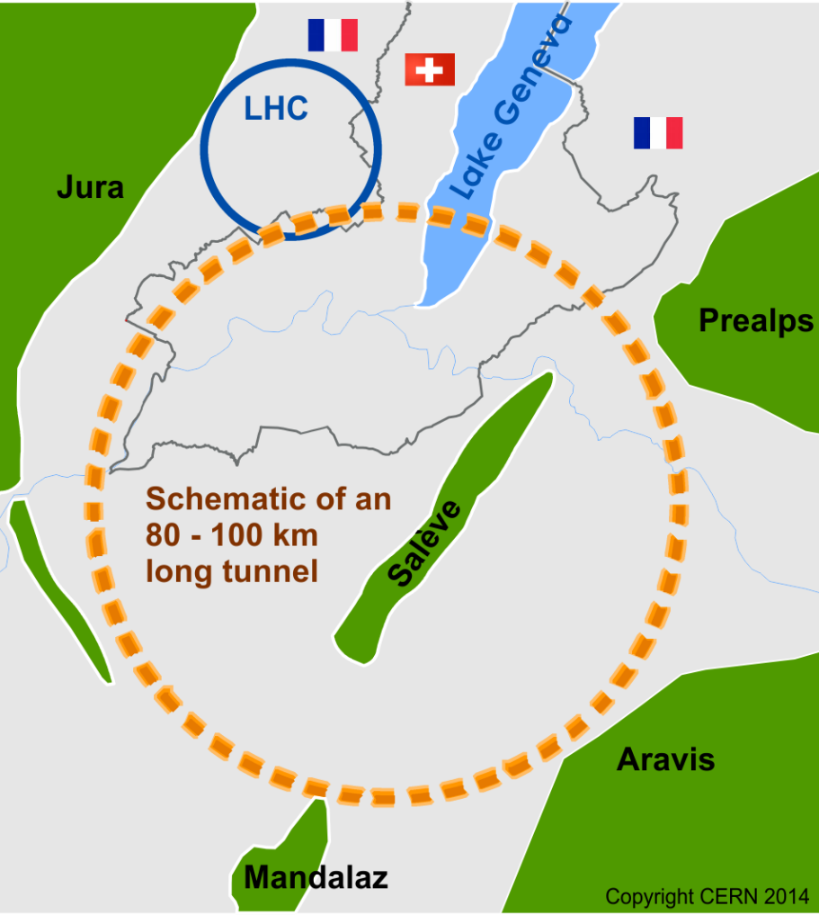
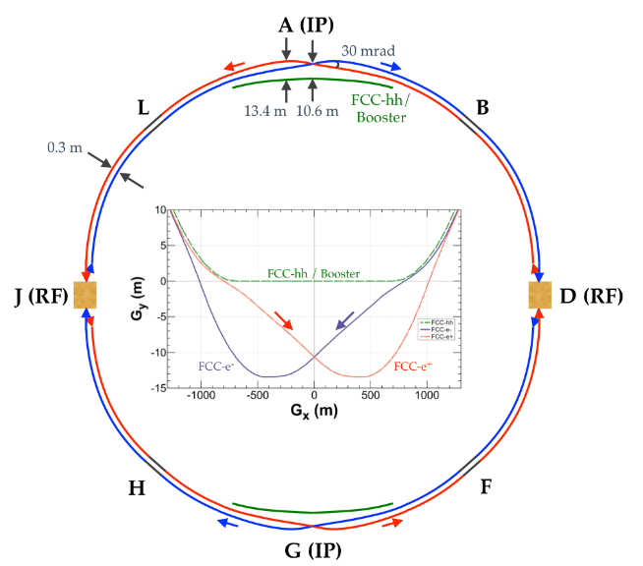
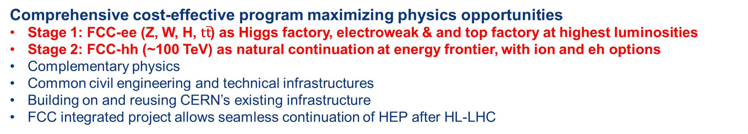
The FCC integrated program
inspired by successful LEP – LHC programs at CERN
Comprehensive cost-effective program maximizing physics opportunities
Stage 1: FCC-ee (Z, W, H, $\text{t}\overline{\text{t}}$) as Higgs factory, electroweak & and top factory at highest luminosities
Stage 2: FCC-hh (~100 TeV) as natural continuation at energy frontier, with ion and eh options
Complementary physics
Common civil engineering and technical infrastructures
Building on and reusing CERN’s existing infrastructure
FCC integrated project allows seamless continuation of HEP after HL-LHC
FCC-ee
FCC-hh
Notes:
The FCC study and program comprises of two accelerators: the Lepton Collider FCC-ee and the Hadron Collider FCC-hh.
The aim of this setup is devise a comprehensive, cost-effective program to maximizing the physics opportunities.

Slide 4
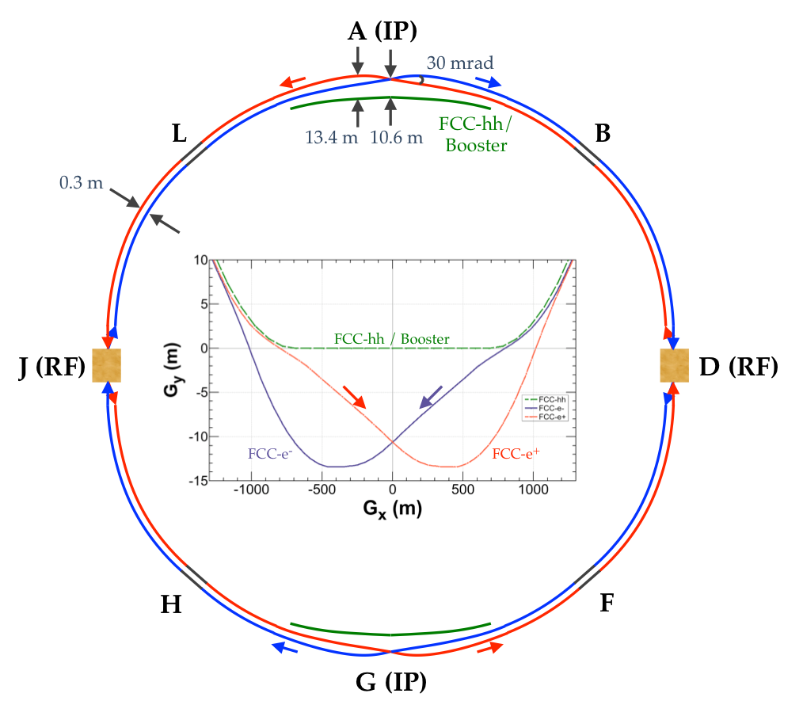
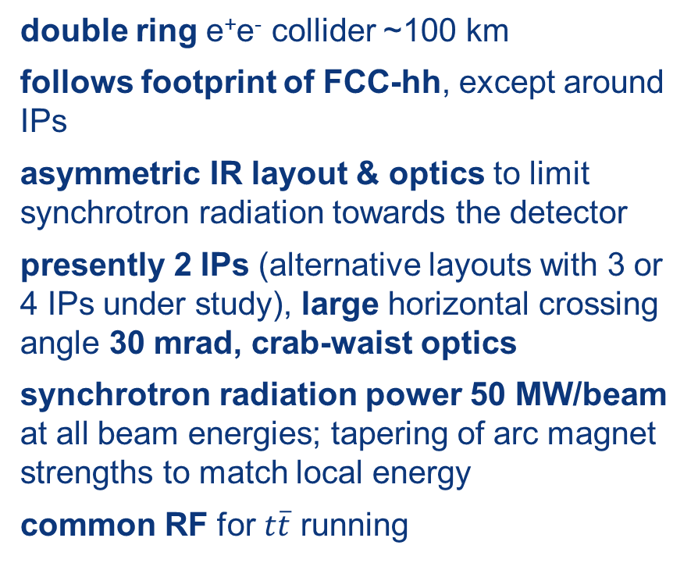
FCC-ee basic design choices
double ring e⁺e⁻ collider ~100 km
follows footprint of FCC-hh, except around IPs
asymmetric IR layout & optics to limit synchrotron radiation towards the detector
presently 2 IPs (alternative layouts with 3 or 4 IPs under study), large horizontal crossing angle 30 mrad, crab-waist optics
synchrotron radiation power 50 MW/beam at all beam energies; tapering of arc magnet strengths to match local energy
common RF for $t\overline{t}$ running
K. Oide et al.
top-up injection requires booster synchrotron in collider tunnel
FCC-ee: The Lepton Collider, Eur. Phys. J. Spec. Top. 228, 261–623 (2019)
K. Oide et al., Phys. Rev. Accel. Beams 19, 111005 (2016)

Slide 5
FCC-ee Collider Parameters
parameter | Z | WW | H (ZH) | ttbar
beam energy [GeV] | 45 | 80 | 120 | 182.5
beam current [mA] | 1390 | 147 | 29 | 5.4
no. bunches/beam | 16640 | 2000 | 393 | 48
bunch intensity [10¹¹] | 1.7 | 1.5 | 1.5 | 2.3
SR energy loss / turn [GeV] | 0.036 | 0.34 | 1.72 | 9.21
total RF voltage [GV] | 0.1 | 0.44 | 2.0 | 10.9
long. damping time [turns] | 1281 | 235 | 70 | 20
horizontal beta* [m] | 0.15 | 0.2 | 0.3 | 1
vertical beta* [mm] | 0.8 | 1 | 1 | 1.6
horiz. geometric emittance [nm] | 0.27 | 0.28 | 0.63 | 1.46
vert. geom. emittance [pm] | 1.0 | 1.7 | 1.3 | 2.9
bunch length with SR / BS [mm] | 3.5 / 12.1 | 3.0 / 6.0 | 3.3 / 5.3 | 2.0 / 2.5
luminosity per IP [10³⁴ cm⁻²s⁻¹] | 230 | 28 | 8.5 | 1.55
beam lifetime rad Bhabha / BS [min] | 68 / >200 | 49 / >1000 | 38 / 18 | 40 / 18

Slide 6
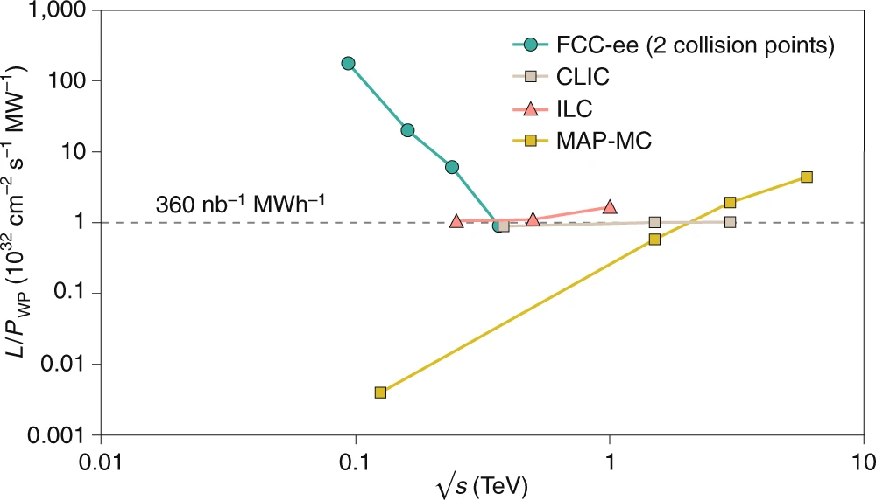

FCC-ee: efficient Higgs/electroweak factory
Luminosity L per supplied electrical wall-plug power P_{WP} is shown as a function of centre-of-mass energy for several proposed future lepton colliders.
Z
91 GeV
WW
160 GeV
ZH
240 GeV
$\text{t}\overline{\text{t}}$
350-365 GeV
€200 electricity cost
per Higgs boson
M. Benedikt, A. Blondel, P. Janot, et al., Nat. Phys. 16, 402-407 (2020), and
European Strategy for Particle Physics Preparatory Group, Physics Briefing Book (CERN, 2019)

Slide 7
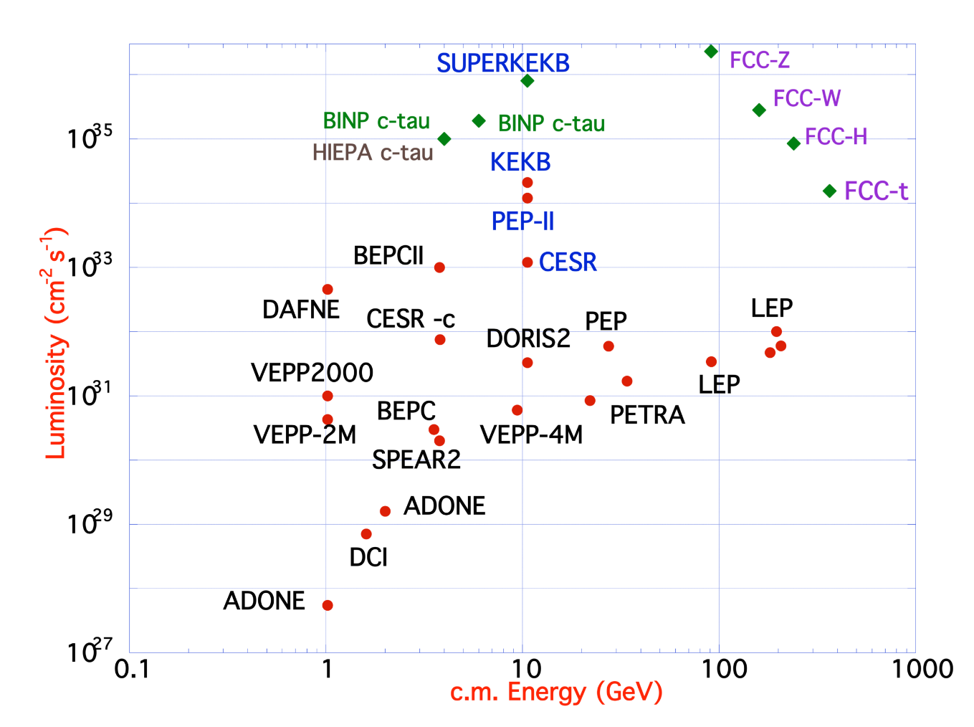
FCC-ee design concept
based on lessons and techniques from past colliders
B-factories: KEKB & PEP-II:
double-ring lepton colliders,
high beam currents,
top-up injection
DAFNE: crab waist, double ring
S-KEKB: low β_{y}*, crab waist
LEP: high energy, SR effects
VEPP-4M, LEP: precision E calibration
KEKB: e⁺ source
HERA, LEP, RHIC: spin gymnastics
Marica Biagini
Marica Biagini
combining successful ingredients of several recent colliders → highest luminosities & energies

Slide 8
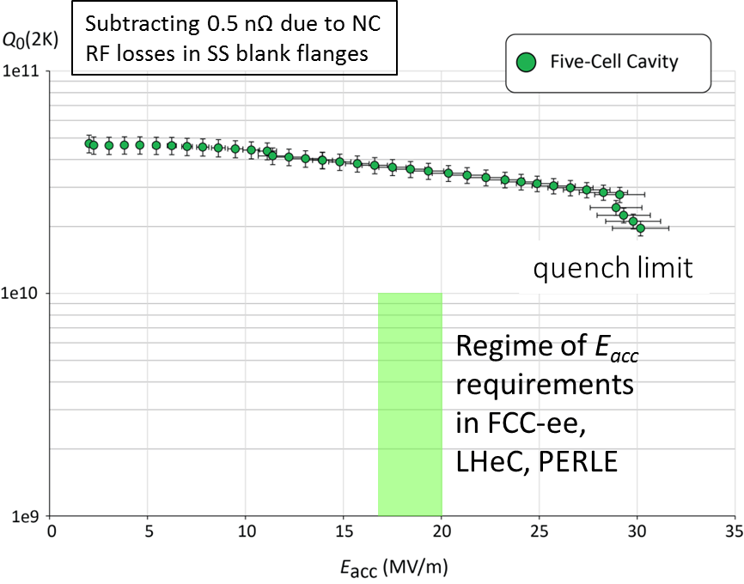
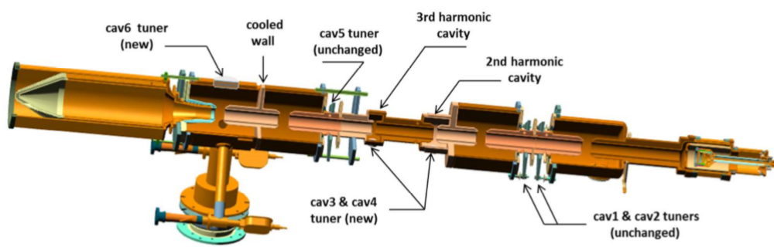

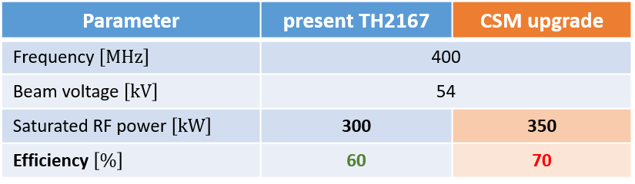
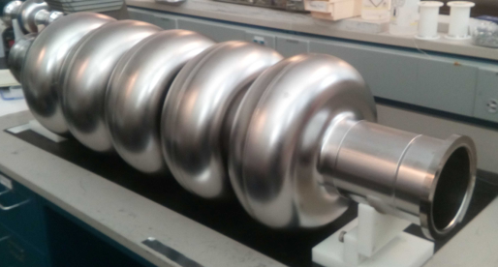
FCC-ee R&D: RF, cryo-modules, power sources
R&D aimed at improving performance & efficiency and reducing cost:
  improved Nb/Cu coating/sputtering, partner STFC (e.g. ECR fibre growth, HiPIMS)
  new cavity fabrication techniques, partner STFC (e.g. EHF, improved polishing, seamless)
  coating of A15 superconductors (e.g. Nb₃Sn), ∙ cryo-module design optimisation
  bulk Nb cavity R&D at FNAL, JLAB, Cornell, also KEK and CEPC/IHEP
  MW-class fundamental power couplers for 400 MHz; ∙ novel high-efficiency klystrons
prototype FCC SRF cavities at JLAB
high-efficiency klystron at CERN
New klystron bunching methods:
LHC klystron retrofit as proof of principle for FCC
800 MHz 5-cell Nb
prototype / JLAB

Slide 9
FCC-hh (pp) collider parameters
parameter | FCC-hh |  | HL-LHC | LHC
collision energy cms [TeV] | 100 |  | 14 | 14
dipole field [T] | 16 |  | 8.33 | 8.33
circumference [km] | 97.75 |  | 26.7 | 26.7
beam current [A] | 0.5 |  | 1.1 | 0.58
bunch intensity [10¹¹] | 1 | 1 | 2.2 | 1.15
bunch spacing [ns] | 25 | 25 | 25 | 25
synchr. rad. power / ring [kW] | 2400 |  | 7.3 | 3.6
SR power / length [W/m/ap.] | 28.4 |  | 0.33 | 0.17
long. emit. damping time [h] | 0.54 |  | 12.9 | 12.9
beta* [m] | 1.1 | 0.3 | 0.15 (min.) | 0.55
normalized emittance [μm] | 2.2 |  | 2.5 | 3.75
peak luminosity [10³⁴ cm⁻²s⁻¹] | 5 | 30 | 5 (lev.) | 1
events/bunch crossing | 170 | 1000 | 132 | 27
stored energy/beam [GJ] | 8.4 |  | 0.7 | 0.36

Slide 10
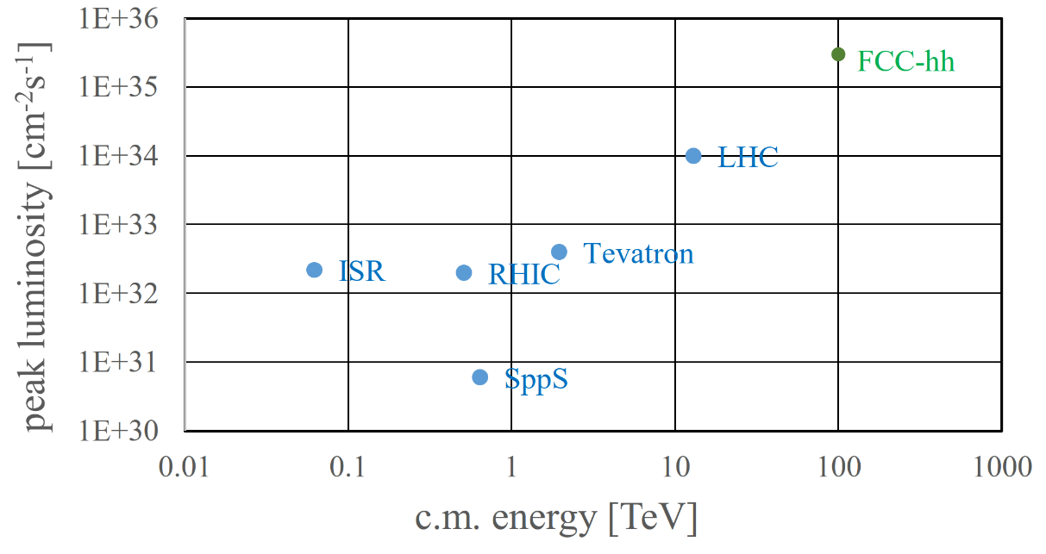
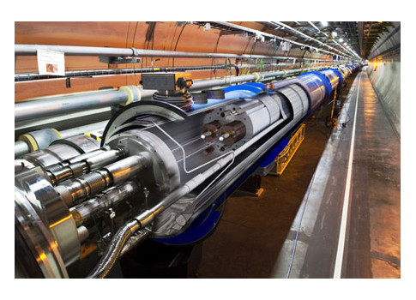
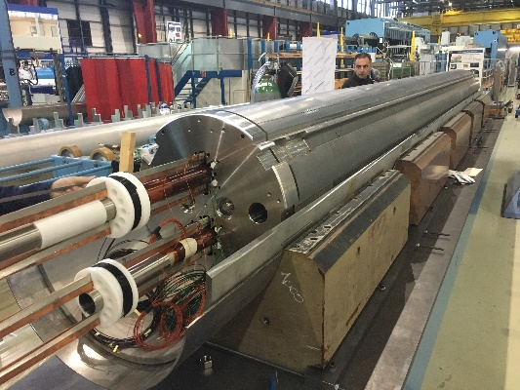
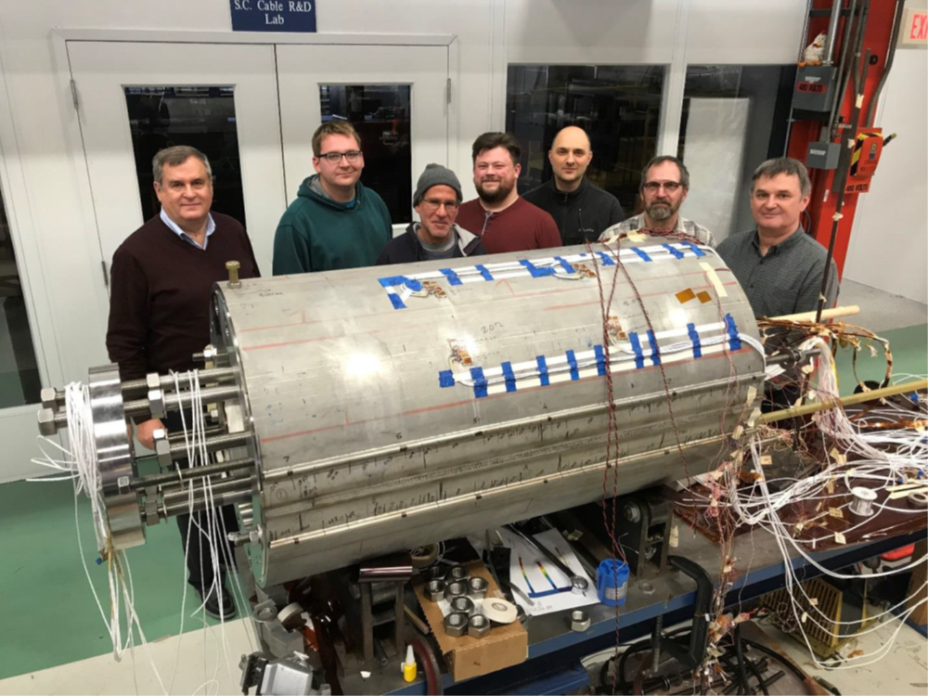
FCC-hh: performance
order of magnitude performance increase in both energy & luminosity
100 TeV cm collision energy (vs 14 TeV for LHC)
20 ab⁻¹ per experiment collected over 25 years of operation (vs 3 ab⁻¹ for LHC)
similar performance increase as from Tevatron to LHC
key technology: high-field magnets
from
LHC technology
8.3 T NbTi
via
HL-LHC technology
11 T Nb₃Sn
FNAL demonstrator
14.5 T Nb₃Sn

Slide 11
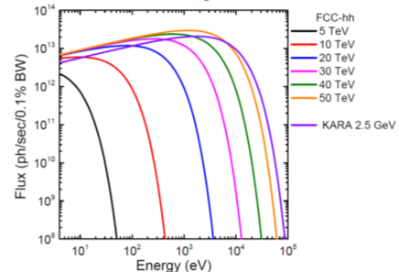
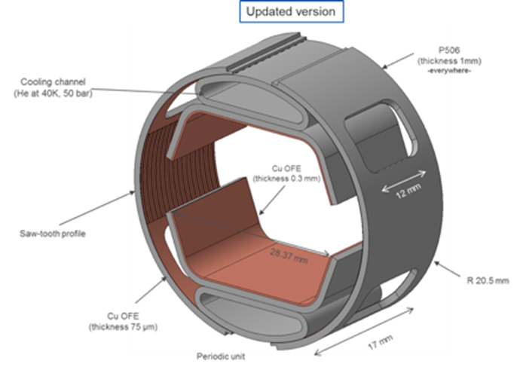
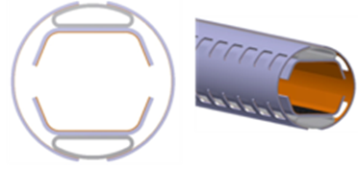





FCC-hh: synchrotron radiation (SR) challenge
synchrotron radiation (~ 30 W/m/beam (@16 T field) (cf. LHC <0.2W/m)
~ 5 MW total SR power in arcs from proton beams, emitted inside the cold magnets
strategy: absorption of synchrotron radiation on “beam screen” at higher temperature (> 1.9 K) for cryogenic efficiency; optimum FCC-hh beam screen temperature 40-60 K (cf. LHC 5-20 K) ; beam screen also provides beam vacuum, must suppress electron cloud effect, impedance, etc.
novel “double” beam screen: low impedance, large cooling channels, adequate vacuum pumping, absorption of photo-electrons
test at ANKA/KARA
beamscreen tests with real SR at KIT
photon spectrum of
ANKA/KARA light source
= photon spectrum in
FCC-hh arcs
I. Bellafont et al., Phys. Rev. Accel. Beams 23, 033201 (2020)
I. Bellafont et al, Phys. Rev. Accel. Beams 23, 043201 (2020)

Slide 12
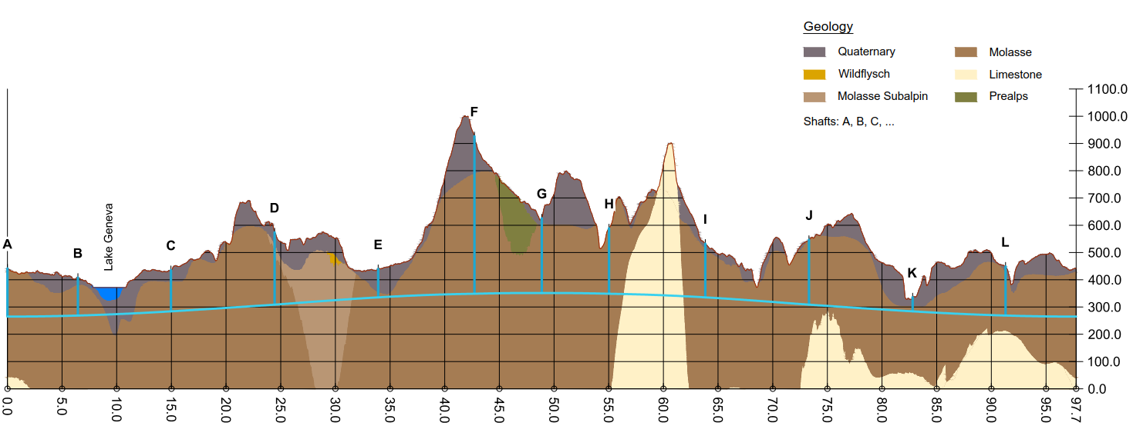
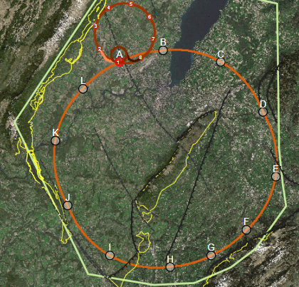
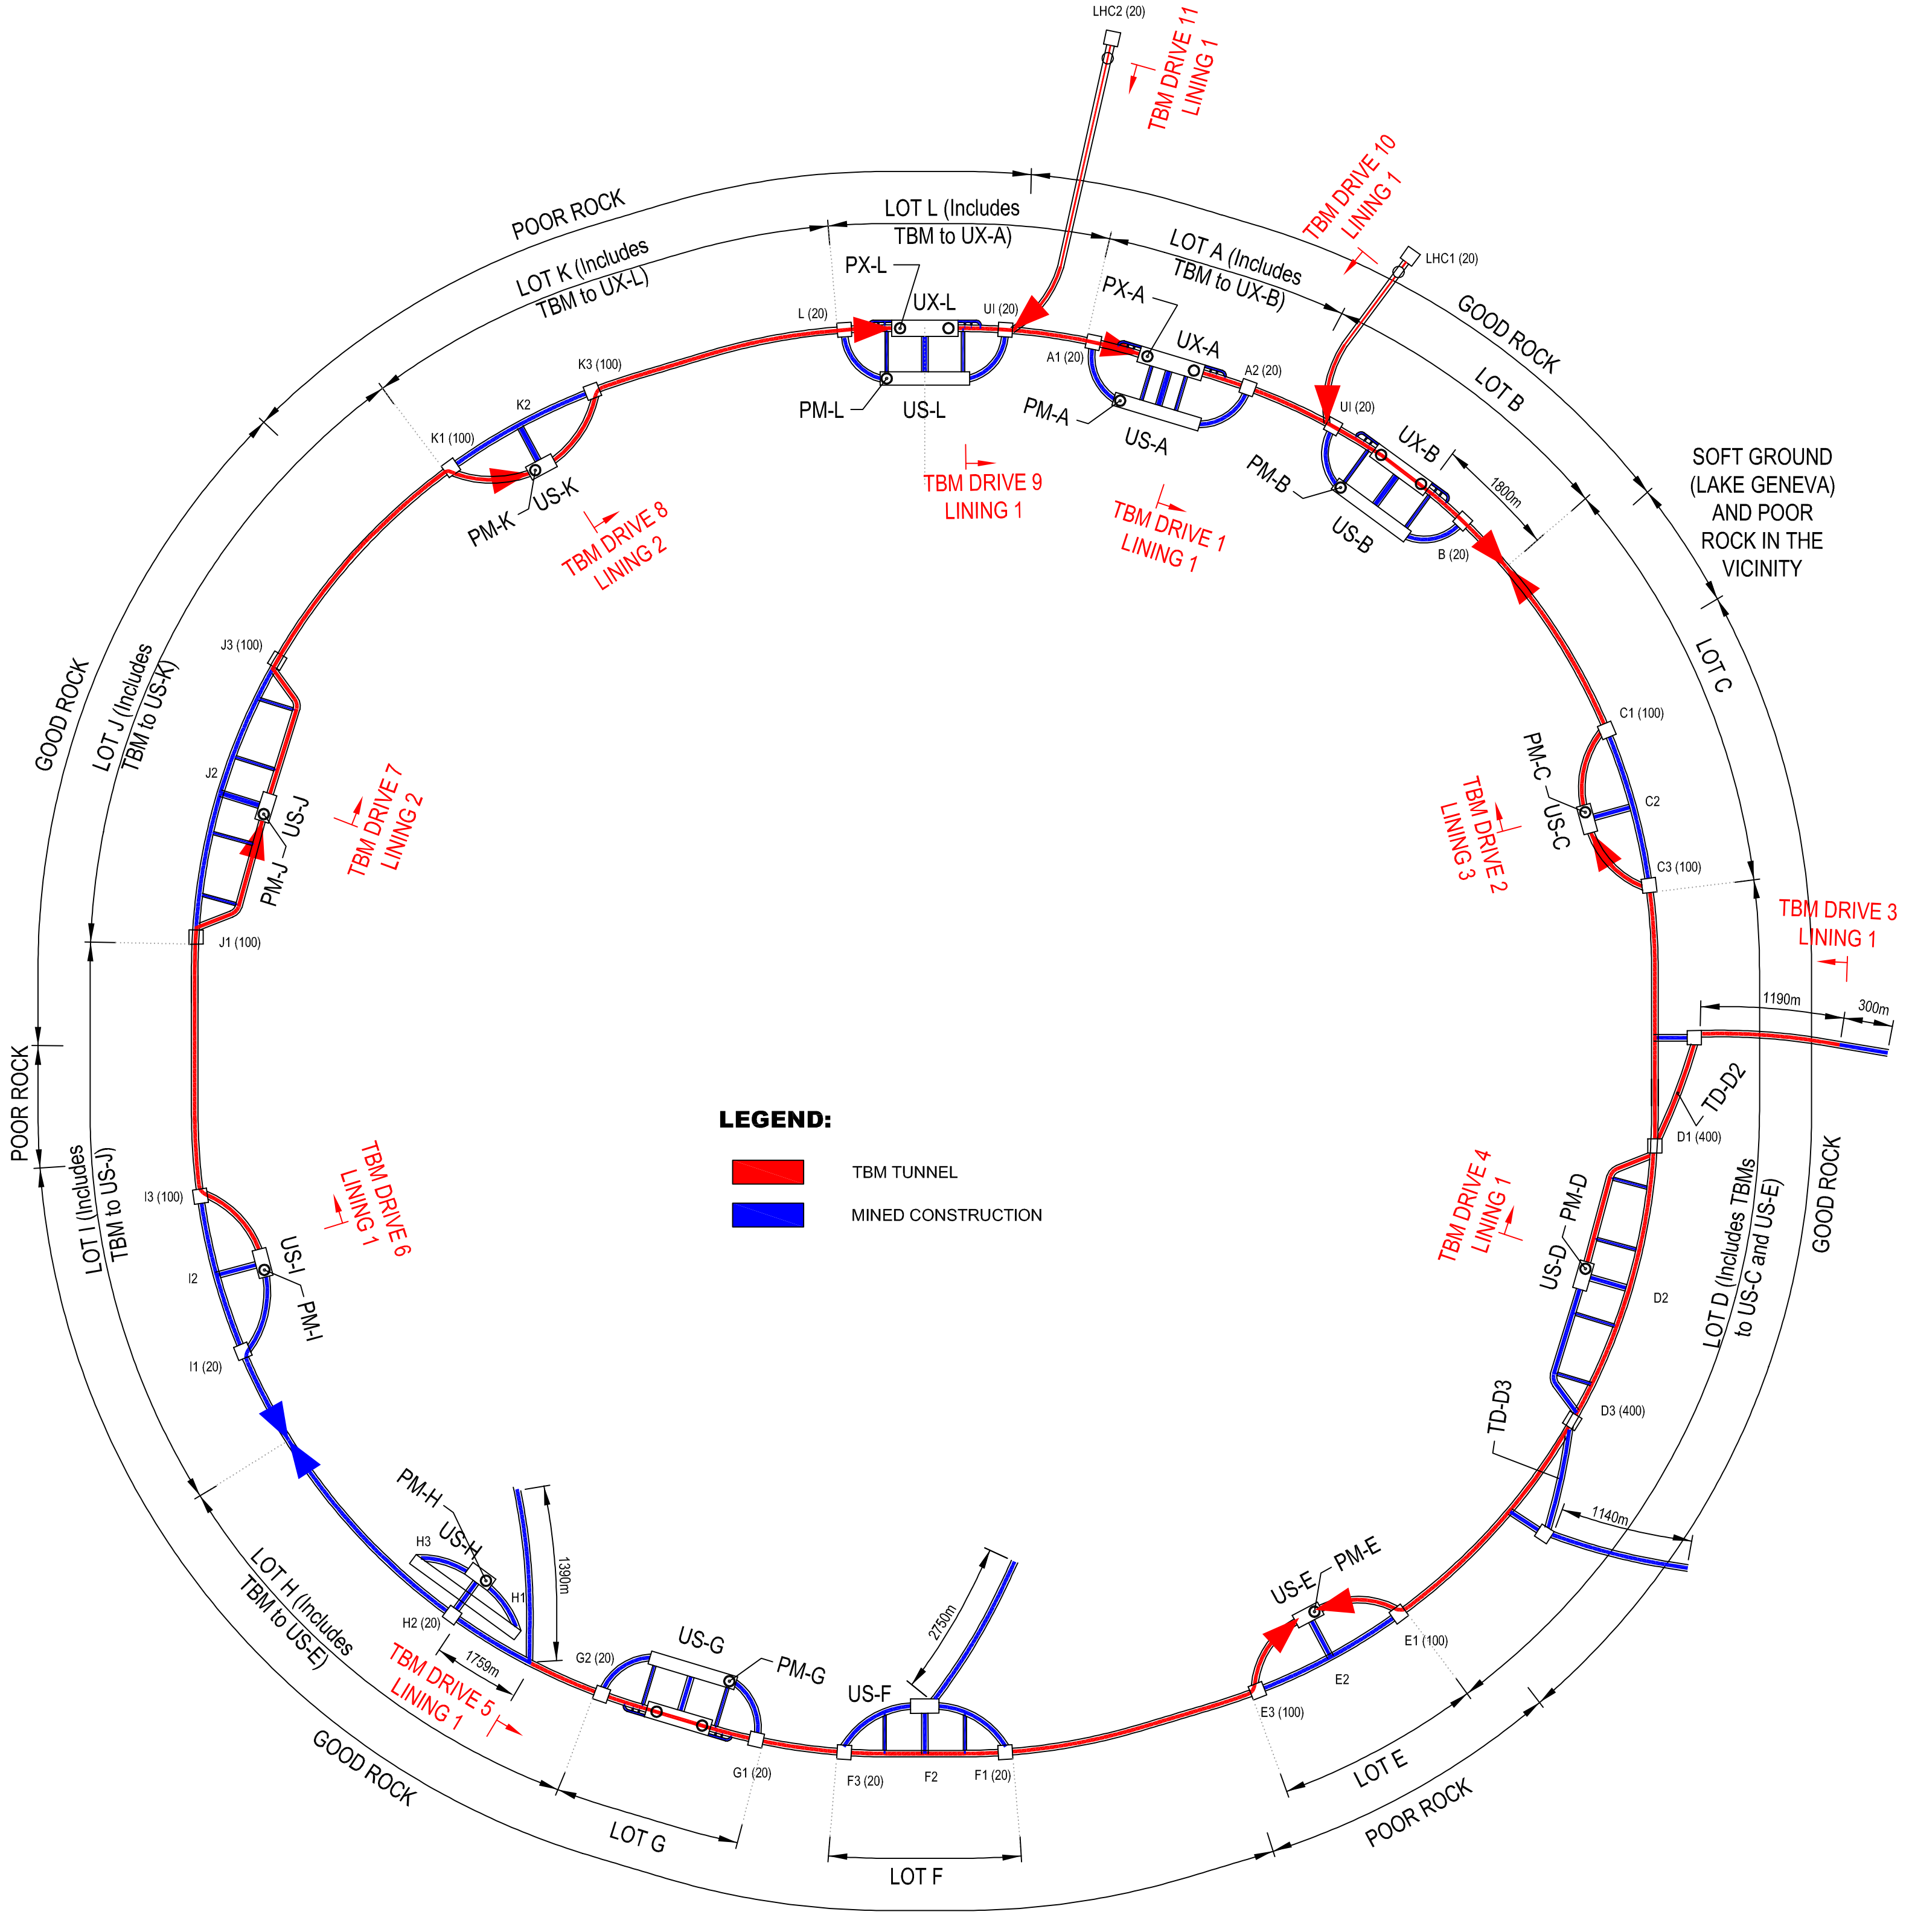
FCC implementation - footprint baseline
Present baseline position was established considering:
lowest risk for construction, fastest and cheapest construction
feasible positions for large span caverns (most challenging structures)
More than 75% tunnel in France, 8 (9) / 12 access points in France.
next step: review of surface site locations and machine layout

Slide 13
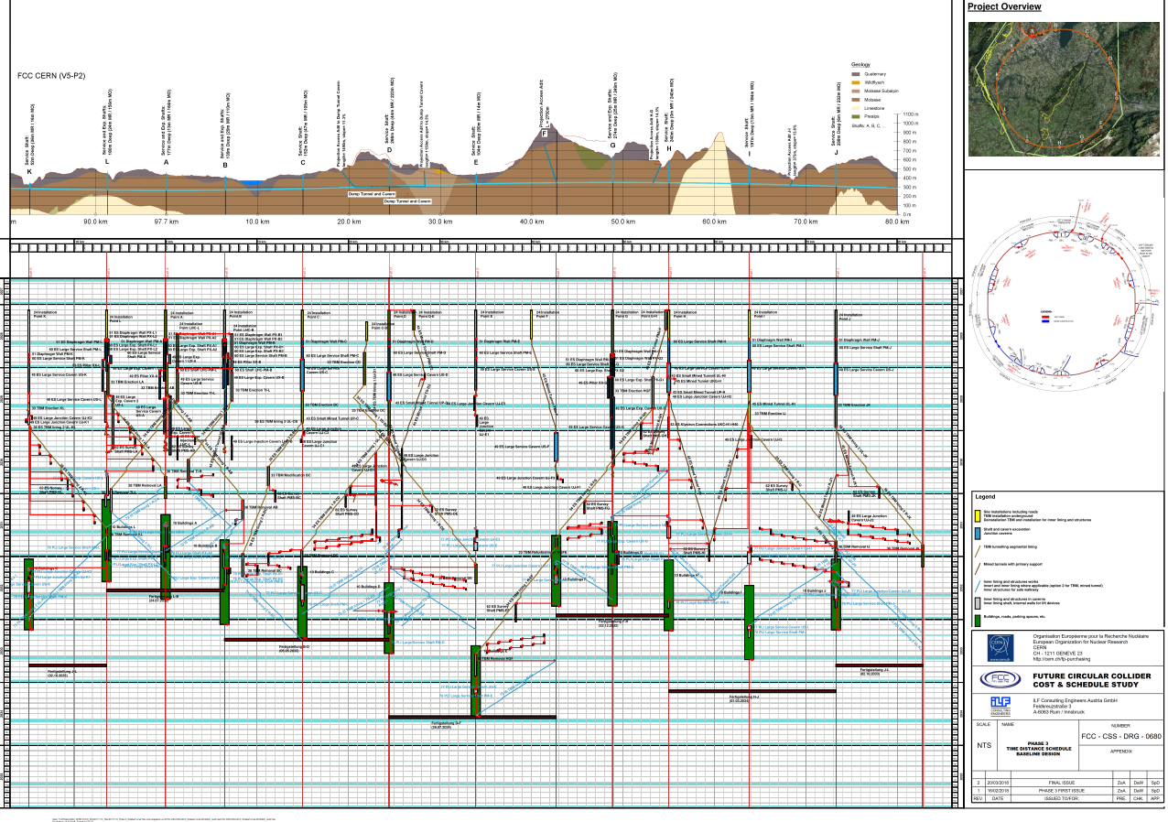
Civil Engineering studies
4.5yrs
6.5yrs
Total construction duration 7 years
First sectors ready after 4.5 years

Slide 14
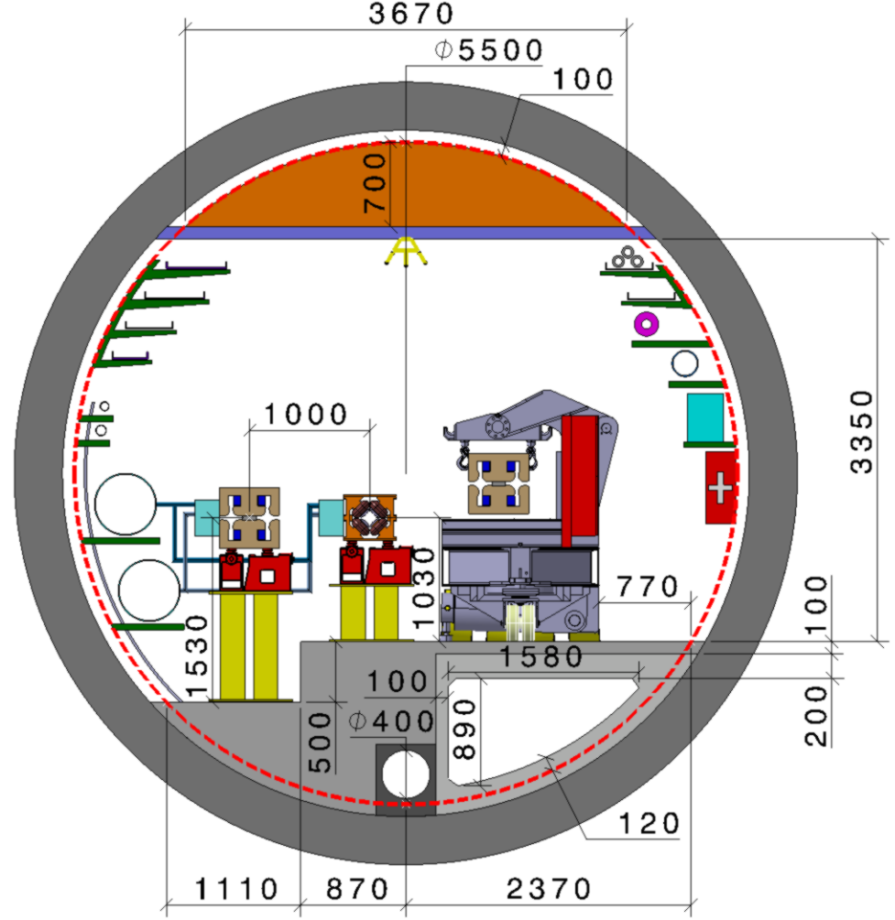
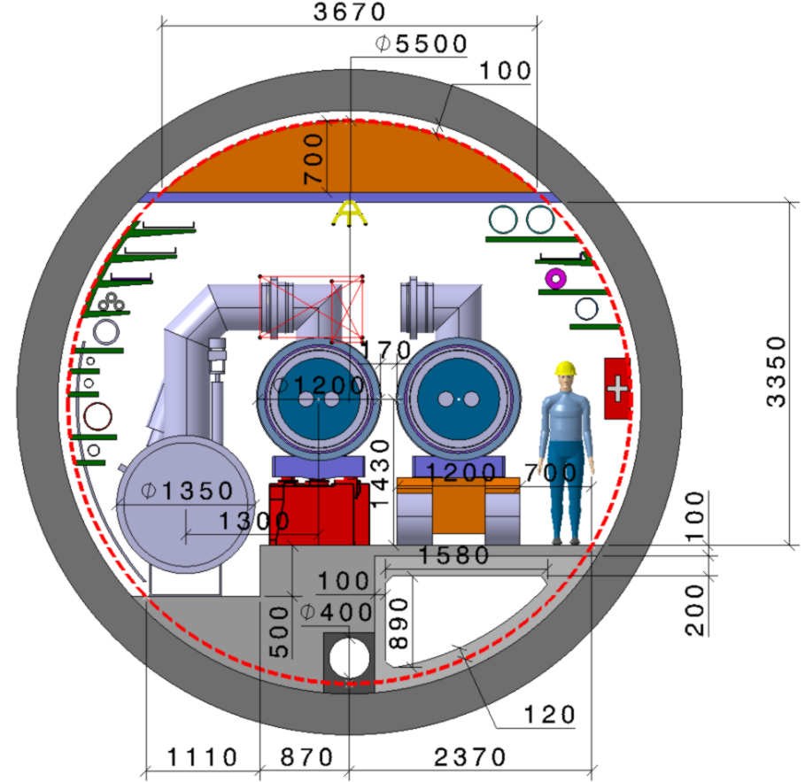
FCC-tunnel integration in arcs
  FCC-ee FCC-hh
  5.5 m inner diameter

Slide 15
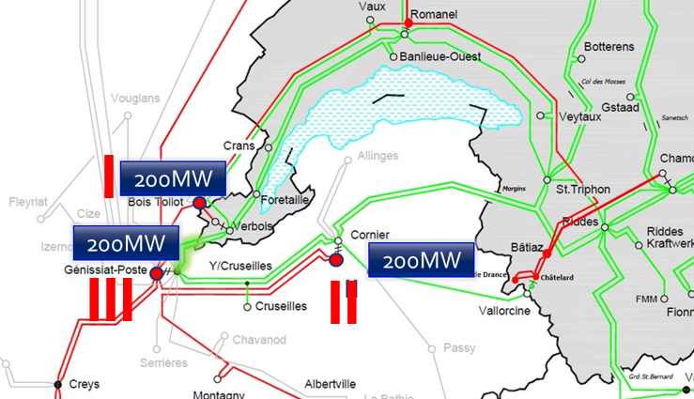
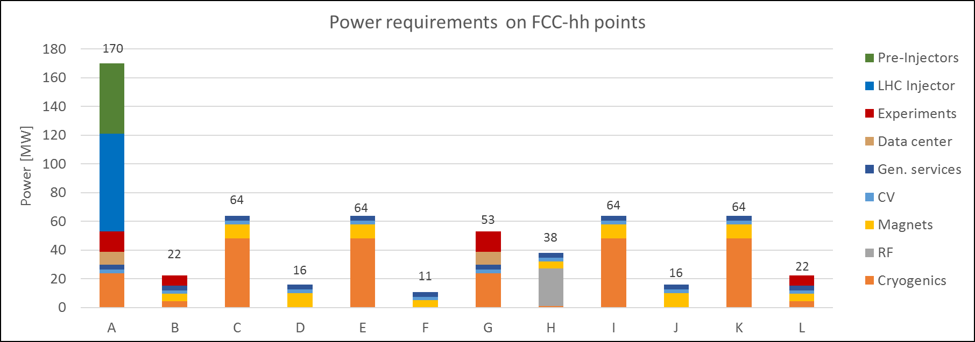
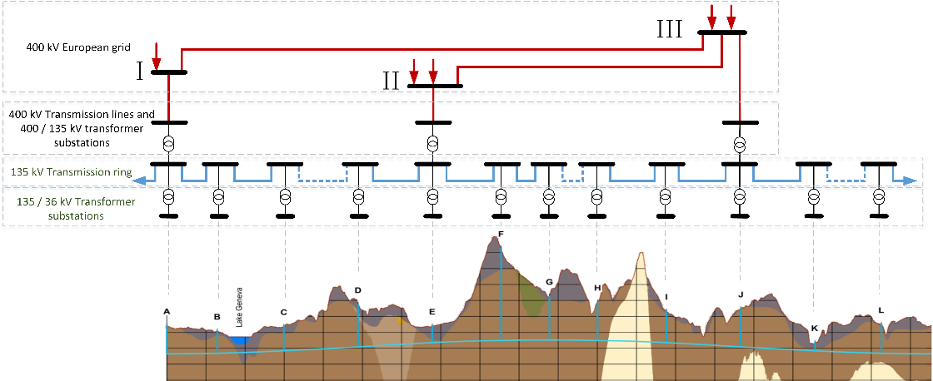
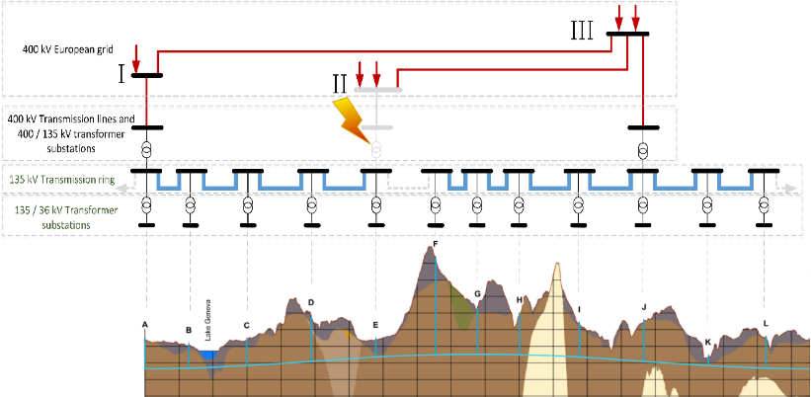
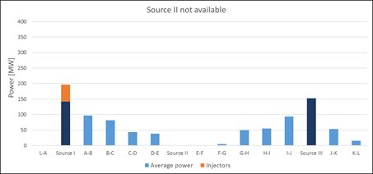
supply & distribution of electrical energy
additional 200 MW available for FCC
at each of the three 400 kV sources
per-point power requirements as input for infrastructure-optimized conceptual design (peak FCC-ee: 260-340 MW, total FCC-hh: 550 MW)
---- 400 kV ---- 230 kV
If one power source goes down fall back to “degraded mode“: FCC remains cold, vacuum preserved, controls on, RF off, no beam (“standby”); all FCC points supplied from 2 other 400 kV points, through the power transmission line
3 x 400 kV connections
+ 135 kV underground power distribution (NC)

Slide 16
FCC integral project technical schedule
1
2
3
4
5
6
7
8
9
10
11
12
13
14
15
16
17
18
15 years operation
34
35
36
37
38
39
40
41
42
43
~ 25 years operation
70
Project preparation &
administrative processes
Permis-sions
Update
Permissions
Funding strategy
Funding and
in-kind contribution agreements
Funding and
in-kind contribution agreements
Geological investigations, infrastructure detailed design and tendering preparation
Tunnel, site and technical infrastructure construction
FCC-ee dismantling, CE & infrastructure adaptations FCC-hh
engineering design, energy efficiency, maintainability
conductors & high-field magnet technology
FCC-ee accelerator R&D and technical design
FCC-ee accelerator construction, installation, commissioning
FCC-hh accelerator R&D and technical design
FCC-hh accelerator construction, installation, commissioning
Set up of international experiment collaborations, detector R&D and concept development
FCC-ee detector technical design
FCC-ee detector
construction, installation, commissioning
FCC-hh detector R&D,
technical design
FCC-hh detector
construction, installation, commissioning
Superconducting wire and magnet R&D, short models
Long model magnets, prototypes, preseries
16 T magnet industrialization and
series production

Slide 17
FCC-integrated project cost estimate
Total construction cost FCC-ee (Z, W, H) amounts to 10,500 MCHF & 1,100 MCHF (tt).
Total construction cost for subsequent FCC-hh amounts to 17,000 MCHF.
(FCC-hh stand alone cost would be 25 BCHF)
24/06/2020
Snowmass AF-EF Meet 2020
17

Slide 18

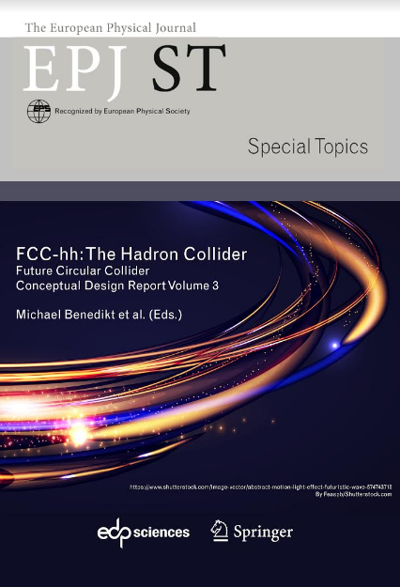
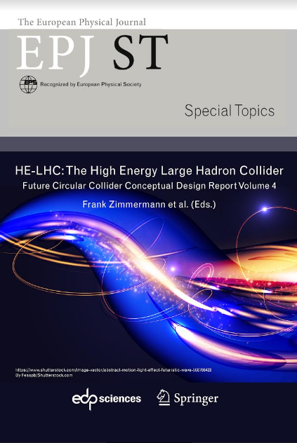
FCC CDR and Study Documentation
FCC-Conceptual Design Reports:
  Vol 1 Physics, Vol 2 FCC-ee, Vol 3 FCC-hh, Vol 4 HE-LHC
  CDRs published in European Physical Journal C (Vol 1) and ST (Vol 2 – 4)
  EPJ C 79, 6 (2019) 474 , EPJ ST 228, 2 (2019) 261-623 ,
  EPJ ST 228, 4 (2019) 755-1107 , EPJ ST 228, 5 (2019) 1109-1382
Summary documents provided to EPPSU SG
  FCC-integral, FCC-ee, FCC-hh, HE-LHC
  Accessible on http://fcc-cdr.web.cern.ch/
>1350 contributors from > 350 institutes,
a truly global effort as suggested by EPPSU 2013

Slide 19
2020 ESU and plans for 2020 – 2025/26

Slide 20
From ESPPU 2020 document
      Core sentence and main request “order of the further FCC study”:
      “Europe, together with its international partners, should investigate the technical and financial feasibility of a future hadron collider at CERN with a centre-of-mass energy of at least 100 TeV and with an electron-positron Higgs and electroweak factory as a possible first stage. Such a feasibility study of the colliders and related infrastructure should be established as a global endeavour and be completed on the timescale of the next Strategy update.”

Slide 21
Feasibility Study of FCC integrated project
Feasibility study to be delivered end 2025 as input for ESPP Update expected for 2026/2027:
Feasibility study of the 100 km tunnel (infrastructure aspects, administrative aspects, local authorities, environment, energy, etc.)
High-risk site investigations included, to confirm principle feasibility
Host-state related processes included to allow start of construction by 2030.
CDR+ for colliders and injectors, including key technologies.
HFM intermediate milestones reached, according to long-term R&D plan.
Physics and experiments CDR + for FCC integrated project.
Financing concept and operation model.
For all these activities the sequential nature of implementation of the colliders and the overall timeline needs to be taken into account!

Slide 22
CERN resources for period 2021-2025
Total material budget for FCC 75 MCHF, i.e. 15 MCHF/y
Roughly 50% dedicated to host state activities, environmental evaluation, implementation preparation out of which 10-15 MCHF for high-risk site investigations.
Remainder for machine studies, experiment concept studies, technology R&D and technical infrastructure and related collaborations.
Personnel: 30 CERN staff FTE, i.e 150 PY integral.
Other FCC related budget lines in MTP:
  HFM line (16T program) with 75 MCHF M&P
  Dedicated line for RF power source development (HE klystrons) and SRF developments

Slide 23
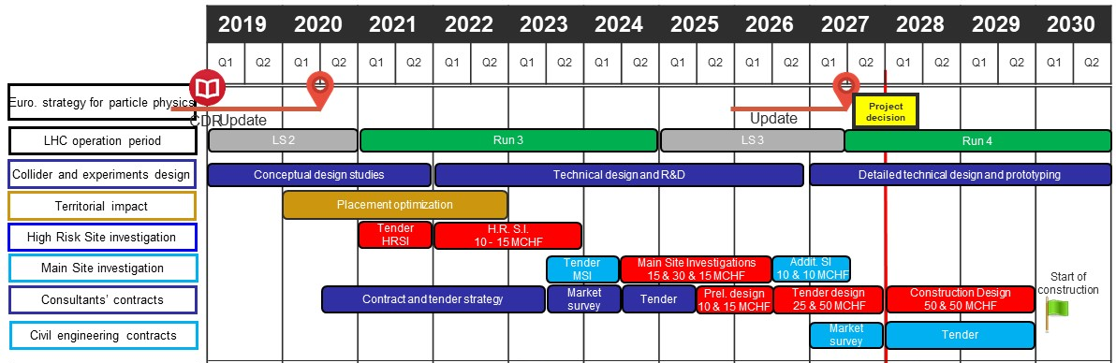
CE preparatory activities 2020 - 2030
Schedule of major processes leading to start of construction begin 2030.
For proof of principle feasibility: High risk site investigations 10 - 15 MCHF in 2022/23.
Additional CE investments required in MTP period to allow start of construction in 2030: MSI 45 MCHF, PD 10 MCHF: Total of 55MCHF.

Slide 24
H2020 FCCIS Design Study
The FCCIS H2020 Design Study project is on one side a co-funding instrument and on the other side a “social promotion” instrument to engage the EC and a community of international partners contractually, including key host state services and offices.
EC co-funding of 2.9 Meuro in the period 11/2020 – 10/2024.
  1.8 Meuro for host state related activities
  1.2 Meuro for FCC-ee optics and machine optimisation
FCCIS follows the EuroCirCol H2020 Design Study that focused on FCC-hh design and technology (2015 – 2019).
The H2020 MarieCurie Training Network EASITrain focuses on FCC cryogenic technologies, SRF and SC magnets and finances 15 Early Stage Researchers (2017 – 2021).

Slide 25
Beneficiaries
H2020 DS FCC Innovation Study 2020-24
Partners
D.R.R.T. (F)
Etat de Geneve (CH)
DOE (US)
BINP (Ru)
U Oxford (UK)
Beneficiaries
FCCIS Kick-off meeting 9-13 November 2020, in parallel to FCC Physics and Experiments WS
Design optimisation, construction planning, environmental impact assessment, management of
excavation materials, user community building and public engagement, socio-economic impact,…

Slide 26
Further FCC supporting initiatives
CHART Switzerland:
  Support FCC via accelerator design and technology developments
  CHART 1 2016-2018, CHART 2 2019 - 2023
  Funding from Swiss State Secretariat, ETHZ, EPFL, UNIGE and CERN, total volume ~40 MCHF.
FCC France:
  Aim is to intensify French participation through concrete studies on physics and detectors, as well as on accelerator design and technologies
  So far one “information day” https://indico.in2p3.fr/event/19693/ and one workshop https://indico.in2p3.fr/event/20792/ with participants from French research institutions and universities.
Discussions in several other countries launched. Goal is to enlarge and strengthen the FCC global collaboration

Slide 27
NSLS-II, EIC & FCC-ee beam parameters
Potential EIC – FCC collaboration
 | NSLS-II | EIC | FCC-ee-Z
Beam energy [GeV] | 3 | 10 (20) | 45.6
Bunch population [10¹¹] | 0.08 | 1.7 | 1.7
Bunch spacing [ns] | 2 | 10 | 15, 17.5 or 20
Rms bunch length [mm] | 4.5 - 9 | 2 | 3.5 (SR)
Beam current [A] | 0.5 | 2.5 (0.27) | 1.39
RF frequency [MHz] | 500 | 591 | 400
Similarity of several parameters strongly suggests collaboration to exploit synergies in areas such as beam instrumentation, SRF, vacuum system with SR handling, etc.

Slide 28

Status of Global FCC Collaboration
Increasing international collaboration as a prerequisite for success:
links with science, research & development and high-tech industry will be essential to further advance and prepare the implementation of FCC
139
Institutes
30
Companies
34
Countries
EC
H2020

Slide 29
UK participants in FCC Collaboration
Birmingham U., UK
Cockcroft Institute, Daresbury, UK
John Adams Institute, Oxford, UK
King’s College London, UK
Lancaster U., UK
Liverpool U., UK
Oxford U., UK
Royal Holloway, UK
SFTC, Daresbury, UK
UNIMAN, Manchester, UK

Slide 30
Status and Outlook
1st phase of FCC design study completed → baseline machine designs, performance matching physics requirements, in 4 CDRs
Integrated FCC programme was submitted to the European Strategy Update 2019/20 → Request for feasibility study as basis for project decision by 2026/27.
Next steps: concrete local/regional implementation scenario in collaboration with host state authorities, accompanied by machine optimization, physics studies and technology R&D, performed via global collaboration and supported by EC H2020 Design Study FCCIS.
Long term goal: a world-leading HEP infrastructure for the 21st century to push the particle-physics precision and energy frontiers far beyond the present limits.

Slide 31
Summary
FCC-ee = most efficient Higgs & electro-weak factory at c.m. energies from 90 to 365 GeV
all FCC-ee key concepts, ingredients, and parameters already demonstrated or exceeded at various past & present machines (crab waist collisions, β_{y}*~1 mm, ~1.5 A beam current, e⁺ source with required rate, target emittances, top up, SR power / unit length, MeV photon energies,…)
main technologies for FCC-ee exist today; strong R&D program with industry for optimizing energy efficiency (efficient SRF, highly efficient RF power sources, energy-efficient magnets,…) maintainability, machine availability (modular design, early involvement of industry,…) and construction cost
FCC-hh = highest energy collider conceivable in 21st century, solid design based on LHC lessons
required technology – high-field 16 T magnets – not yet available; rigorous conductor & magnet R&D program to have magnets available towards the end of FCC-ee operation ~2050/55
FCC-ee/FCC-hh integrated programme: efficient coherent long-term strategy: sharing of tunnel, technical infrastructure (electricity, C&V, …), perhaps detector modules + complementary physics + exploiting existing CERN infrastructure and LEP/LHC experience

Slide 32

EU H2020 Design Study EuroCirCol
European Union Horizon 2020 program
3 MEURO co-funding
Completed in December 2019
15 European beneficiaries & KEK & associated FNAL, BNL, LBL, NHFML
Scope:
FCC-hh collider key work packages
Optics Design Arc and IR
Cryogenic beam vacuum system design including beam tests at ANKA
16 T dipole design, construction folder demonstrator
Notes:
New slide from Davide.
Showing that conductor development is launched at international level, Russia, Japan, (Korea and Europe in preparation)
Underline importance of that development as main cost driver for the hadron collider machine.

Slide 33
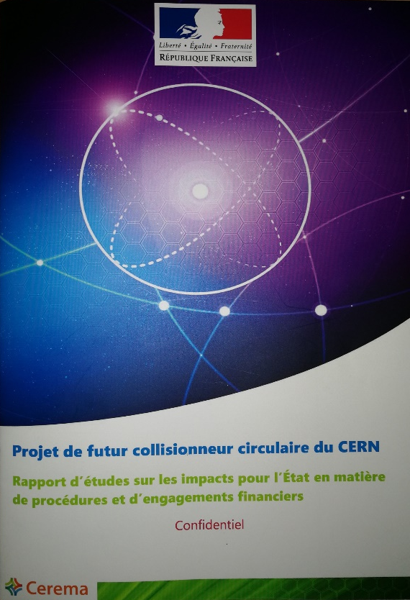



preparatory work with Host States
General secretariat of the region Auvergne-Rhône-Alpes and notified body “Centre d'études et d'expertise sur les risques, l'environnement, la mobilité et l'aménagement” CEREMA
Working group with representatives of federation, canton and state of Geneva and representation of Switzerland at the international organisations and consultancy companies
Administrative processes for project preparatory phase developed.
First review of tunnel placement performed.
Requirements for urbanistic, environmental, economic impact, land acquisition and construction permit related processes defined.
Ongoing: common optimization of collider tunnel and surface site infrastructure implementation.

Slide 34
Conclusions
1st phase of FCC design study completed → baseline machine designs, performance matching physics requirements, in 4 conceptual design reports
Integrated FCC programme submitted to the European Strategy Update
Next steps: concrete local/regional implementation scenario in collaboration with host state authorities, accompanied by machine optimization, physics studies and technology R&D
Increasing international collaboration and links with science, research & development and high-tech industry will be essential to further advance and prepare the implementation of FCC
Long term goal: a world-leading HEP infrastructure for the 21st century to push the particle-physics precision and energy frontiers far into unknown territory

