Slide 1
Enhancing the diagnostic performance of Raman spectroscopy-based bowel cancer blood test using advanced machine learning algorithms
Presented by: Natalia Sikora
Project supervisors: Prof. Peter Dunstan and Prof. Dean Harris

Slide 2
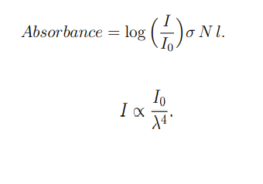
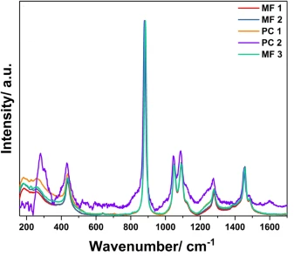
Biofluids analysis in cancer research - combining Raman spectrophotometry and multiple machine learning techniques
Image adapted from: (Averill and Eldredge, 2006)
Image adapted from: (Berghian-Grosan and Magdas, 2020)

Slide 3
Why is this important?
A multidisciplinary approach allowing for a quicker diagnosis of the 4th most common cancer in the UK
Current diagnostic procedures are invasive and the disease is difficult to diagnose
Utilizing ML techniques for the analysis of biofluids may allow for fast detection and a better survival rate
How can we improve the model?
Several ideas: subjecting the data from particle detectors to a range of optimized ML classifiers, metanalysis,
building the patient’s medical record into the model etc.
- Filter out the spectral abnormalities with a program created for human serum analysis
- Creating an algorithm where classifiers consider both, medical data and pre-processing budget in a medical research

Slide 4
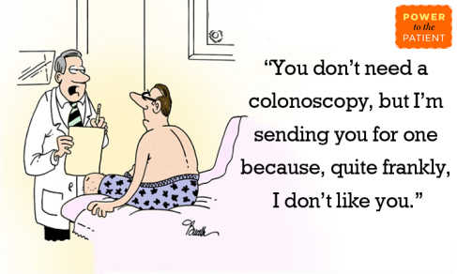
Thank you for your attention

