Slide 1
Targetry for High Power
Muon Facilities
Reminder : design parameters & constraints
R&D Needs
Synergies
I. Efthymiopoulos - CERN

Slide 2
High power muon facilities
Muon Facilities considered since long as attractive alternatives to study particle physics in
  the neutrino sector : Neutrino Factory
    high-energy, narrow-band ν_{e} , ν_{μ} neutrinos from stored muon decays
      decay kinematics well, known – study ν_{e}→ν_{μ} oscillations, superior reach in CPV, MH, …
  the energy frontier : Muon Collider
    μ+μ- collisions at high-energy to explore new physics, but also tuned to Higgs production
    as point-like particles full beam energy available for particle production, absence of synchrotron radiation thus small footprint, narrow energy spread at IP, but also come with challenges like electron and neutrino irradiation at IP
Intensive R&D effort for many years at a national and international level : IDS-NF, MuonColl, EU projects, Japan NF group…
Study of Muon Facilities included as path for R&D in the recent European Strategy Update…

Slide 3
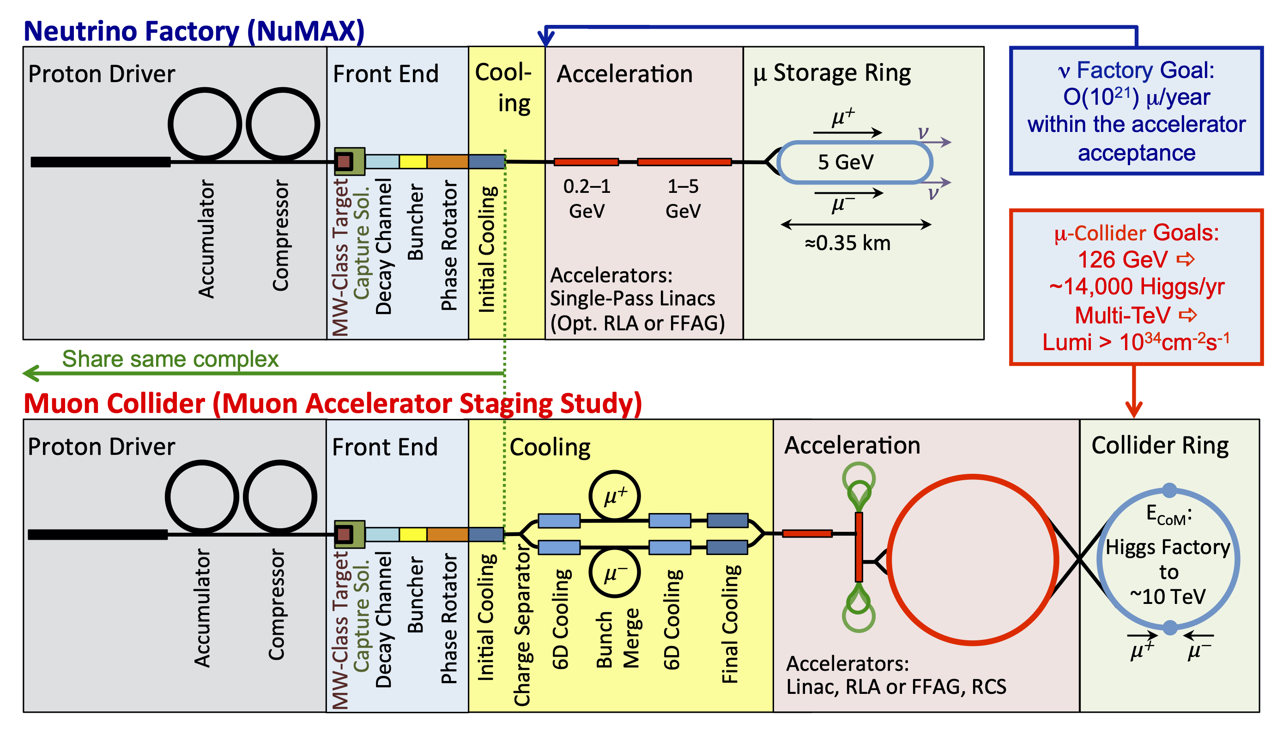
High power muon facilities
MAP : Muon Collider – Neutrino Factory
MAP web : https://map.fnal.gov
R&D in synergy for the two facilities
Share ~identical Proton driver & Front-End

Slide 4
Muon beam challenges
Creating intense muon beams represents several major challenges on:
production: muons are produced as tertiary particles through p → π → μ _{(baseline)}
  implies using high intensity proton source ➟ MW proton pulsed LINAC
  target head that can sustain the impact of multi-MW beam ➟ High-Power Targetry
  high-capture efficiency, handling of energy spread and transverse phase space ➟ Emittance Cooling, large acceptance accelerator system
  Alternative proposal : muons from positron beam – LEMMA scheme, with its advantages and challenges
acceleration and beam handling due to short muon lifetime (2.2μs at rest)
  rapid beam manipulations, high-gradient RF, fast acceleration, collision ring

Slide 5
The MUON COLLIDER
The Ultimate option for a high-energy collider
MAP web : https://map.fnal.gov
 | Units | Higgs | M-TeV
CoM Energy | TeV | 0.126 | 1.5 | 3.0
Colliding beam μ/bunch | μ/s | 6.0 10¹³ | 3.0 10¹³ | 2.4 10¹³
 |  | ~4.0 10¹³
Production: μ/bunch |  | ~4.0 10¹⁴
Protons on Target (POT) | p/s | ~4.0 10¹⁵ → ~8 10¹³ ppp @ 50 Hz, 8 GeV 4 MW proton beam

Slide 6
The Muon collider Target
Target system requirements
The target material must withstand the impact of the intense proton focused beam
  high energy density deposition - ~80 kJ/pulse
  ~20% of the proton beam power would be deposited in the target material: 0.8 MW for a 4 MW beam!
  Issues to consider:
    Thermal management : melting, vaporization, shock wave
    Radiation management : DPA, change of material properties
Need to capture both signs of pions(muons) to a sizeable volume as input to the front-end channel - solenoid
Use of a high-Z material to promote the creation of secondaries
Optimized target geometry to allow separating the captured beam from the remnant proton beam, and..
  don’t forget the beam dump! A sizeable fraction of the proton beam will arrive to the dump (depends on the exact parameters of the target) plus, the dump must be able to withstand the full beam in case of an accident
Robust design for all systems to assure long (>10-year?) lifetime, foresee remote handling with associated labs for exchanges or repairs

Slide 7
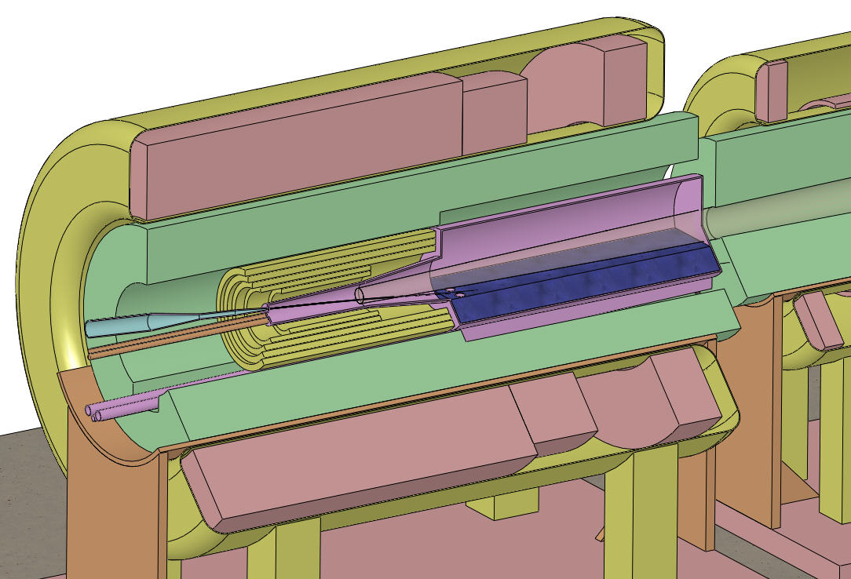
The Muon collider Target Station
Rigorous R&D program for the last ~20+ years
SC solenoids
Be window
extensive study on materials (solid, liquid, granular,…),
capture options (solenoid, toroids,…),
topology
Final baseline :
Hg-jet target
  fast-moving 20m/s, regenerates after each pulse
Solenoid capture (sc + nc magnets)
  high-field around the target 20T
  tapering system to 2T
Tilt angle of the proton beam to solenoid axis
  proton beam direction towards the dump (Hg-pool), out of the capture beam path
W shields
NC solenoids
Hg-jet
Beam dump
(Hg-pool)
Proton beam

Slide 8

The MERIT Experiment @ CERN-PS
Proof-of-principle experiment of a high-power target for NF/MC based on a free Hg-jet
Key results #1 :
Hg-jet disruption mitigated by magnetic field
20 m/s jet operation allows up to 70Hz operation with beam
Hg-jet - beam impact
4×10¹² protons, 10T field
Key results #2 :
Disruption threshold: >4×10¹² protons @14 GeV, 10T field
  115kJ pulse containment demonstrated
  8 MW capability demonstrated
The MERIT experiment validated the baseline option, and remains so far, the only option for a multi-MW target system. However, it comes with a great safety challenge from the use of Hg.
Alternatives?

Slide 9
Multi-MW Target - Alternatives
Fluidized granular target C. Densham et. al – RAL High-power Target Group
Single pulse tests - HiRadMat@CERN facility
Active R&D continues, studies for LBNF, T2K, …

Slide 10
Multi-MW Target - Alternatives
4 MW = 4×1MW – EUROν, and recently ESSnuSB neutrino super beam
Not a “real” multi-MW option
Shares the constraints between:
  the target,
  the switchyard and,
  the dump
Works well for a long-baseline ν-beam, not easy to extend the concept to an accelerator muon beam
  could imagine the four beam segments are not // but tilted pointing to a common center
    provides the needed tilt angle with the target,
    possibly use a single beam dump at the center
  numerous challenges: the four solenoids of high-field, fast pulsing magnets (~25 Hz) and the front-end to merge the four beam segments

Slide 11




HPT Facilities – staged approach?
Multi-MW HPT installations extremely challenging to design and operate
present operational installations approach the range of ~0.7-1.0 MW _{(T2K, NuMI)}, with design capabilities to reach ~1.5 MW. New facilities under design for LBL neutrino beam to reach ~2.5 MW _{(LBNF)}
going beyond requires a) finding technical solutions and b) building operational experience in a high-radioactive environment
MAP considered a staged approach towards the final NF/MC installation
profit from synergies, start from available technology, provide R&D test bed for the next stages
4 MW
2.75 MW
1 MW
0.2 MW
nuSTORM
NuMAX
NuMAX_+
MC @ Higgs, multi-TeV

Slide 12
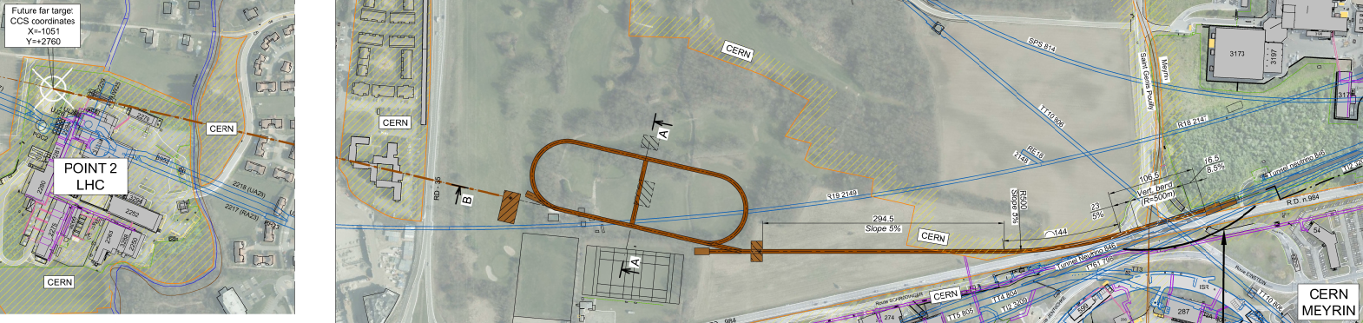
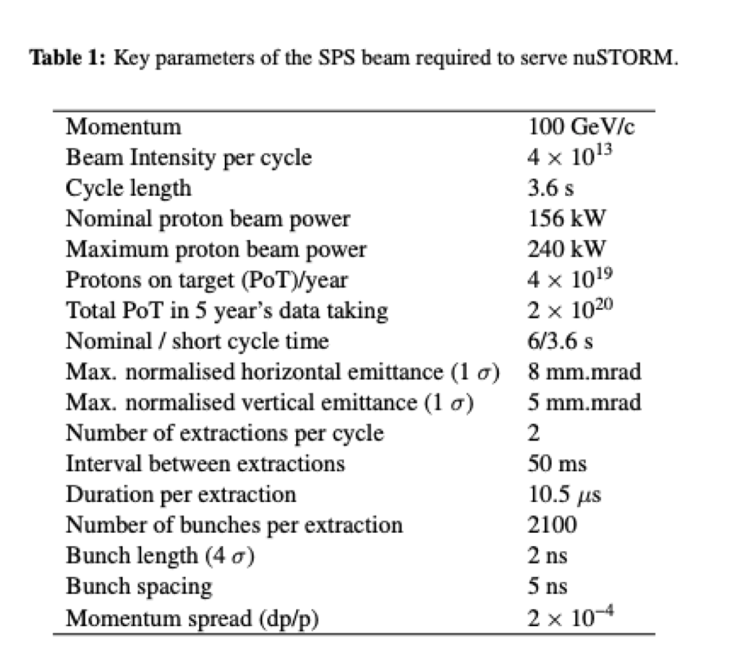
nuSTORM @ CERN-SPS
nuSTORM : proposed and currently under study @ CERN
The beam : collect single-charge pions(π) from the target _{(horn capture)} → select momentum bite with conventional magnets → inject to the ring → pions decay in first straight section to muons → accumulate to produce intense muon/neutrino beam
Layout study using a fast extracted proton beam from SPS
In parallel to its own physics program, the facility, can offer a unique opportunity for R&D towards high-power targetry and front-end (..and with muons – Chris’s talk), but also to develop synergies other neutrino or muon programs

Slide 13
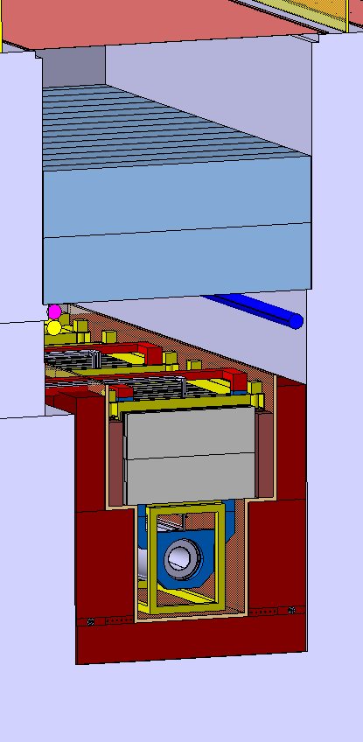
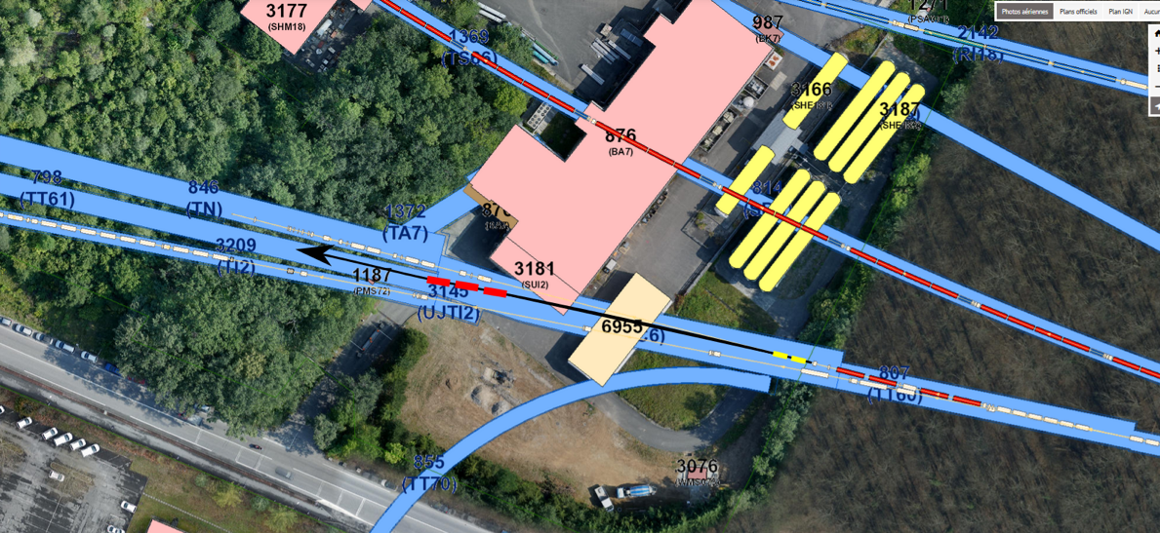
nuSTORM @ CERN-SPS
Beam extraction and transfer
fast extraction @ 100 GeV – like CNGS _{2×10.5 μs pulses, ~20 Tppp}
Target station
Baseline : FNAL scheme, graphite target like CNGS
Horn and quads to select the pion beam
nuSTORM@CERN – W. Bartmann, CERN
nuSTORM@CERN – M.Calviani, CERN

Slide 14
nuSTORM @ CERN – HPT R&D Synergies
Target material R&D
The operational target of nuSTORM would be a low-power target ~200kW. However, for R&D tests, the full beam of SPS could be used like in HiRadMat. Combined with a low emittance can emulate the parameters in a NF/MC multi-MW operation.
Themes:
evaluate alternative material to Hg – synergy with RADIATE collaboration – single pulse ⟺ long-term irradiations
examples:
  further investigate and optimize the design of granular or fluidized targets for mMW operation
  perform tests to compare and validate simulation codes, related to the dynamics of the target materials in pulsed beams; evaluate threshold effects on damage to determine lifetime of components

Slide 15
nuSTORM @ CERN – HPT R&D Synergies
Target head R&D - implementation
Option B: create a new test stand upstream or downstream of the operational target
pros :
separated from the operational target, can switch back/forth relatively fast
cons:
need to control the beam shape to the sample maybe install additional magnets?
need remote handling in that area – should exist anyhow
must install additional instrumentation to monitor the beam to the samples
Option A: Use the operational target location for the tests
pros:
  easy to implement, has all the instrumentation before to monitor the beam (position and shape)
cons:
must remove operational target_{and horn} (remote anyhow) – long stop of operations
needs temp. storage for horn/target

Slide 16
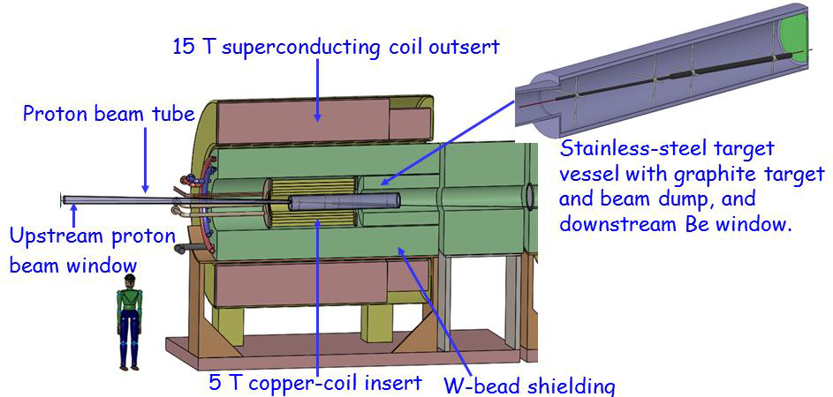
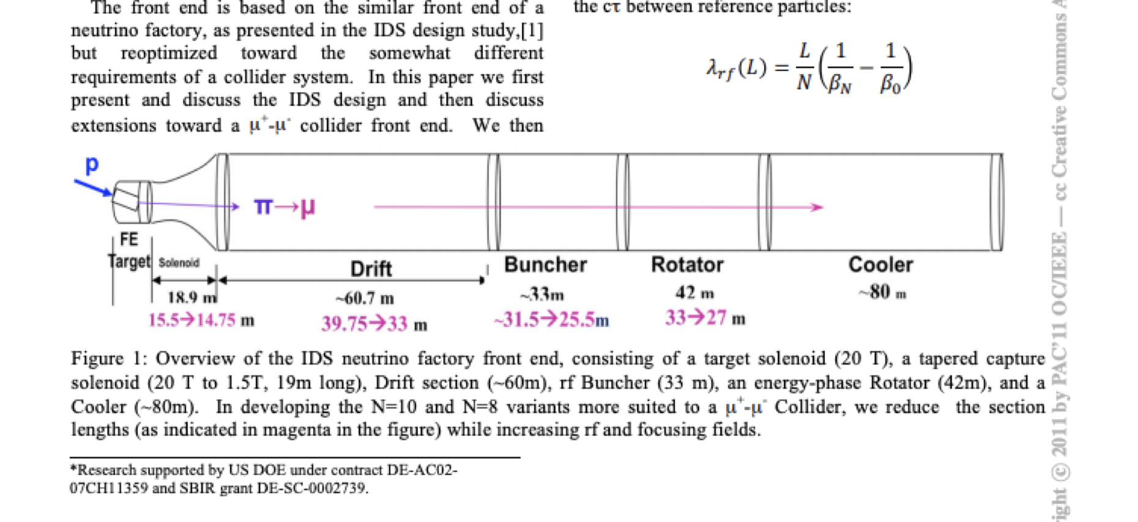
nuSTORM @ CERN – HPT R&D Synergies
NF/MC Front-end R&D
profiting from the higher beam energy of SPS _{(100-400 GeV)} and by properly adjusting the beam intensity, the production of secondaries from the target can be made to match that of a NF/MC at a single pulse level
this opens the possibility to
  test the full target-capture system with solenoids
  gradually build up the full front-end of a NF/MC installation pion-muon separation, background, buncher (RF?)
    then inject directly muons into the ring that would open a variety of studies with μ-beams
nuMAX
~1MW target option
(graphite)
P. Sala – 2nd NBI, FNAL 2000

Slide 17
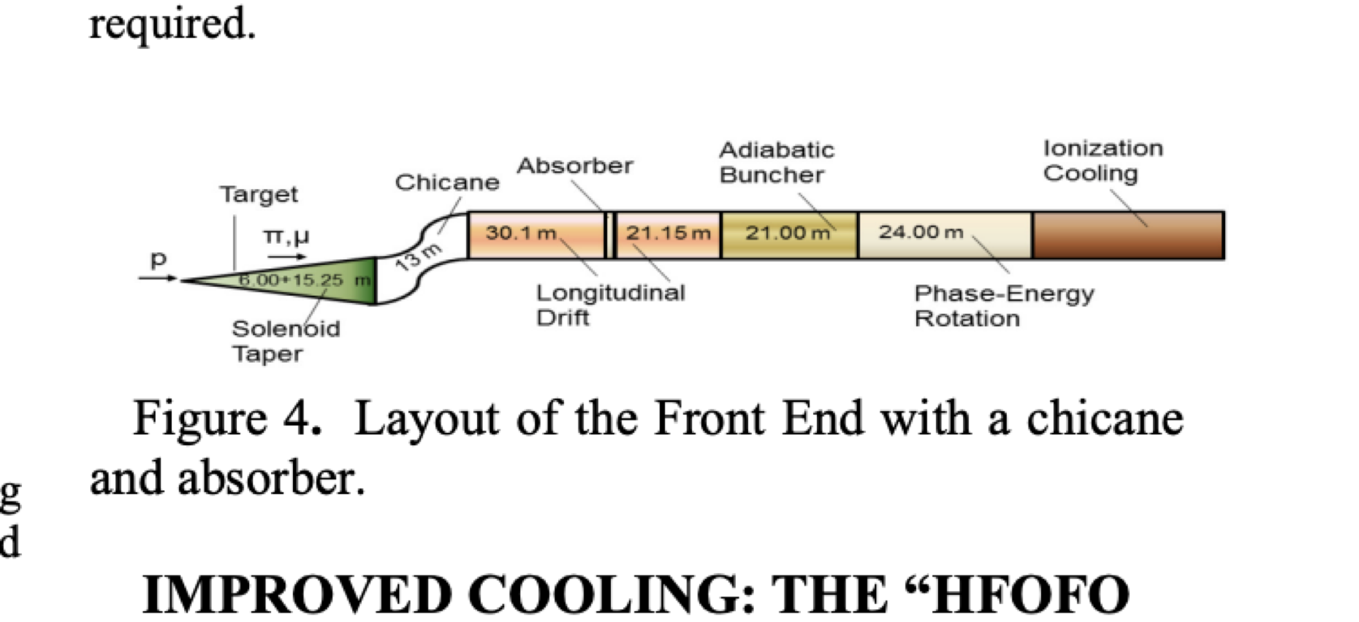
nuSTORM @ CERN – HPT R&D Synergies
Frond-end R&D - implementation
Option B: create a new target downstream and enlarge the tunnel to the dump such to accommodate the Front-End equipment. Add new tunnel to allow injecting into the storage ring
pros:
separated from the operational target, can switch back/forth relatively fast
maintain original option of nuSTORM with pion capture/injection
cons:
need remote handling in that area – should exist anywhow
Option A: Replace the operational target and horn with a NF-type C-target and solenoid. Install the FE equipment gradually until the injection into the ring.
pros:
  straight forward to implement
cons:
requires removing target head and horn
not compatible with normal nuSTORM operation

Slide 18
nuSTORM @ CERN –Synergies
ENUBET /NP06 – Enhanced NeUtrino BEams from Kaon Tagging
The beam layout looks like nuSTORM – room for synergies !
      …but the devil is in the details !
Issues to consider:
Beam capture from the target: horns, dipoles, etc..
Layout : use same detector locations?
Note : narrow band beams were made in the past at CERN and FermiLab in two configurations:
horn focusing with “plug” or dipole for momentum selection
dichromatic NBB without horn and only magnetic elements
  See: Sascha E. Knopp, Phys.Rept.439:101-159, 2007
A.Longhin – Neutrino 2020

Slide 19
nuSTORM @ CERN –Synergies
ENUBET /NP06 – Beam Extraction
The slow-extraction option, if preferred and possible at the foreseen installation of nuSTORM, could be accommodated by a fast + slow extraction from SPS as was done for years for WANF
The burst mode could be accommodated in the decay ring design
  didn’t have the time to look at it…

Slide 20
nuSTORM @ CERN – HPT R&D Synergies
ENUBET & nuSTORM - implementation
Option A: Use a solenoid to capture both signs of secondaries, followed by focusing elements and dipole to distribute the charged beam to nuSTORM & ENUBET
pros:
  Easy solution can allow // operation of the two projects
  The layout can be adjusted to allow pointing the neutrinos to the same detector
  The solenoid option can work at any pulse duration
cons:
requires development of a solenoid solution!
Option B: split the incoming beam to two targets and two horn systems like ESSnuSB
pros:
separated target/capture system for each project, possibly tuned to its needs
cons:
beam sharing, reduced flux to each project
requires development of fast cycling magnets, 0.25Hz

Slide 21
Summary
High-power Targetry in application to Muon Beams is a very challenging but at the same time a very exciting R&D subject
Thanks to the long-running R&D studies for ~30 years already, a conceptual baseline option for a multi-MW NF/MC application emerged.
  Unfortunately, this solution comes with important safety and operational concerns, therefore, the need to continue, investigate alternatives, perform detailed studies and gain experience
The nuSTORM proposal, valid on its own by an appealing physics program, can serve as test bed for HPT and Front End R&D studies for muon beams, and to build synergies with other projects in the field.
An opportunity to carefully value and not miss!

Slide 22
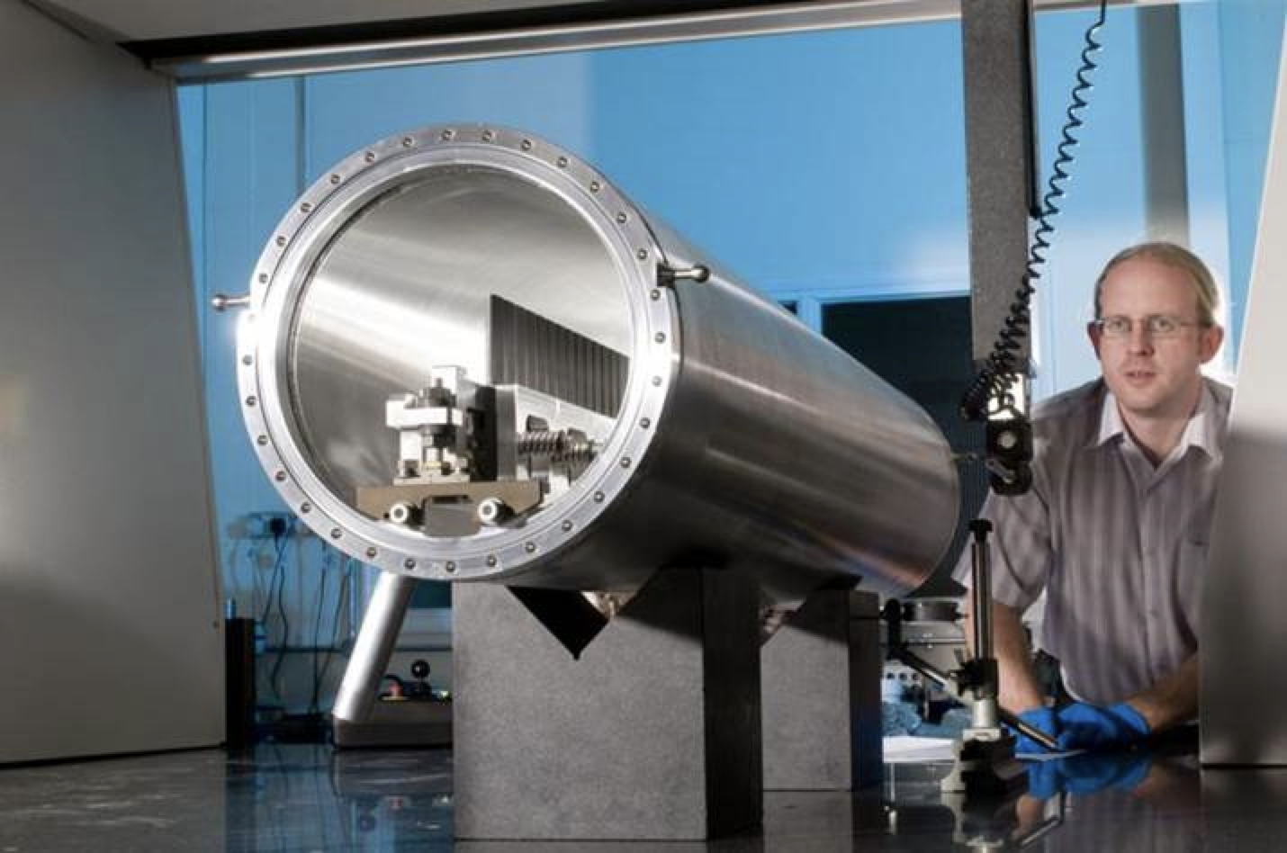
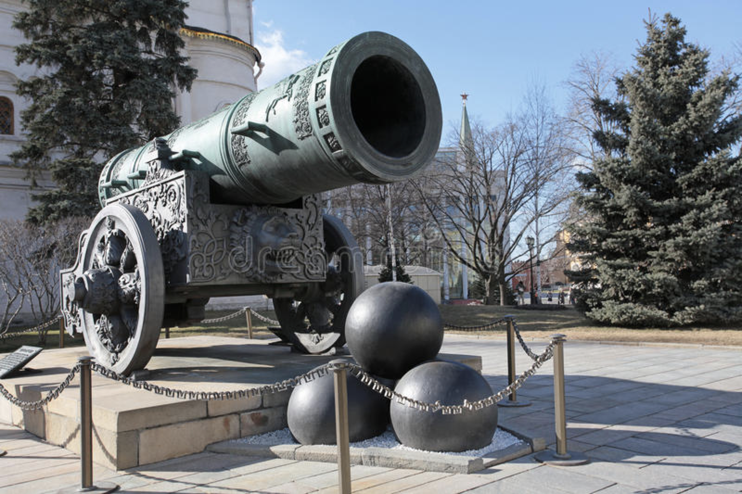
High power targetry
NoVa ν target – High Power Targets Group STFC
Big Canon in Moscow Kremlin
maybe indeed the future in high-power is in granular pebble bed targets!

